Slide 1
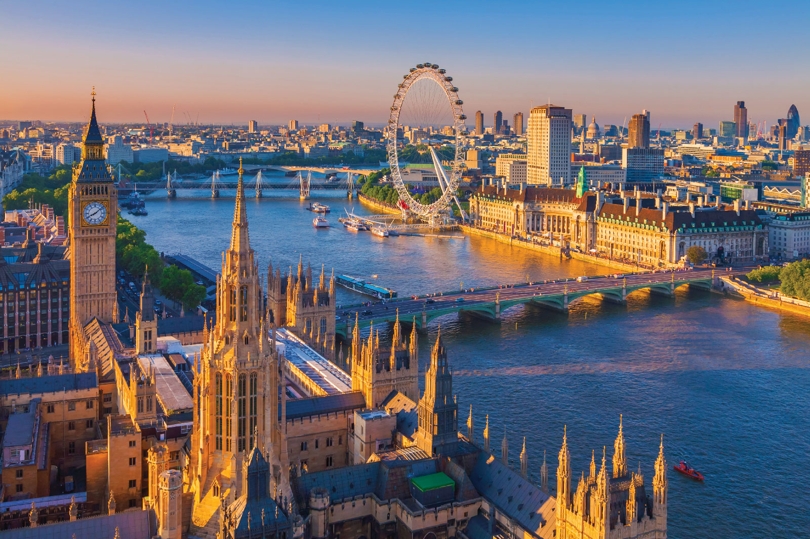
Я ЛЮБЛЮ ЛОНДОН
I LIKE LONDON

Slide 2
ПРЕДМЕТ ИССЛЕДОВАНИЯ:
* ДОСТОПРИМЕЧАТЕЛЬНОСТИ ЛОНДОНА.
ЦЕЛЬ:
ИЗУЧИТЬ И ПРОАНАЛИЗИРОВАТЬ
ТЕКСТОВУЮ, ВИДЕОИНФОРМАЦИЮ О
ДОСТОПРИМЕЧАТЕЛЬНОСТЯХ ЛОНДОНА;
СОЗДАТЬ НА ОСНОВЕ ПОЛУЧЕННОЙ
ИНФОРМАЦИИ КАРТУ ЛОНДОНА.

Slide 3
ЗАДАЧИ:
НАУЧИТЬСЯ РАБОТАТЬ В ГРУППЕ;
НАУЧИТЬСЯ ОБОБЩАТЬ ИЗУЧЕННЫЙ МАТЕРИАЛ ПО ТЕМЕ;
НАУЧИТЬСЯ РАБОТАТЬ С ДОПОЛНИТЕЛЬНОЙ ЛИТЕРАТУРОЙ;
РАЗВИВАТЬ САМОСТОЯТЕЛЬНОСТЬ, ТВОРЧЕСТВО, АКТИВНОСТЬ.

Slide 4
МЕТОДЫ:
ПОИСКОВЫЙ- ИНФОРМАЦИЯ В СЕТИ ИНТЕРНЕТ, ДОПОЛНИТЕЛЬНАЯ ЛИТЕРАТУРА, ВИДЕОМАТЕРИАЛЫ.
АНАЛИЗ-ОТБОР ТОЛЬКО САМОЙ ВАЖНОЙ И ИНТЕРЕСНОЙ ОНФОРМАЦИИ ПО ТЕМЕ.
СИНТЕЗ- ОБОБЩЕНИЕ ПОЛУЧЕННОЙ ИНФОРМАЦИИ И СТРУКТИРОВАНИЕ ПО РУБРИКАМ.

Slide 5
У КАЖДОГО ЧЕЛОВЕКА ЕСТЬ МЕЧТА. НАША МЕЧТА – ПОЕХАТЬ В ЛОНДОН! ЧТО ДЛЯ ЭТОГО НУЖНО? КТО-ТО СКАЖЕТ: «МНОГО ДЕНЕГ», КТО-ТО - «ЗНАНИЕ АНГЛИЙСКОГО ЯЗЫКА». НО ГЛАВНОЕ ВСЕ ЖЕ – ЖЕЛАНИЕ ПОСЕТИТЬ ОДНУ ИЗ ДРЕВНЕЙШИХ СТОЛИЦ МИРА, ПРОЙТИСЬ ПО ЦЕНТРАЛЬНОЙ ТРАФАЛЬГАРСКОЙ ПЛОЩАДИ, ПОСИДЕТЬ В ОДНОМ ИЗ ТИХИХ ПАРКОВ, ПОЗНАКОМИТЬСЯ С БОГАТЕЙШЕЙ ИСТОРИЕЙ ВЕЛИКОБРИТАНИИ И ЕЕ КУЛЬТУРНЫМИ ПАМЯТНИКАМИ. НЕСКОЛЬКО МИЛЛИОНОВ ТУРИСТОВ ЕЖЕГОДНО ПРИЕЗЖАЮТ В ЭТУ СТРАНУ. МЫ ТОЖЕ РЕШИЛИ СОВЕРШИТЬ «ЗАОЧНОЕ» ПУТЕШЕСТВИЕ ПО ДОСТОПРИМЕЧАТЕЛЬНОСТЯМ ЛОНДОНА И СОЗДАТЬ КАРТУ ЛОНДОНА. ОТПРАВЛЯЙТЕСЬ В УВЛЕКАТЕЛЬНОЕ ПУТЕШЕСТВИЕ ВМЕСТЕ С НАМИ!

Slide 6
Big Ben is the name of the Great bell of the clock at the Palace of Westminster. Nowadays this name mostly refers to the clock and the clock tower. In 2012 the tower was renamed to celebrate the Diamond Jubilee of the Queen and is now officially known as the Elizabeth Tower. The height of the tower is 96,3 meters. Big Ben is one of the most prominent symbols of the United Kingdom.

Slide 7
The Tower of London is one of the main London's places of interest. It is located on the north bank of the River Thames and is one of the oldest buildings. At different times the Tower was used as a royal residence, fortress, prison, mint and, even, zoo. Today the Tower of London is the place where the Crown Jewels are kept. Every day its doors are open for tourists. A few black ravens live on its territory. The walls of the Tower are still guarded by palace guard in historical outfits.

Slide 8
Tower Bridge has stood over the River Thames in London since 1894 and is one of the finest, most recognisable bridges in the world. It is the London bridge you tend to see in movies and on advertising literature for London. Tower Bridge is the only Thames bridge which can be raised. Its middle section can be raised to permit large vessels to pass the Tower Bridge. Massive engines raise the bridge sections, which weigh about 1000 tons each, in just over a minute. It used to be raised about 50 times a day, but nowadays it is only raised 4 to 5 times a week.Tower Bridge is 60 meters long with towers that rise to a height of 43 meters.

Slide 9
Buckingham Palace is the official residence of Queen Elizabeth. It is located near Green Park. When the Queen is in the residence, the Royal Standard flies over Buckingham Palace. There are 775 rooms where members of the Royal family and their servants live. There are also rooms for guests. There are offices, on-site post and even swimming pool in the palace. Throughout the year right in front of Buckingham Palace the ceremony of the Changing of the Guard takes place, attracting a lot of tourists.

Slide 10
The London Eye is one the largest Ferris wheels in Europe. Unforgettable views of the city open from its height of 135 metres. The wheel consists of 32 air-conditioned capsules which symbolize 32 boroughs of London. The London Eye rotates with the speed of 0,9 km/hour. The ride takes 30 minutes. The wheel looks like a big bicycle wheel.

Slide 11
THANK YOU
THE END

