Slide 1
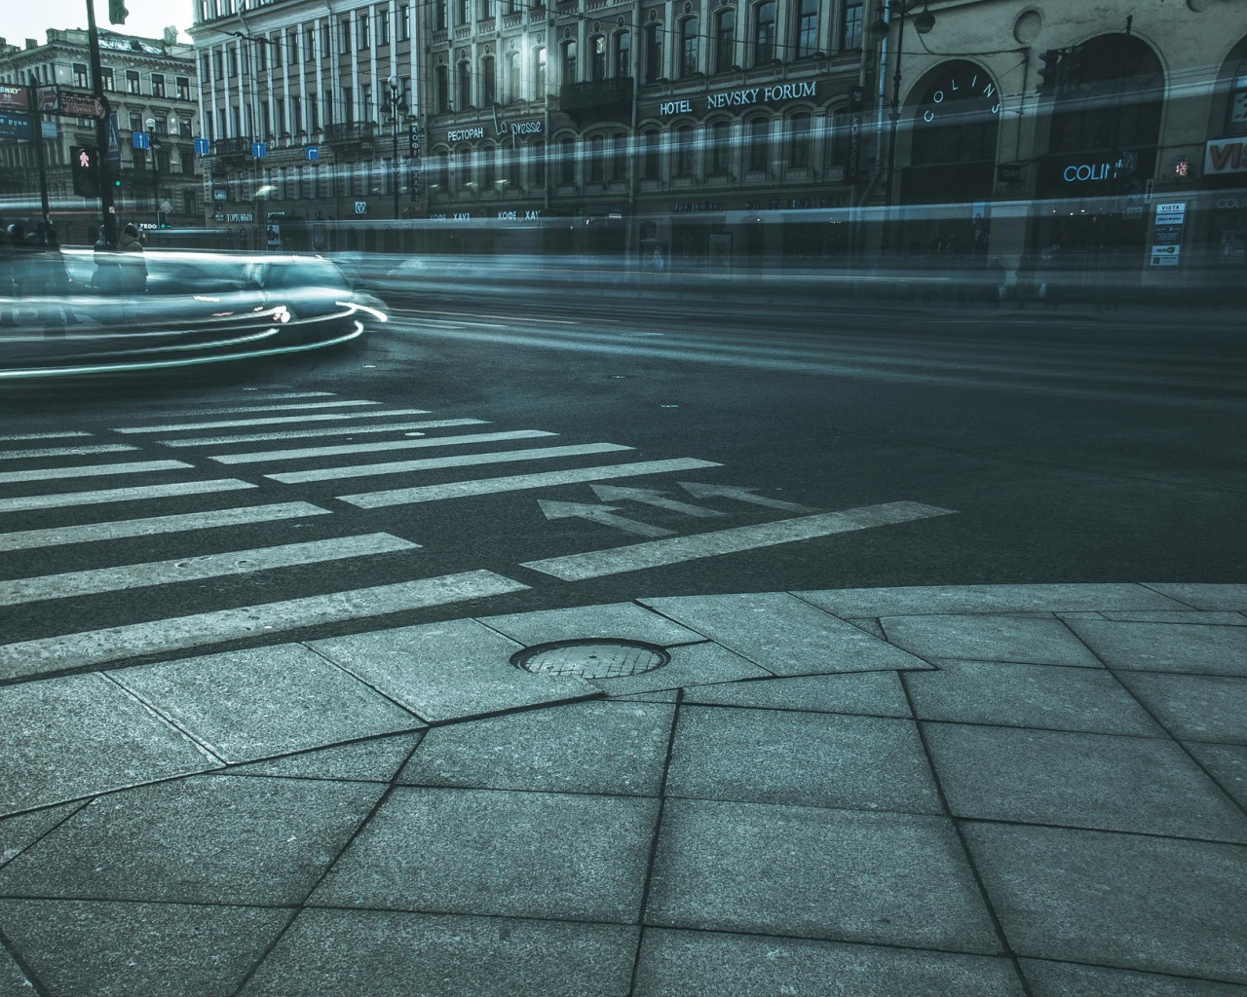
Types of public transport in Saint-Petersburg

Slide 2
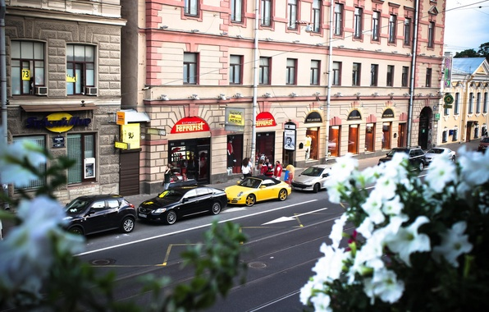
Public transport in Saint-Petersburg
The movement in St. Petersburg is very difficult to carry out on foot. If you are going somewhere in the city centre on their own two, it might take a whole day. Therefore in St. Petersburg many different types of public transport. Among them: metro, bus, tram, trolleybus and others

Slide 3
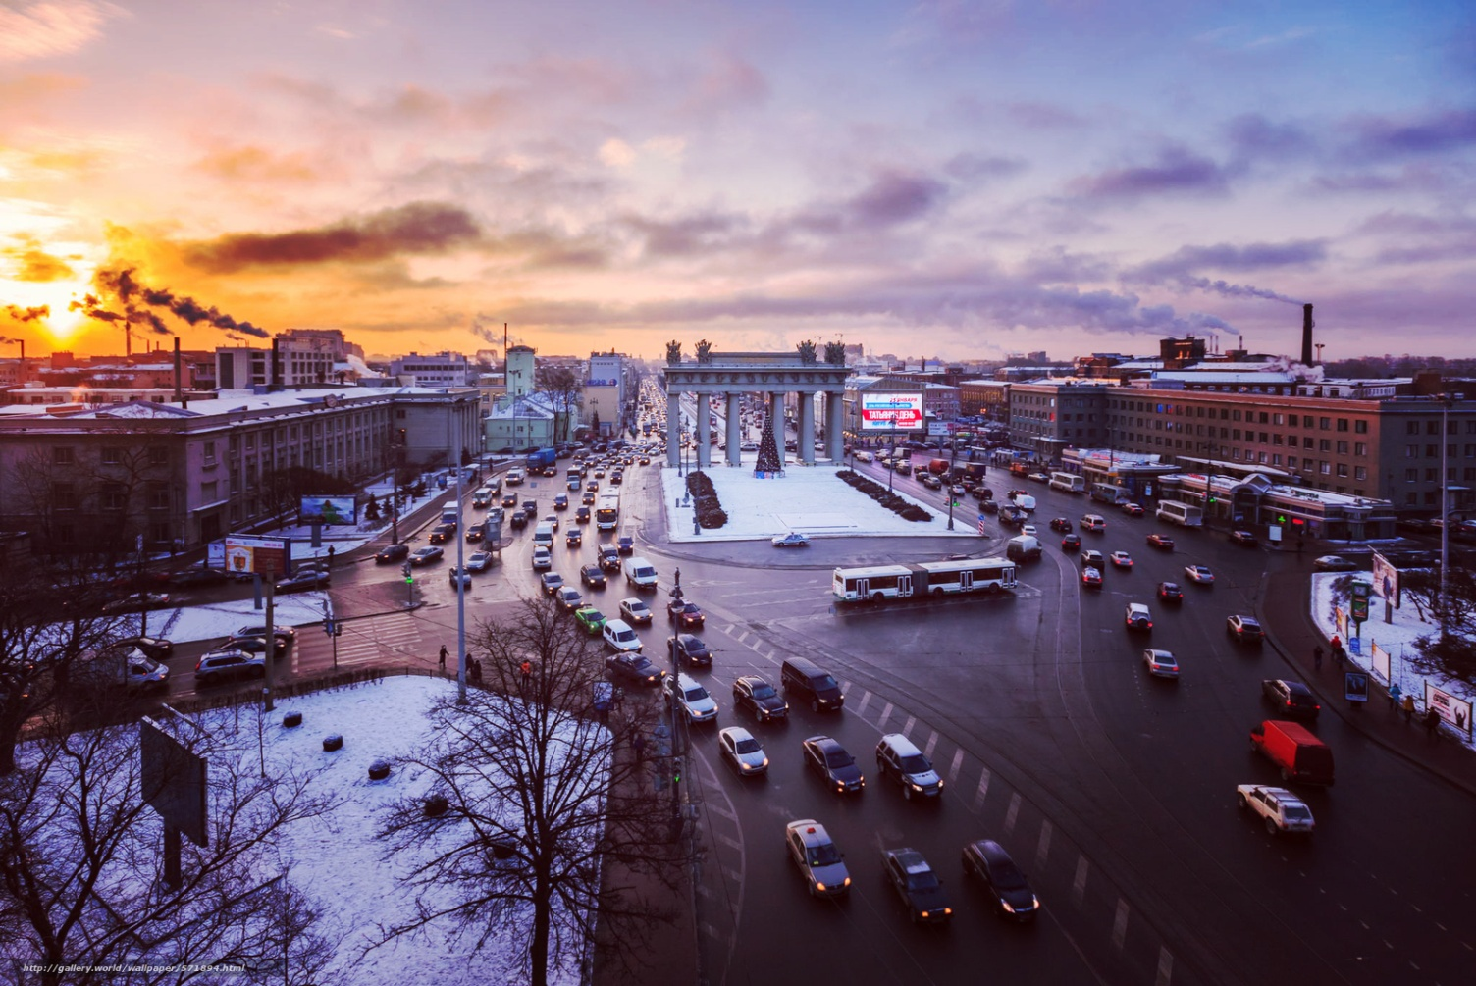
Overground transport is bewilderingly varied, but not difficult to use with the help of a few pointers, and St. Petersburg's latest transport project means that you can even use the city's waterways to get around. The only real disadvantage of the public transport system is the lack of nighttime services, so if you plan to stay out after midnight, you will have to rely on taxis or your own two feet to get home.

Slide 4
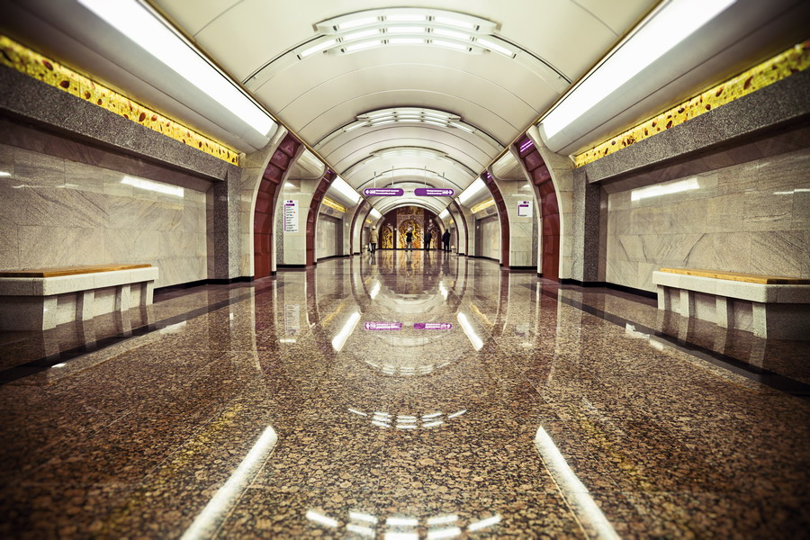
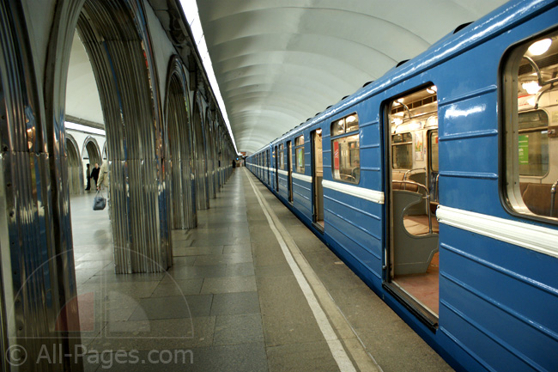
St. Petersburg Metro
The system is also remarkably efficient. During the day, trains arrive every 2-3 minutes, with slightly longer waiting periods early in the morning and late at night. On average, the stations open at about 5:45am and close between midnight and 0:30am You can transfer from one line to the other until 0:15am.
Tickets:
The fare for a single journey to anywhere in the city is around $1. St. Petersburg's metro still uses a system of tokens ("zheton") the size of larger coins.

Slide 5
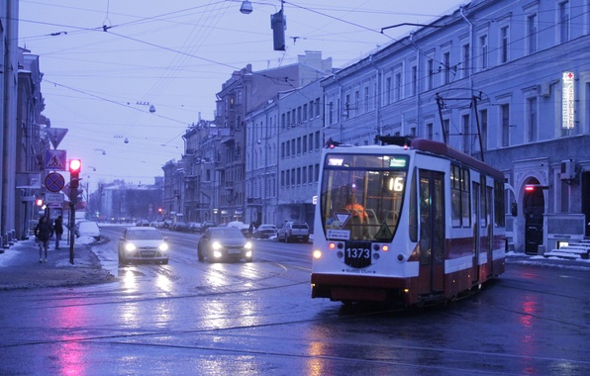
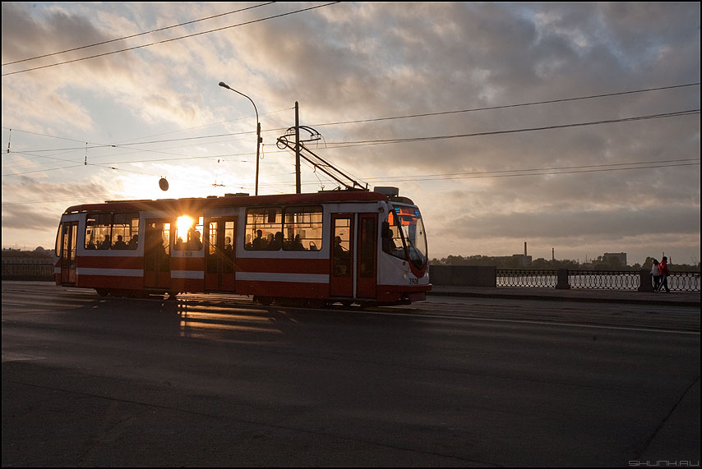
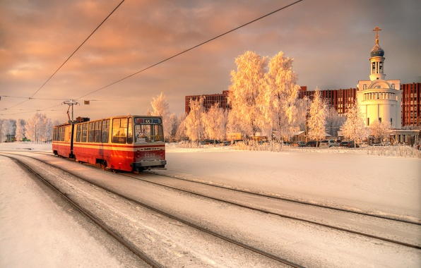
St. Petersburg Trams
One can call St. Petersburg a "City of Trams" because it has more trams than any other city in the world. Tram stops are marked with signs above the tracks (with a letter "T" on them).
Since January 1998 all trams have conductors on board.

Slide 6
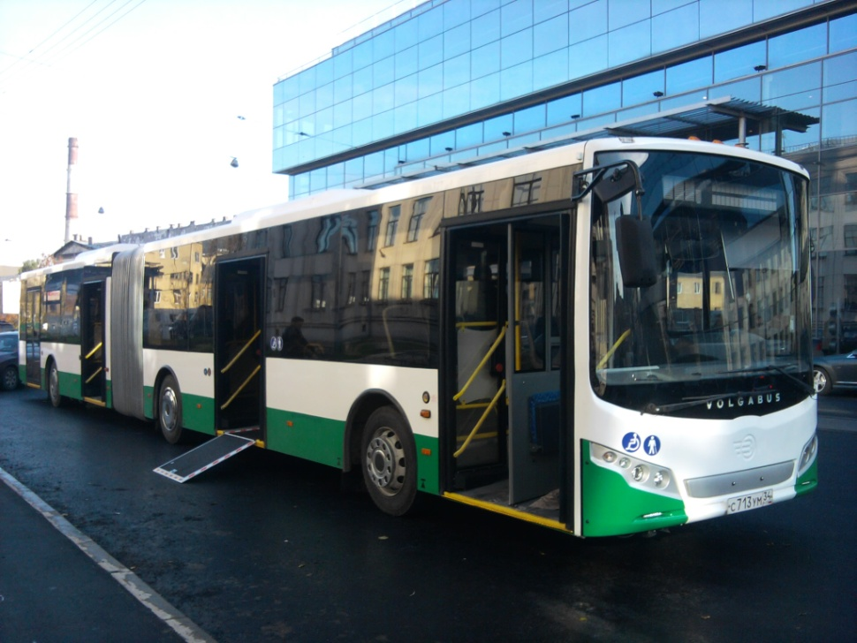
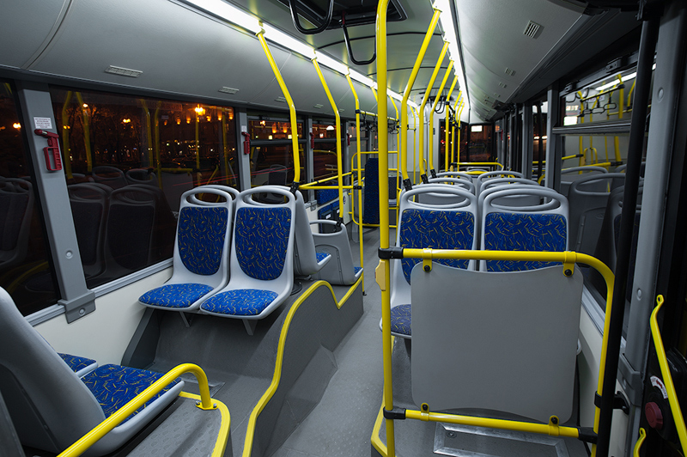
St. Petersburg Buses
The bus network of St. Petersburg is extensive, but can be a bit confusing for a foreigner. Bus stops are marked by signs with the letter "A", which stands for bus. Routes are listed on signs (double-sided) at most bus stops, but only in Cyrillic.

Slide 7
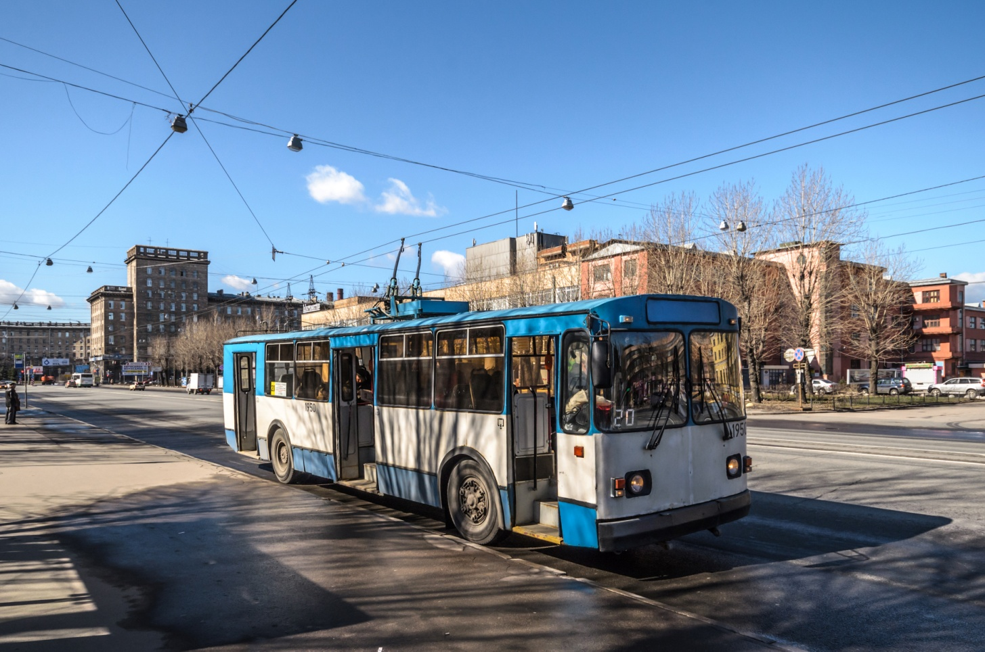
Trolleybuses in St. Petersburg
Trolleybus stops are marked with signs with blue letter "T". They operate exactly the same way as St. Petersburg's buses and are very common in the centre of the city. The only disadvantage of trolleybuses is that they cannot change lanes, and are therefore more prone to delays when congestion gets bad.

Slide 8
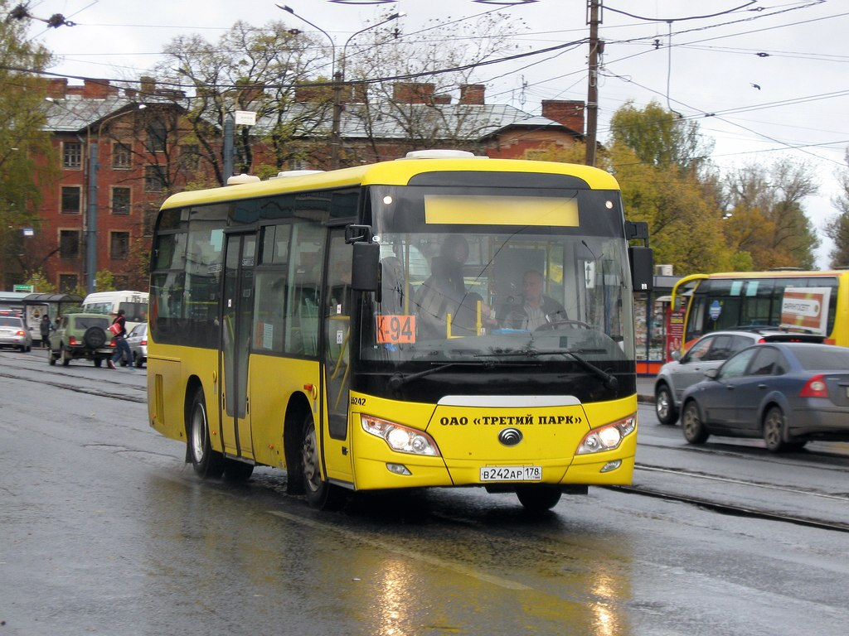
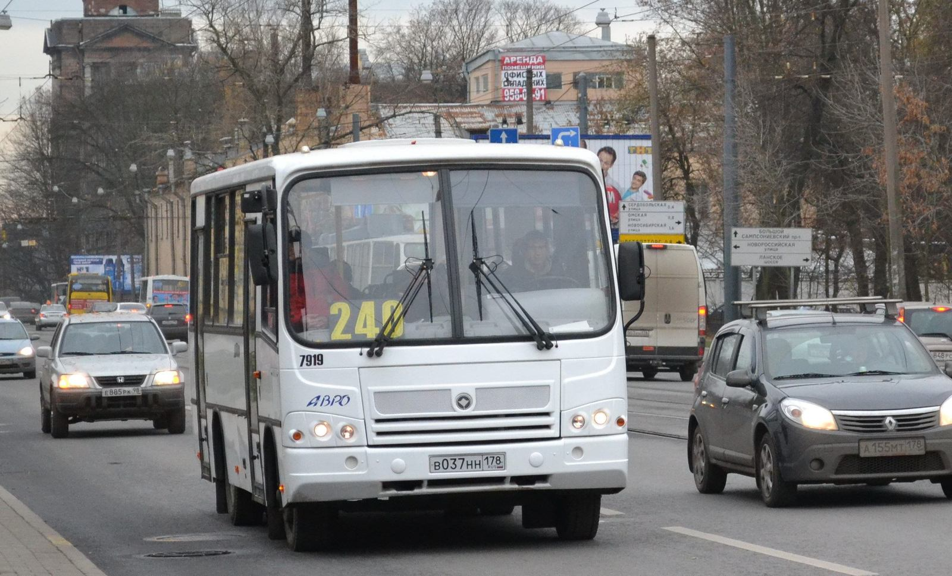
St. Petersburg Marshrutka
A marshrutka or marshrutnoe taxi is a privately owned minivan or small bus that follows a fixed route, collecting and depositing passengers anywhere along the way. Visitors may find the network of marshrutki a little too complicated to be worth using in the city center, especially now that they can longer run along Nevsky Prospekt, but they are often the best means of getting to St. Petersburg's suburban attractions, and are the cheapest way to get to/from the city's airports.

Slide 9
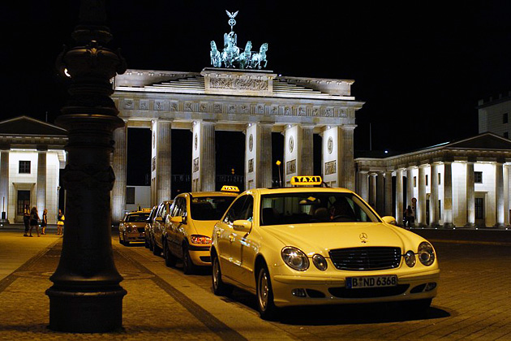
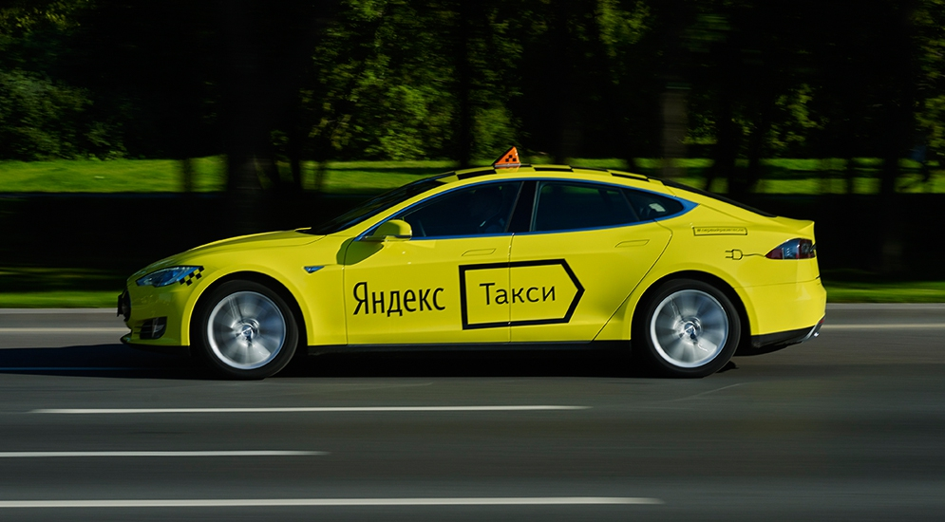
Taxi in St. Petersburg
If you wish to take a taxi, you will need to call a reputable cab company. Most companies will now be able to get a car to you anywhere in the centre in 15-20 minutes. There is usually a minimum fare of around $10, which covers the first 5km of your journey. After that, you pay per kilometer, and the price will be calculated when you book. You will need to give the operator a phone number that you can be contacted on.

Slide 10
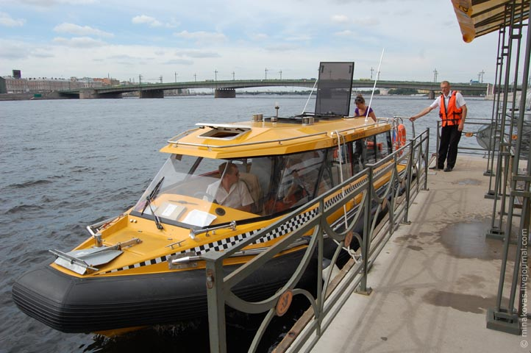
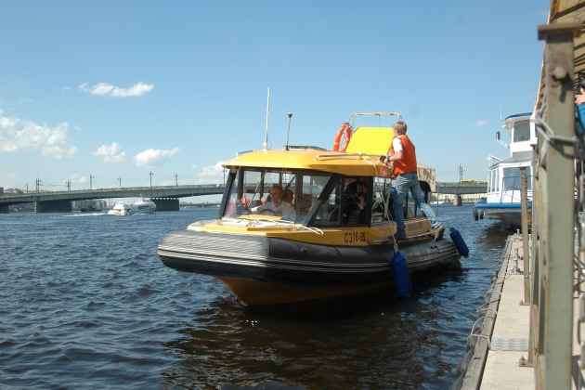
Aquabus water taxi service
The Aquabus, also referred to as river tram or water taxi, is a public river transport system ferrying passengers along a fixed route to a set timetable. Despite the enormous distance covered by St. Petersburg's rivers and canals, there are currently only one inner-city line in operation. Reaching speeds of up to 80 km/h, the Aquabus really does provide a fast way of getting from A to B, although locals are yet to take it seriously as a transport option, and most passengers - travelling from one end of the line to the other and then back again - are tourists.

Slide 11
Thanks for attentions!!!

