Slide 1
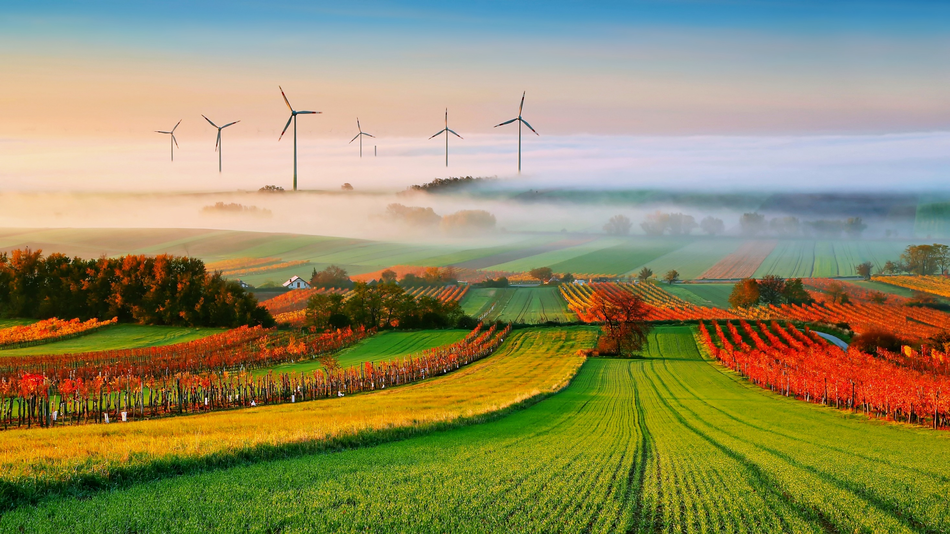
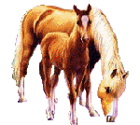
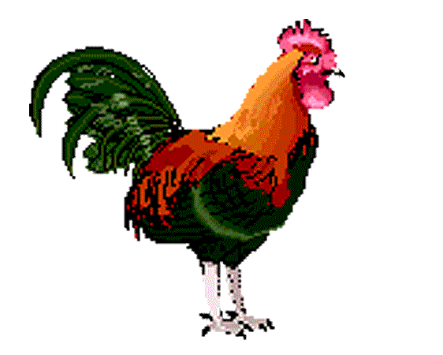
Presentation
The British agriculture
Bulgakova V. P.
2rd year student,
faculty of biotechnology and veterinary medicine,
Of the Orel state agricultural university them. N. V. Parahina,
Russia, Orel.

Slide 2
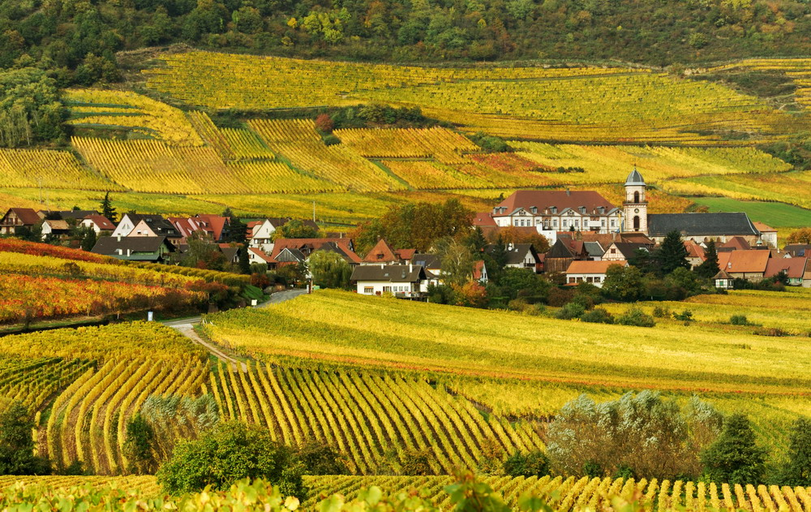
In general, small farms dominate in the country.

Slide 3
There are three main types of farming in Great Britain: pastoral, arable and mixed

Slide 4
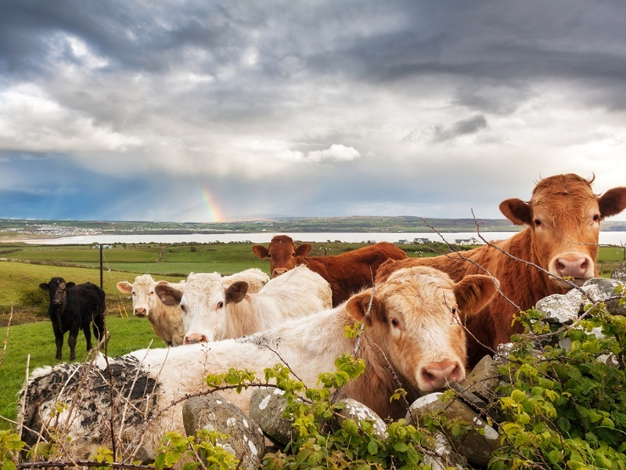
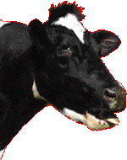
Livestock farming is of great importance. On most farms it is presented by dairy or beef cattle and sheep.

Slide 5
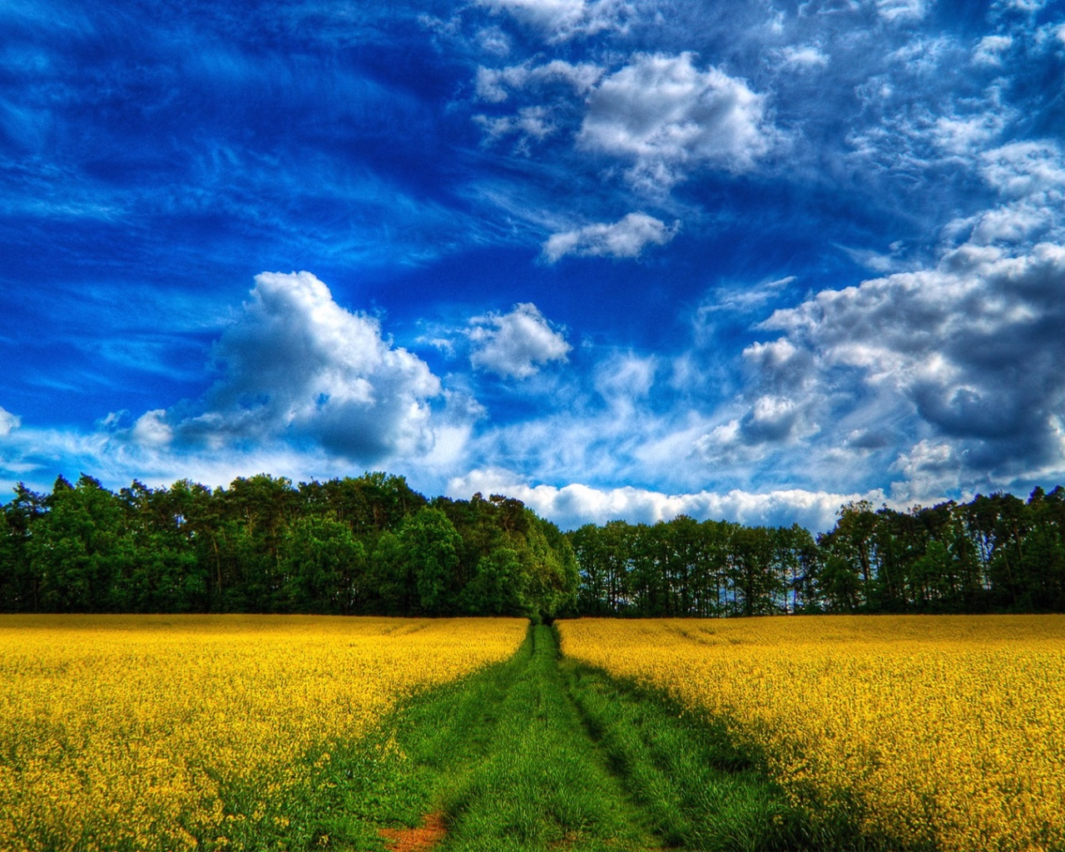
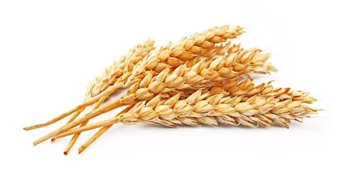
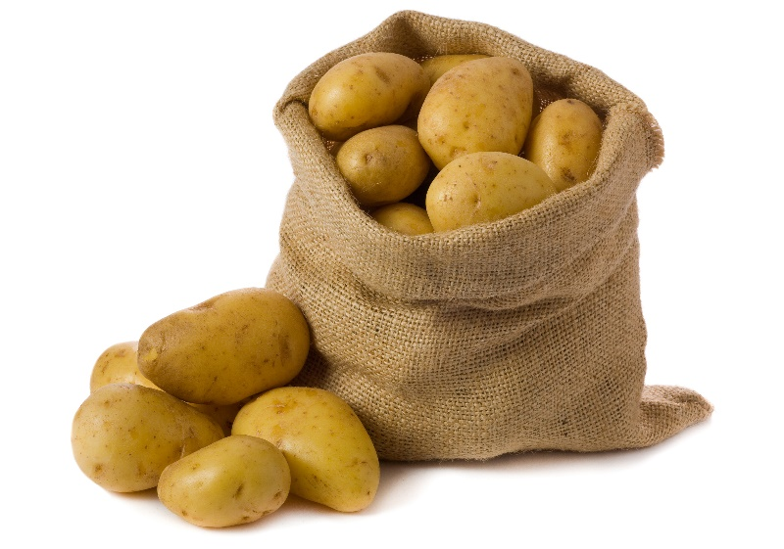
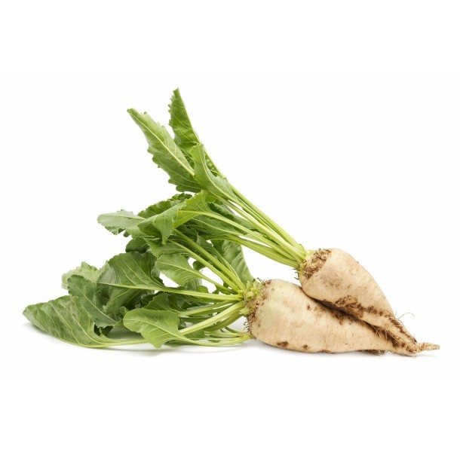
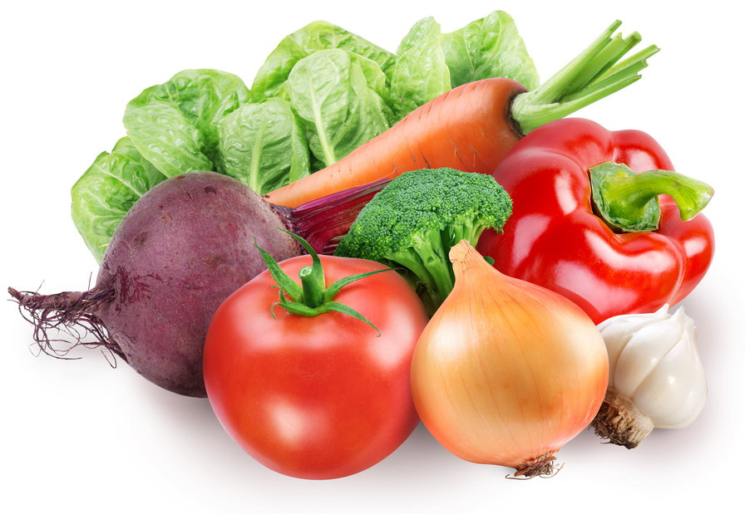
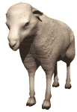
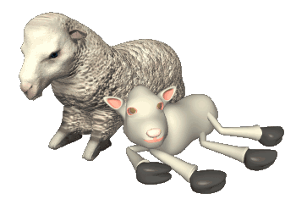

Slide 6
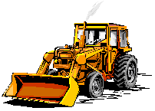
Great Britain is self-sufficient in milk, eggs, meat, potatoes and
wheat. But it usually imports butter, cheese, sugar and some other agricultural products.

Slide 7
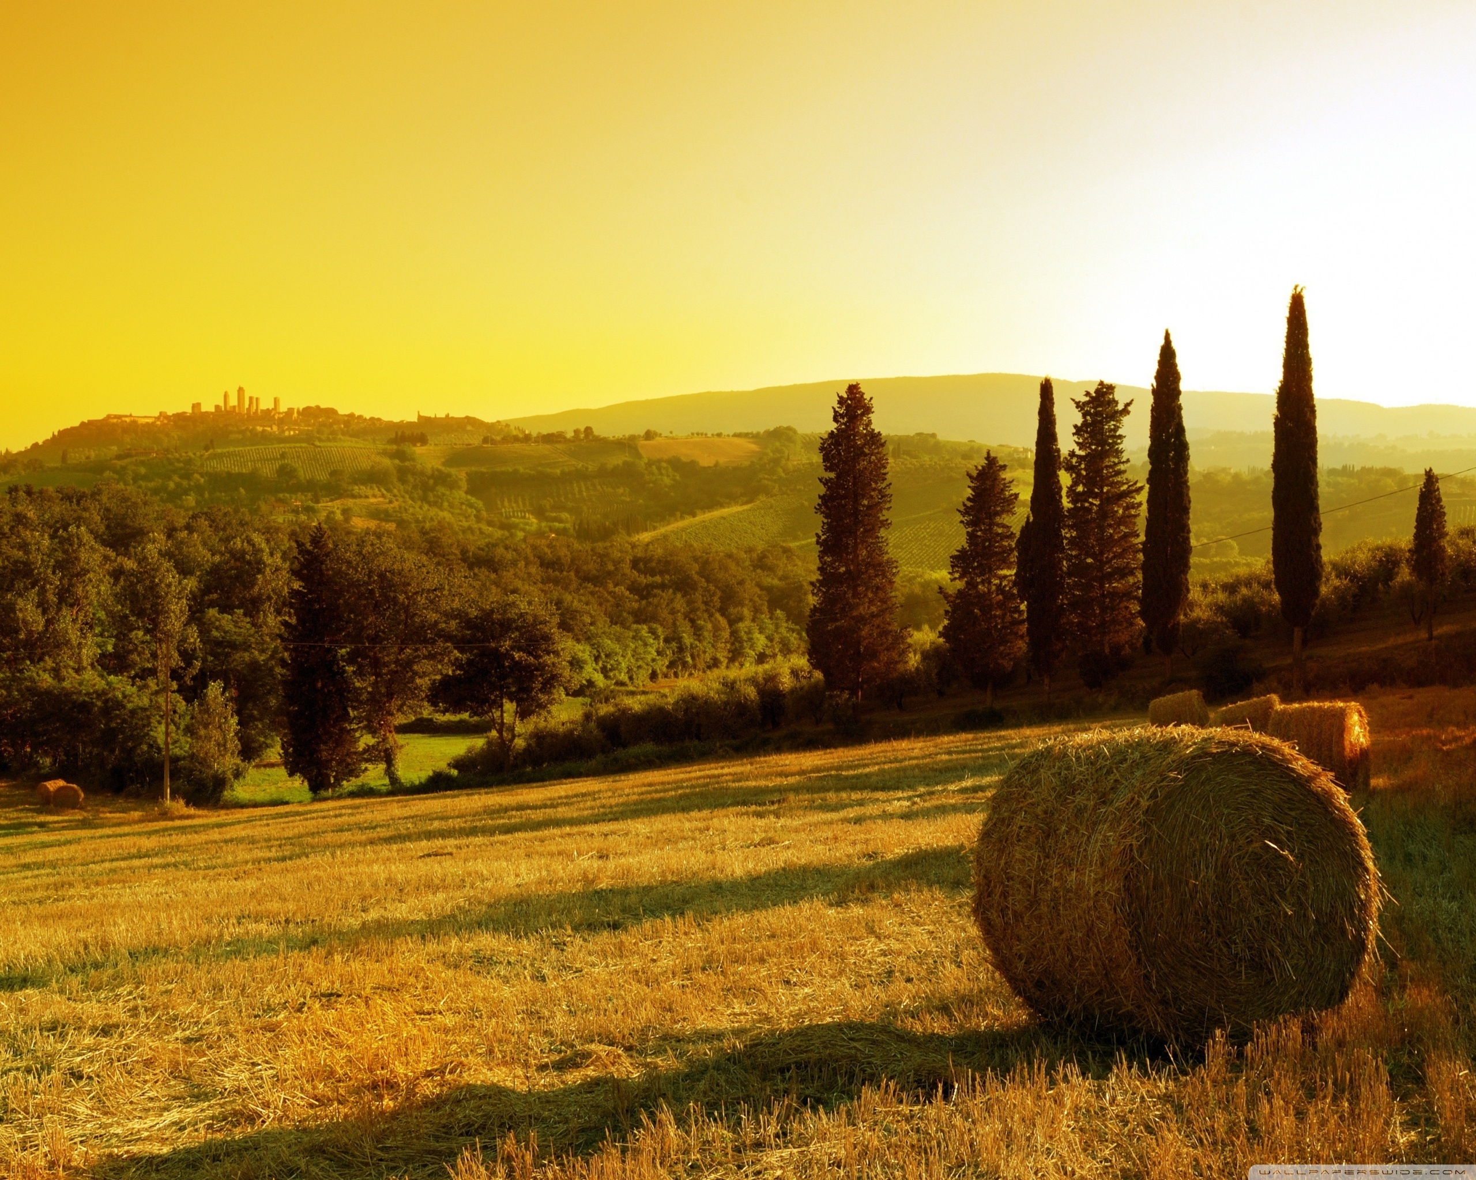
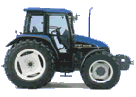
THANK YOU FOR YOUR ATTENTION!

