Slide 1

WELCOME TO THE LESSON

Slide 2


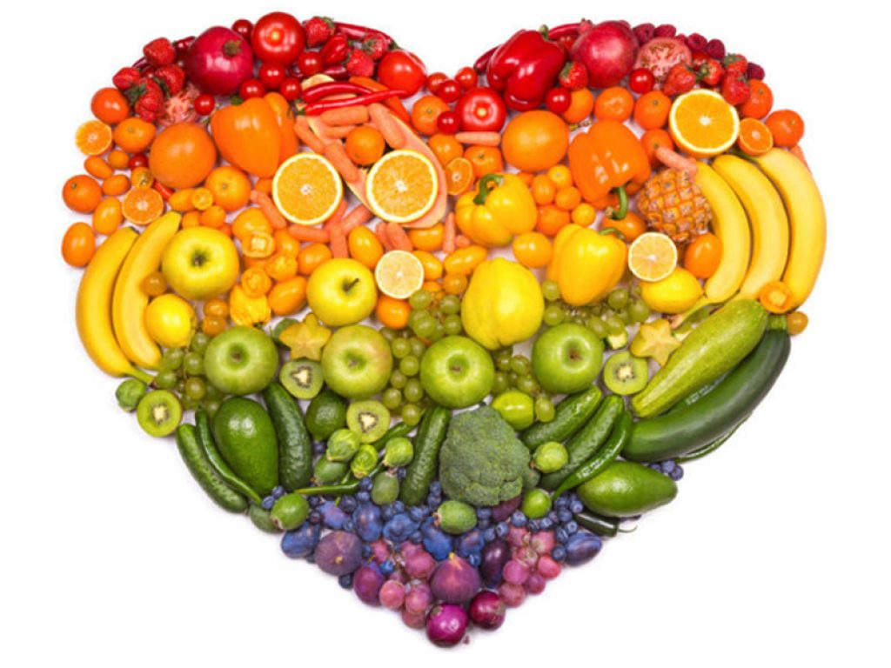


Slide 3
HEALTHY LIFESTYLE
“An apple a day keeps the doctor away”

Slide 4
Butter, sweets, pork, chicken, cheese, sour cream, eggs, ham, cucumbers, carrots, yoghurts, cabbage, sausages, oil, beans, peas, cakes, bananas, salmon, onions, tuna fish, milk, porridge, oranges, pasta, potatoes, beef, rice, ice cream

Slide 5
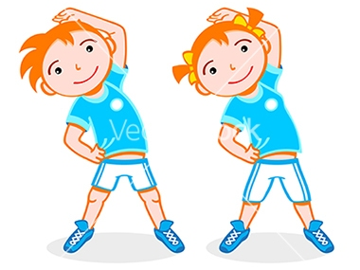


Slide 6
Not every diet is good for you.
Everybody should do exercises three times a week.
Excess weight can lead to health problems.
A balanced diet is a very important thing.

Slide 7
5. Fats are an important part of the diet.
6. Physical activity is good for our health.
7. Only swimming and jogging can help you burn calories.
8. Coffee is good for teenagers.

Slide 8


Thank you !

