Slide 1
The Victory That Cannot Be Forgotten
Выполнил: Алексей Губар, ученик 10б класса
МКОУ Вихоревская СОШ 2
Руководитель: Сорокина Тамара Станиславовна, учитель 1 квалификационной категории

Slide 2
Alexey Gubar

Slide 3
Notes:
Vasiliy

Slide 4
Notes:
Кем были эти люди?

Slide 7
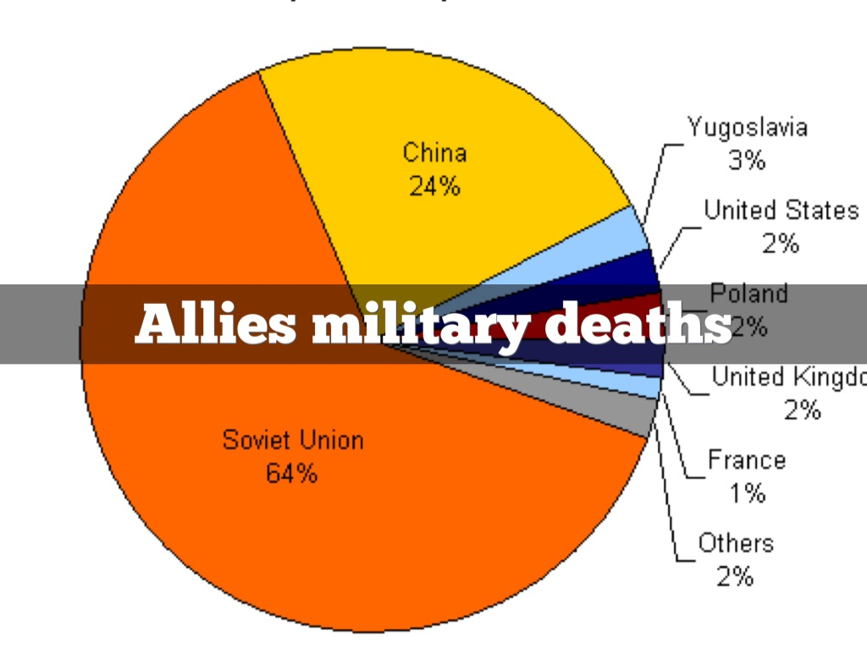

Slide 9
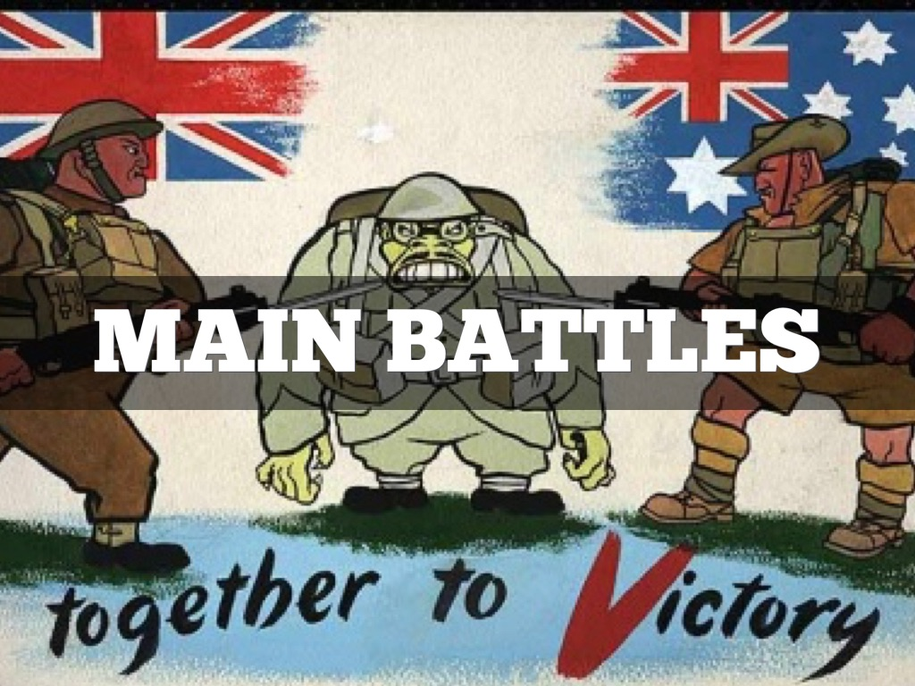

Slide 19
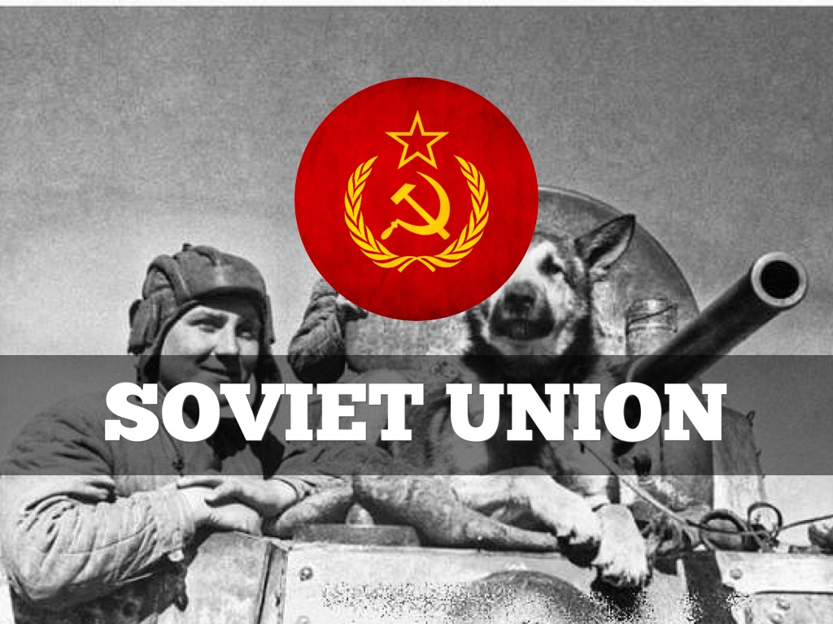

Slide 28
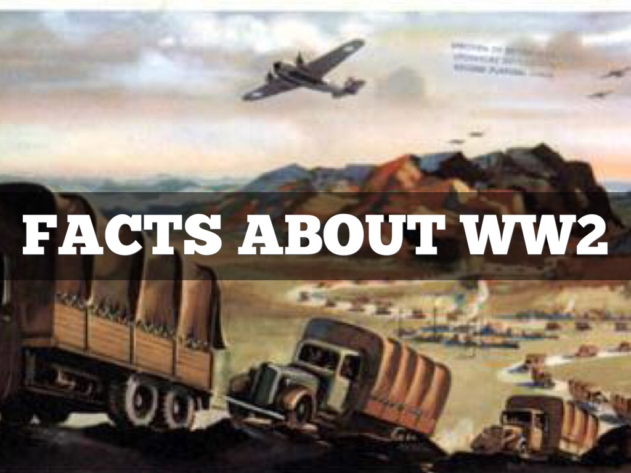

Slide 32
Notes:
Не надо is

Slide 38
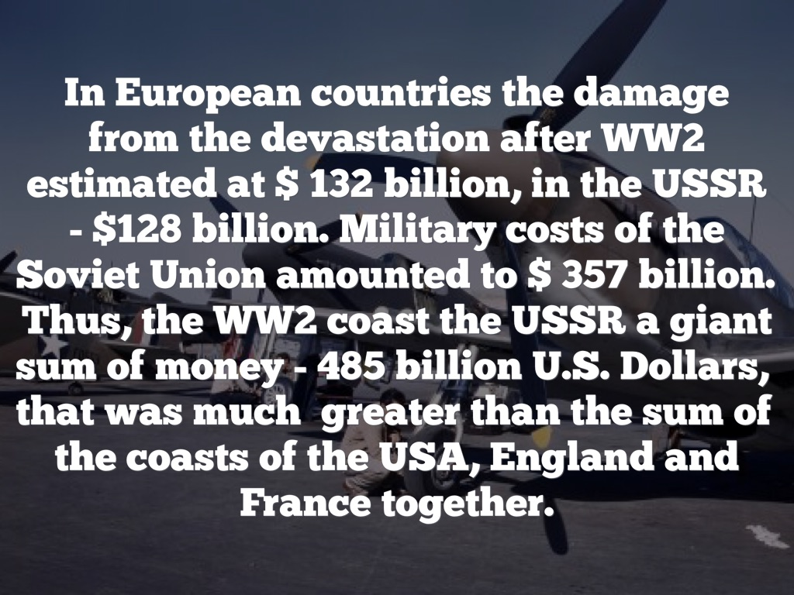

Slide 39
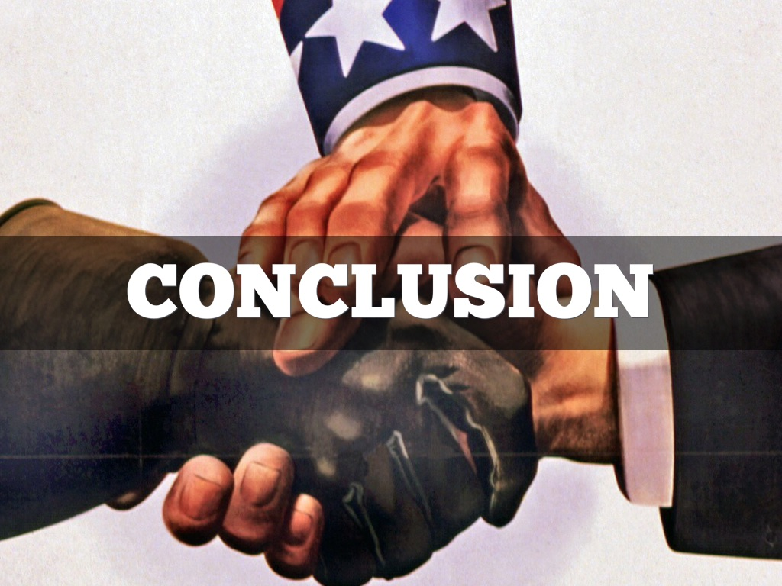

Slide 40
Notes:
…would have been unable… the whole Soviet Union and Europe… May 9,1945 according to Tehran agreement.
Можно в отдельный слайд: Today when memories of war are set to fade, it is important to remember the second world war “correctly”, not paying attention to nationalist politicians seeking to downplay the historic victory of USSR.

Slide 41
Today when memories of war are set to fade, it is important to remember the second world war “correctly”, not paying attention to nationalist politicians seeking to downplay the historic victory of USSR.

