Slide 1
Для любого УМК
Олейникова Светлана Александровна
учитель английского языка
МКОУ Сидорская сош
Городской округ город Михайловка
Волгоградская область

Slide 2
A Birthday party is one of the most LOVELY days in our life.

Slide 3
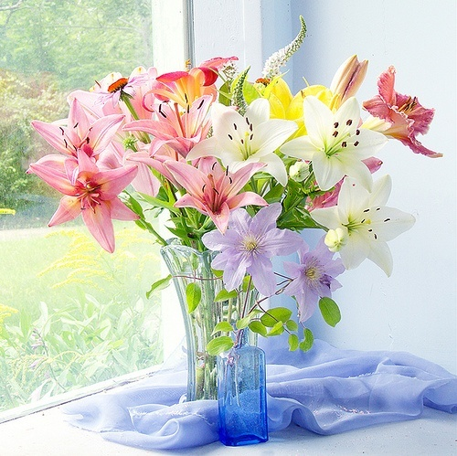
What will the day bring?
We roll out of bed with more enthusiasm than usually !!!

Slide 4
What do we need to make this day so special?
The first, we need some decorations.
We prefer colorful balloons.

Slide 5
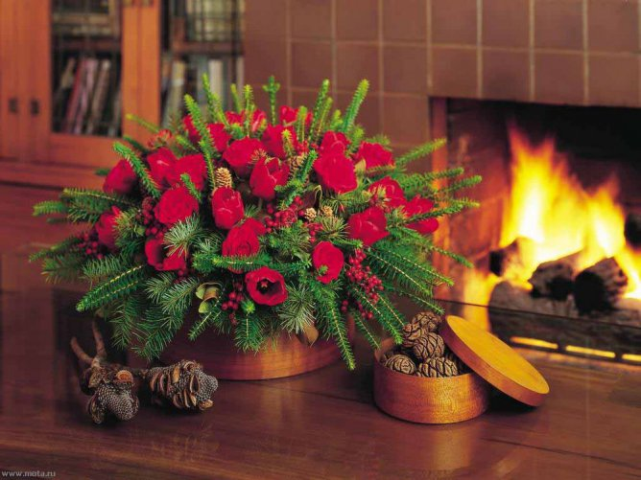
The second, let`s try to buy a lot of flowers.

Slide 6
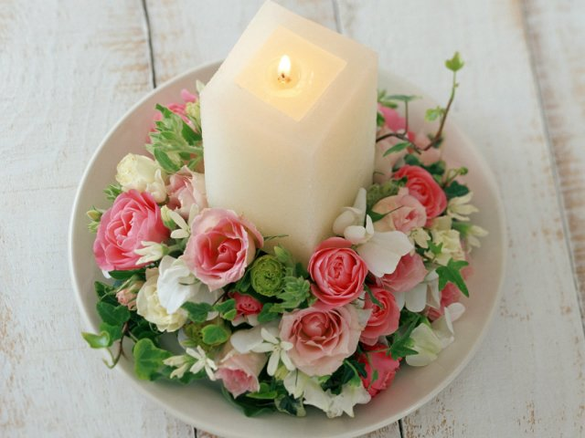
It would be better to have candles.

Slide 7
Before you start to celebrate, think of what you are going to cook and how to enjoy your guests.

Slide 8
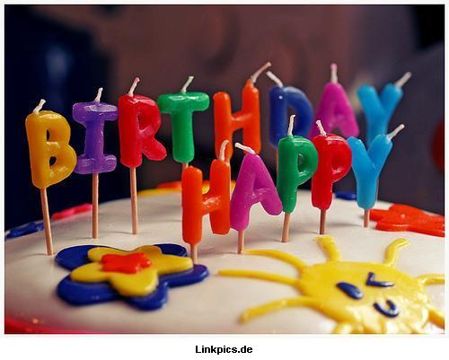
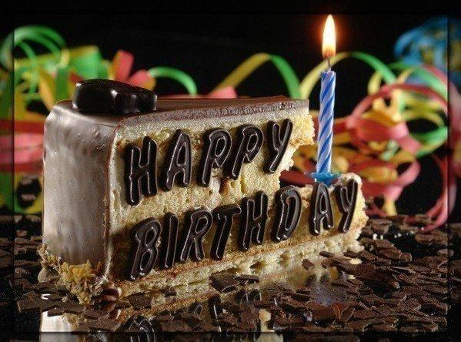
A special birthday cake
is a traditional dish
Candles and wishes!!!
We wait for them
the whole year!!!

Slide 9
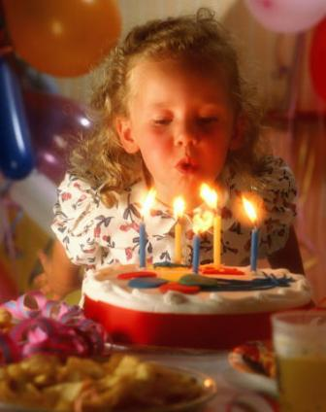
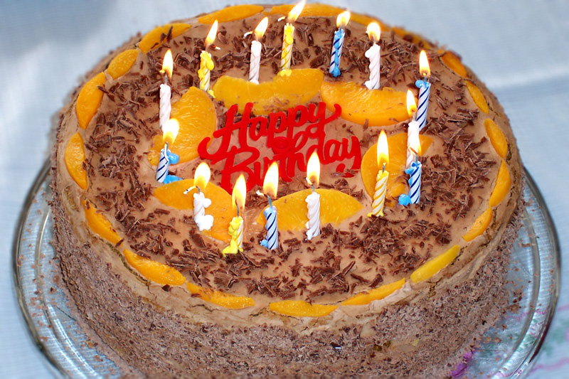
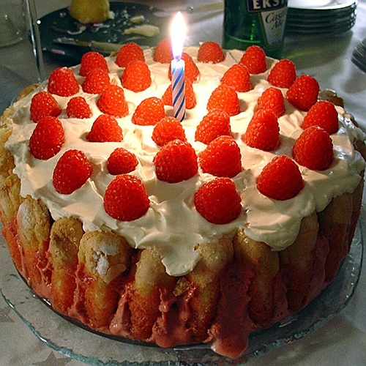
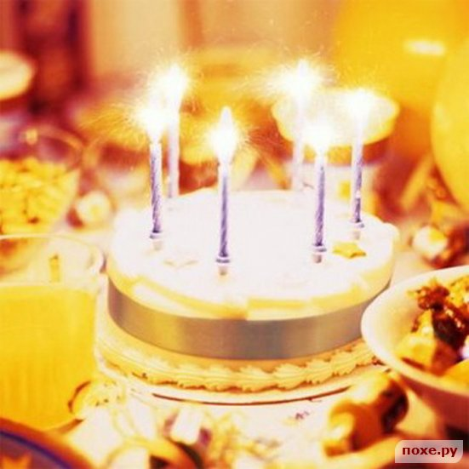

Slide 10
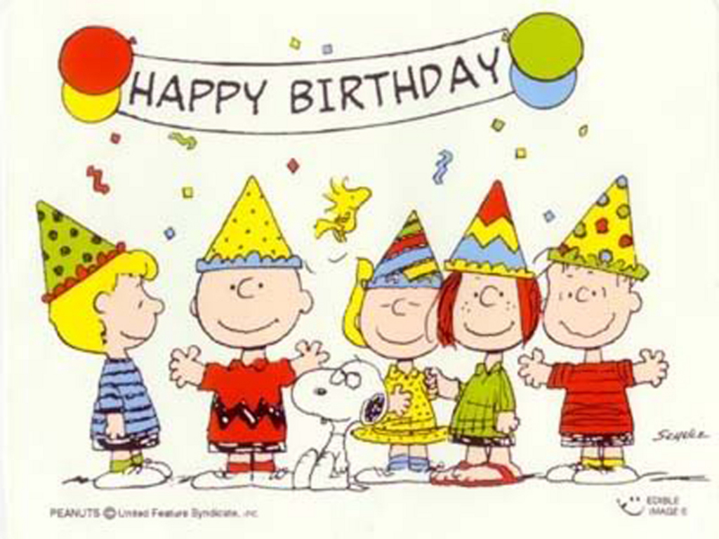
Don`t forget about
A Happy Birthday To You song!!!

Slide 11
PRESENTS AND GIFTS
POSTCARDS

Slide 12
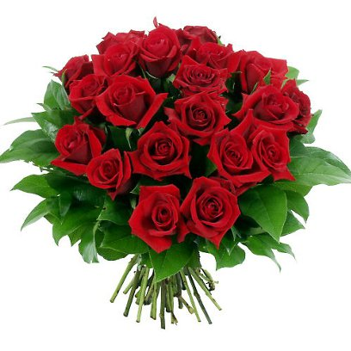
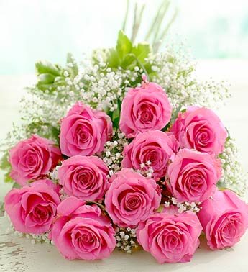
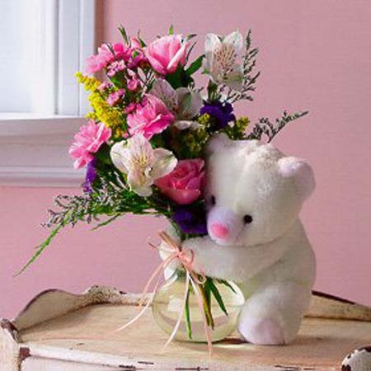
PRESENTS AND GIFTS
FLOWERES
TOYS

Slide 13
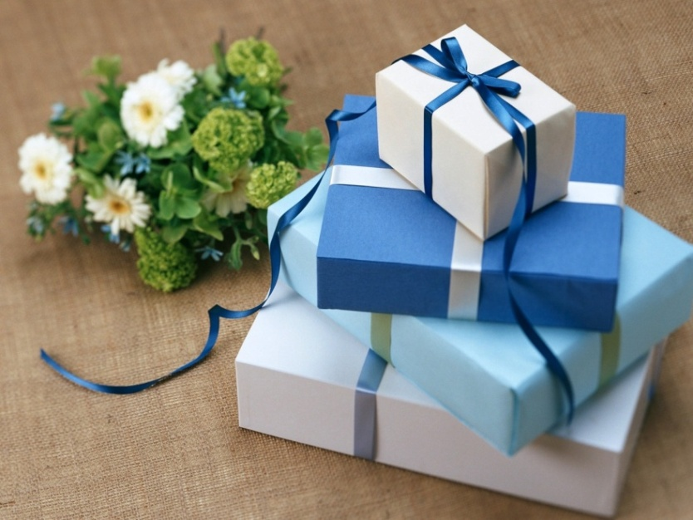
PRESENTS AND GIFTS
CANDIES SOVENIERS
EVEN CARS

Slide 14
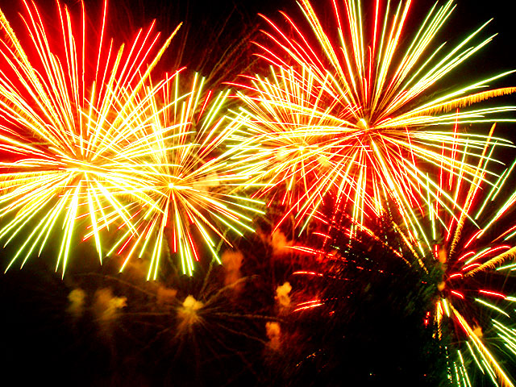
BE HEALTHY WEALTHY HAPPY

Slide 15
THANKS FOR YOUR ATTENTION!!!

