Slide 1
PRESENTATION THEME
“MY FUTURE JOB”
The 1st year student group PO-19
Gizatullin Ruslan

Slide 2
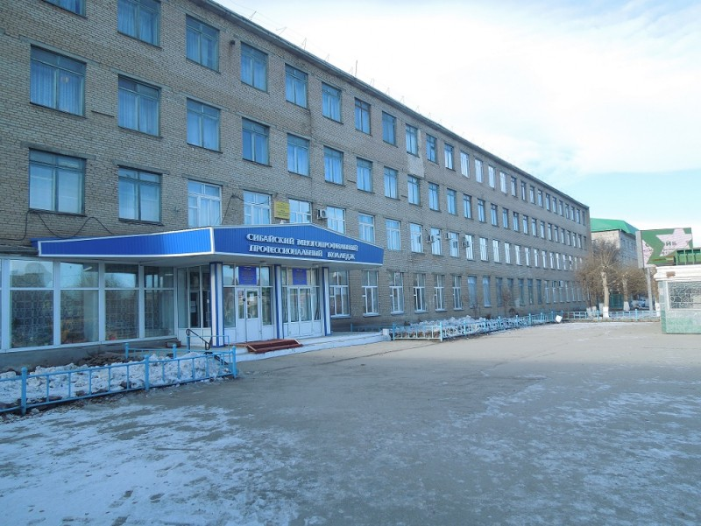
MY FUTURE JOB
My name is Rulan Gizatullin. I am а student of Sibay Multiprofil Professional College. I am going to be a programmer because I like to sit and work at a computer.

Slide 3
Even before the 9th grade, I did not know what I should become and what to do, but I knew for sure that I would enter the Sibay techie. When I graduated from the 8th grade and was already ready to go to the 9th grade at this time, my older brother graduated from the 9th grade and passed the OGE. He then also did not know what to do, and when he looked at the lists of professions, he chose and decided to become a programmer. Why am I saying this? But because if not for my brother, then I would hardly have chosen the profession of a programmer.

Slide 4
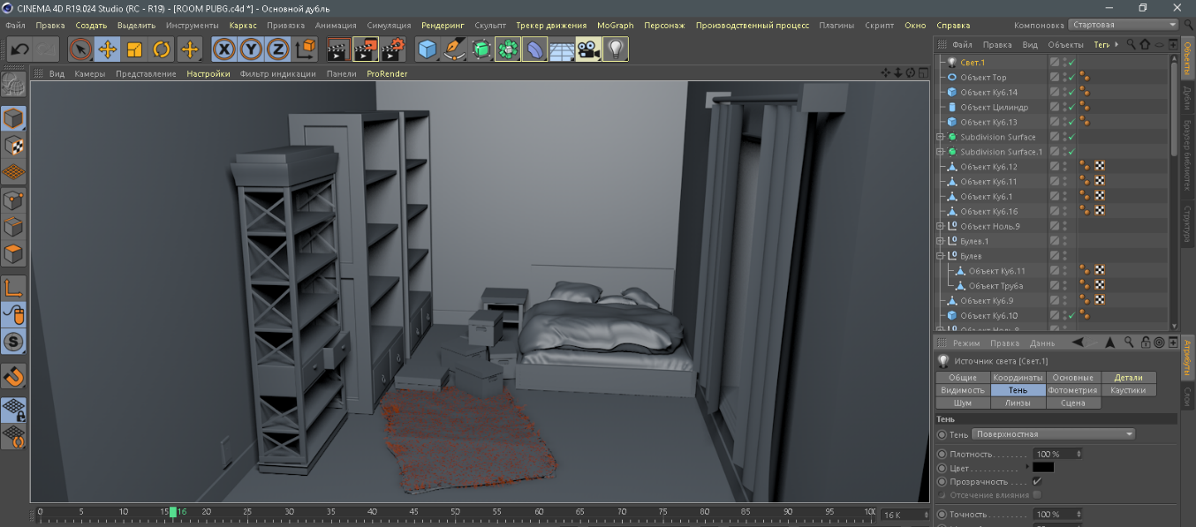
PHOTOSHOP
I was then interested in this profession and decided to look in more details on the Internet. Then I was just starting to develop in such programs as Photoshop and Cinema 4D (3D modeling) and it turns out that these programs are needed for the programmer, and Cinema 4D is needed to create 3D objects, figures, locations to transfer them to the game, and even before that I wanted to create some kinds of games of my own.
CINEMA 4D

Slide 5
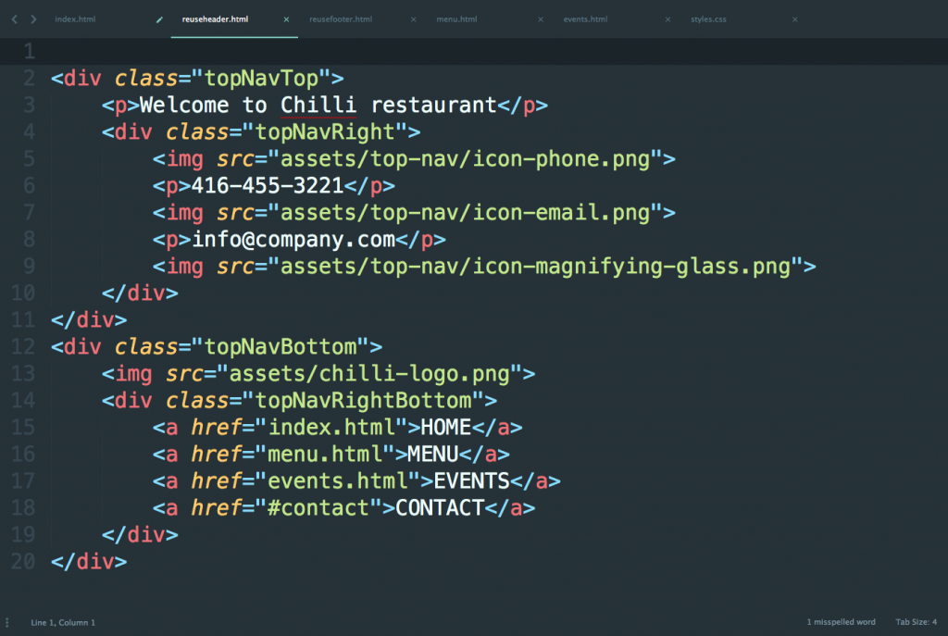
When I graduated from the 9th grade and passed the OGE, I immediately went with my certificate to the Sibay technical school and entered the programmer with confidence. Now I study programming languages ​​and I want to create my own website about music, without copyright, I am interested because I do electronic music myself.

Slide 6
WHO IS A PROGRAMMER?
A programmer is a specialist directly involved in the development of software for various types of computing and operating systems.
This is the most basic concept of a programmer. Many truth be told, speaking a programmer, they immediately build in their head an entire office filled with all kinds of computers, parts, with huge monitors, and other junk. And in the middle of all this junk, there is a bespectacled man who delves into all this.
For me, a programmer is a kind of profession. Of course, the main task after all is the development of various algorithms and programs. But it's not always the case. I would say that it all depends on the direction. That is, from what area the programmer specializes in.

Slide 7
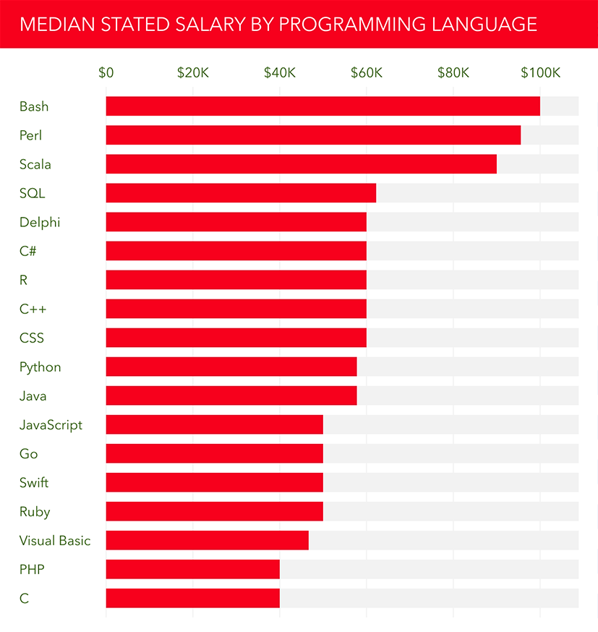
THE PROGRAMMER’S ADVANTAGES INCLUDE:
demand. In the labor market this is the most relevant profession. In any organization or enterprise requires a specialist who understands computers or generally in technology;
high salary. The average salary of a highly skilled programmer is about 50-70 thousand rubles;
the ability to work remotely, independently search for projects;

Slide 8
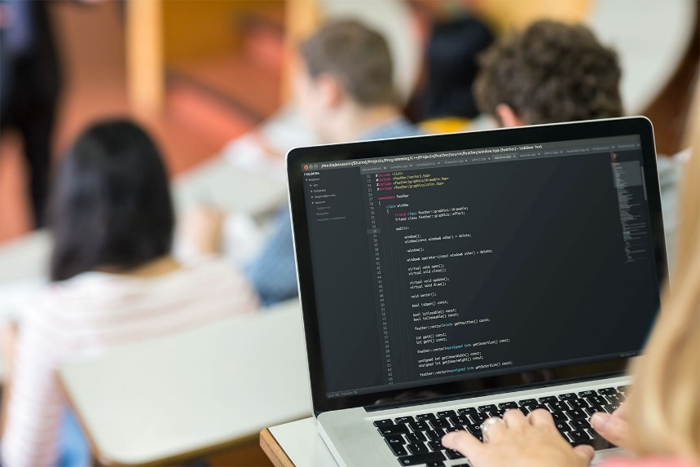
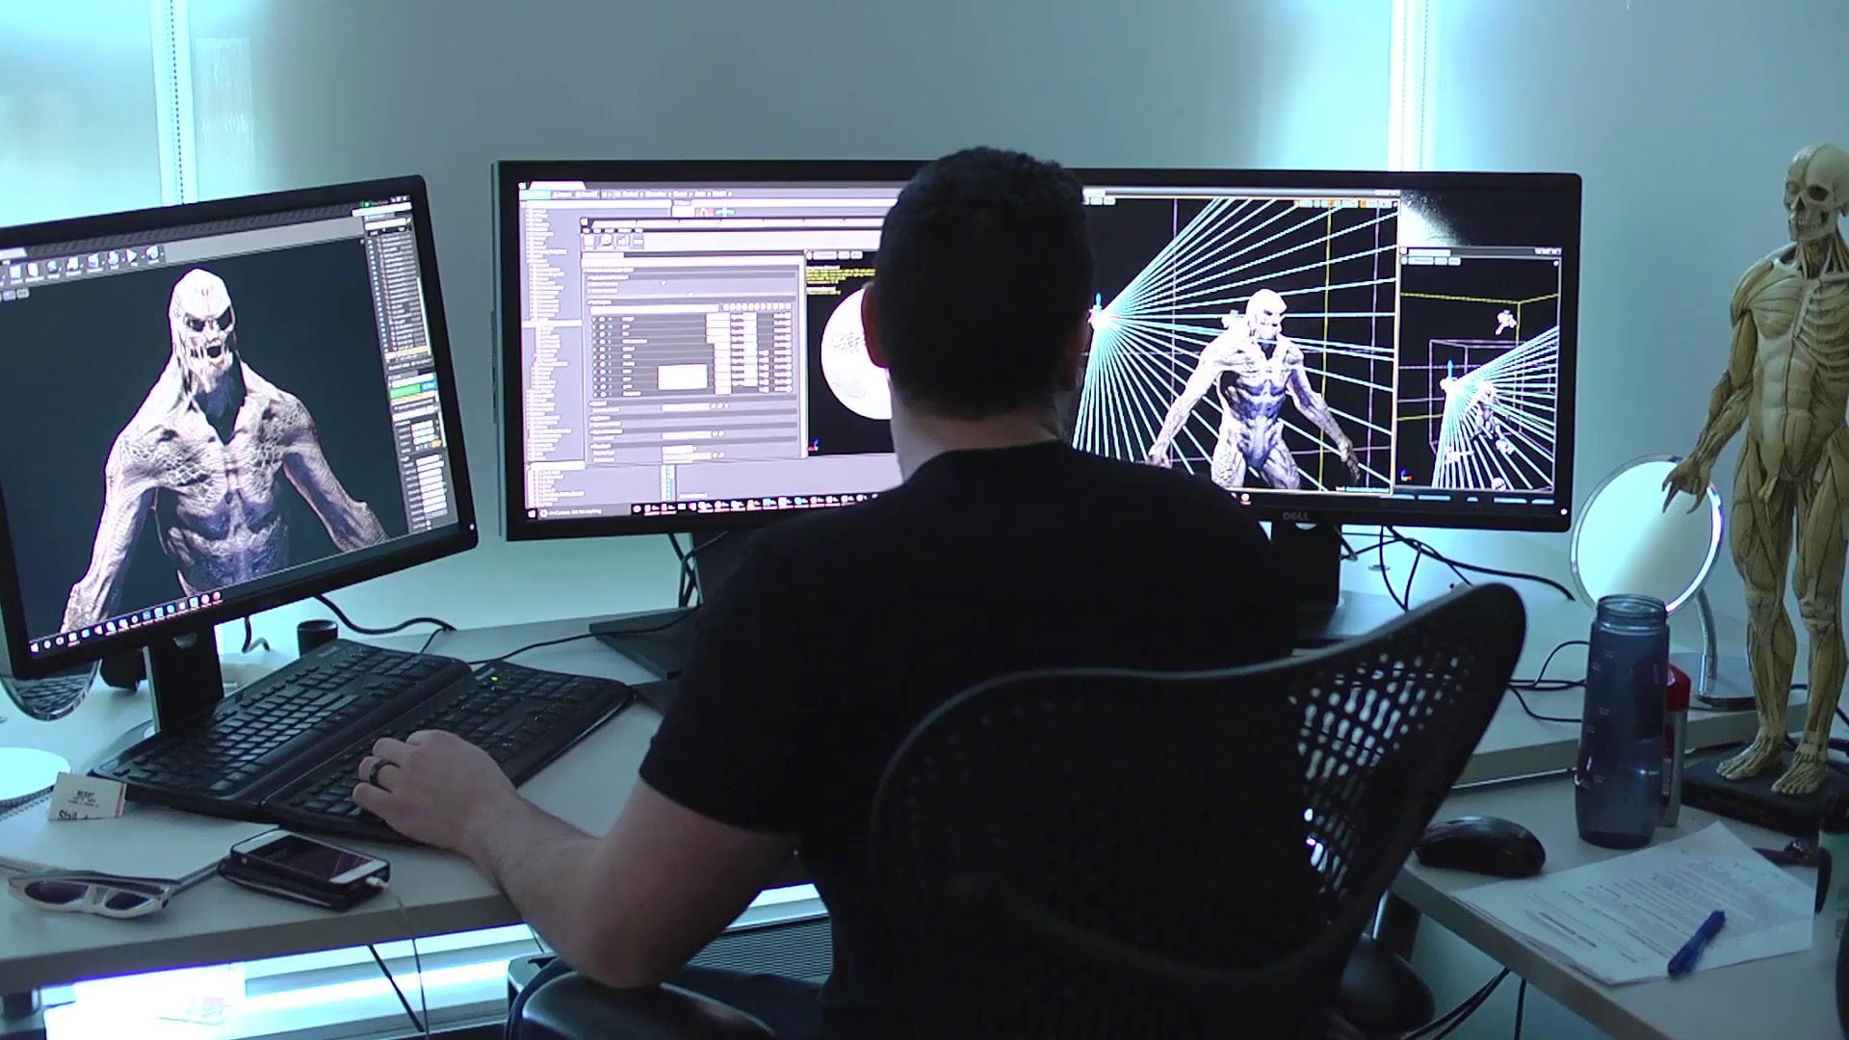
There is no particular need to graduate from a university. You can get a programmer without a diploma if you understand this field;
interesting and creative projects. A programmer can create sites, games, various programs, or even projects. This variety allows you to play fantasy in earnest and gives new opportunities for self-development;
high prospects.

Slide 9
THE DISADVANTAGES OF A PROGRAMMER INCLUDE:
passive lifestyle. For programmers, a pretty big problem. It is necessary to take at least small breaks during prolonged work at the computer;
progression of the profession. Now programming is developing rapidly. It is necessary to constantly develop and supplement your knowledge in order to work as a programmer;

Slide 10
patience. If you want to work as a programmer, then you must understand that not everything works the first time. You need to have patience and perseverance in order to achieve the desired result;
not for everyone. It is no accident that programmers have such a high demand and salary. The complexity of programming languages, the demands on analytical mindset and quick thinking reduce a large number of people who want to work in this field.

Slide 11
PRESENTATION IS OVER
Thank you for attention

