Slide 1
Attractions of Tula
Eroshkina Taniana Nikolaevna

Slide 2
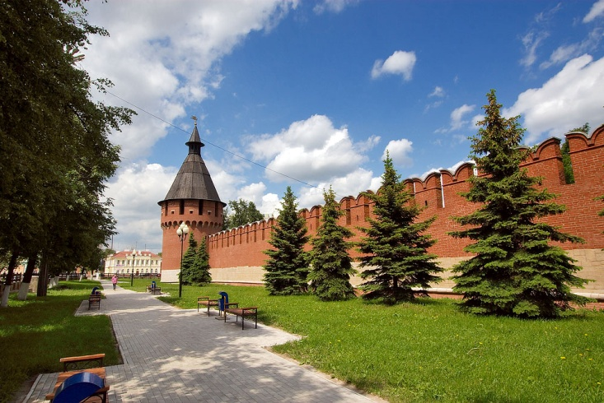
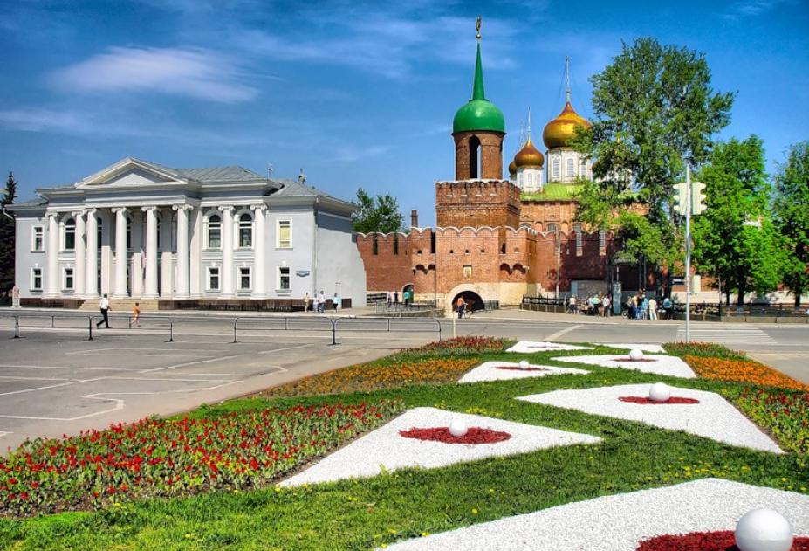
Town of TUla
When we hear the name Tula - at once before eyes pancake week fair at which the pink-checked children push gingerbreads for cheeks emerges, important ladies have tea at a zolotoboky samovar, moloditsa muffle up in openwork scarfs, and bearded fathers of families consider guns and sabers.
For the first time Tula is mentioned in chronicles of 1146, as the created independent populous city. Vladimir Dahl explained the name of the city so: "Tula - a reserved, inaccessible place, a pritulya for protection, a shelter, or for an imprisonment."

Slide 3
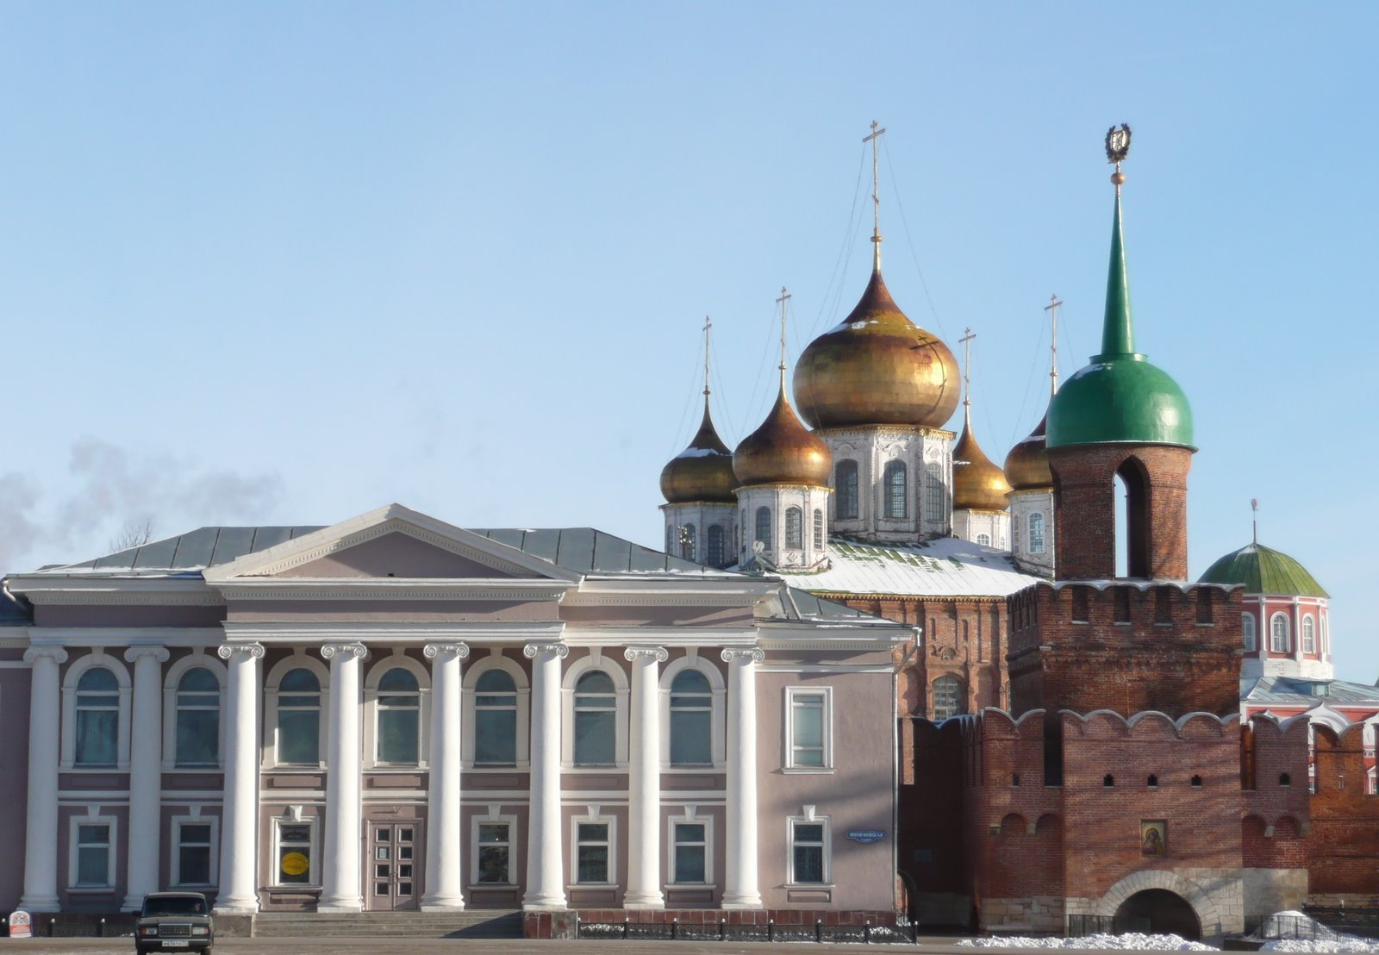
Attractions of Tula
The museum "Tula Samovars" contains a big collection of samples of samovars of the XVIII-XX centuries. The museum is open in 1990. The exposition of the museum which consists of three halls, acquaints with history of emergence and development of one of the most known Tula crafts - samovarny.

Slide 4
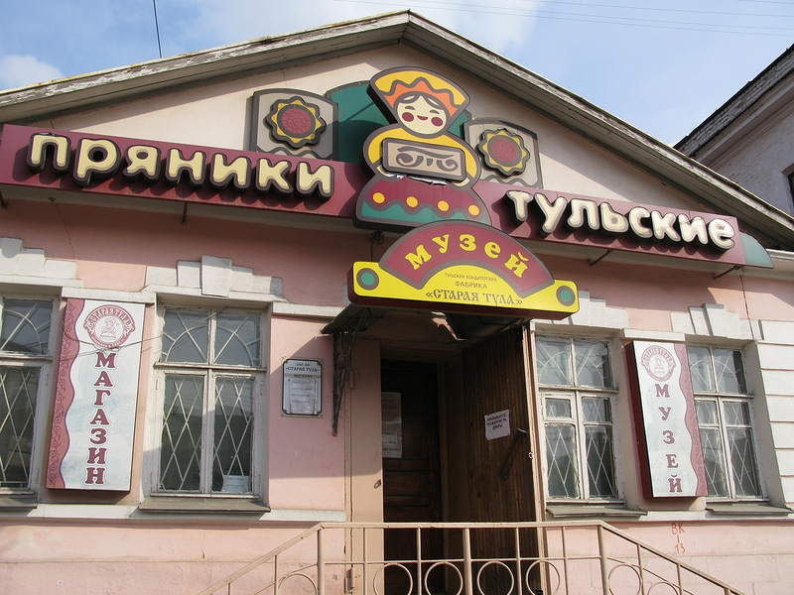
The museum "Tula Gingerbread" is devoted to history, a variety and tradition of production of gingerbreads. The museum was formed in 1996 in the former wings of armorers and samovarshchik of brothers Lyalinykh. In the same building the gingerbread shop and shop is placed. The exposition of the museum narrates about ancient traditions of production of gingerbreads, and also in modern conditions. Here the smallest also is presented to expositions, it is slightly more than fifty-kopeck piece, gingerbread and huge - pood, only in the country.

Slide 5
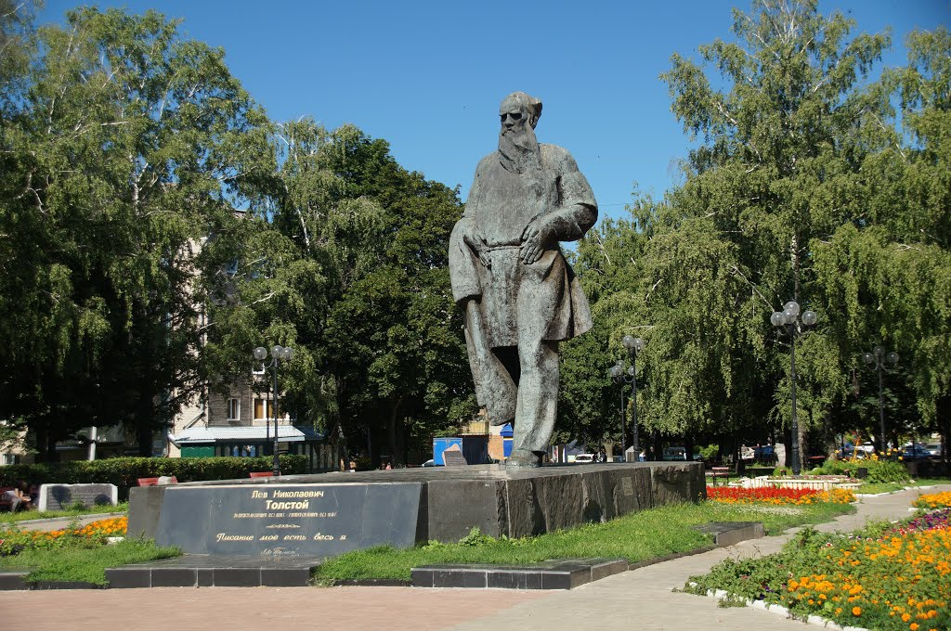
The monument is on Lenin Avenue, near the Central Park. Opening of a monument took place in 1973 in honor of the 145 anniversary since the birth of Lev Nikolaevich .Tolstoy.

Slide 6
Tula State Arms Museum — the oldest museum of the weapon in Russia, one of the main sights of Tula. The museum suggests to get acquainted with the collections telling about evolution of the weapon since the end of the XVI century up to now. All main samples which were adopted the Russian army and also the weapon of Western Europe and the East are presented to expositions. Rare samples of the sports and hunting weapon confirm original skill of armorers of the past and the present. In 1724 under Peter I's decree at the Tula small-arms factory started assembling ancient guns which made a basis of a collection of the museum subsequently. Today the museum collection gives the chance to track evolution of the weapon since the end of the XVI century up to now. Samples of a fire and cold weapon of work of masters of Russia, Western Europe and the East allow to compare achievements of domestic and foreign armorers. Among modern samples the particular interest calls the weapon of a special purpose: small-sized submachine guns, underwater and silent machine guns and guns, the shooting knife of the scout. The museum exhibits also the guns and machine guns intended for arms of planes, helicopters, ships and fighting vehicles.

Slide 7
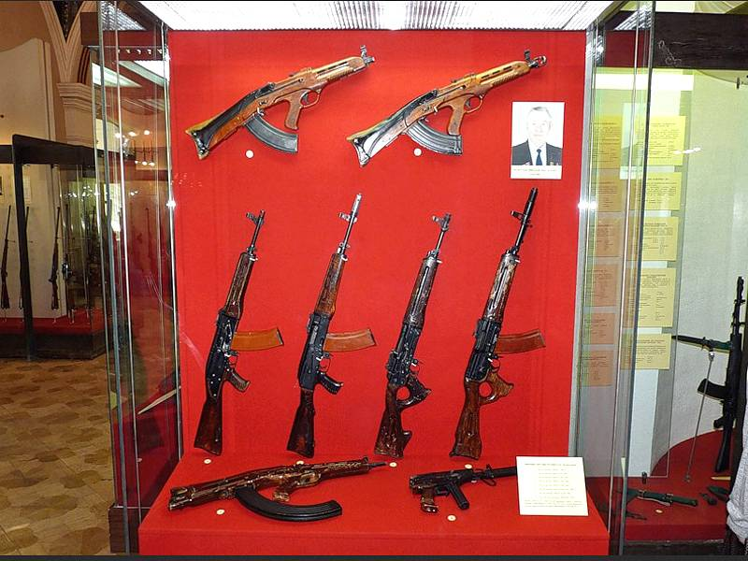
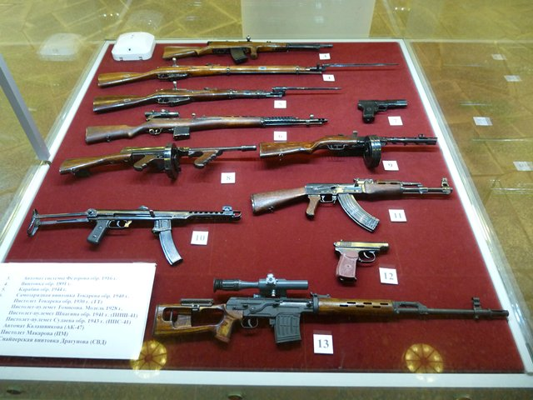
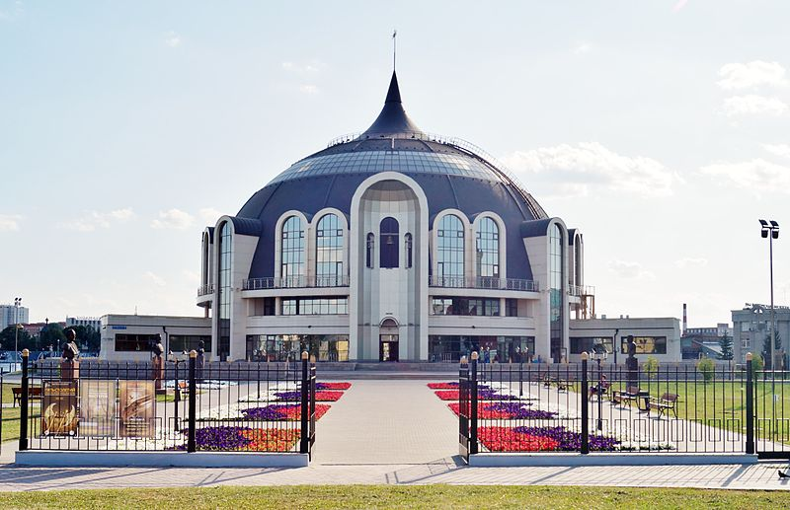

Slide 8
The Tula state academic drama theater of M. Gorky - one of the drama theaters, oldest in Russia, was created in 1777 on the occasion of introduction of Tula to a rank of the provincial center. Tula can be proud of that its theater left remarkable actors of the Russian scene of the end of XVIII – the beginning of the XIX centuries. In 1822 in Tula the ingenious Russian actor M. S. Shchepkin worked, from where was transferred to the Moscow Maly Imperial Theatre where served forty years, having become the best actor of the time. In 1832 on the Tula stage the debut of the ancestor of an artistic dynasty of Maly Theatre P. M. Sadovsky took place. The city of Tula and, of course, the Tula theater are fanned by breath of our great fellow countryman L.N. Tolstoy living and creating in Yasnaya Polyana. On April 15, 1890 on a scene of Nobility assemly the first public performance "Education Fruits" in which rehearsals the author took part was given.

Slide 9
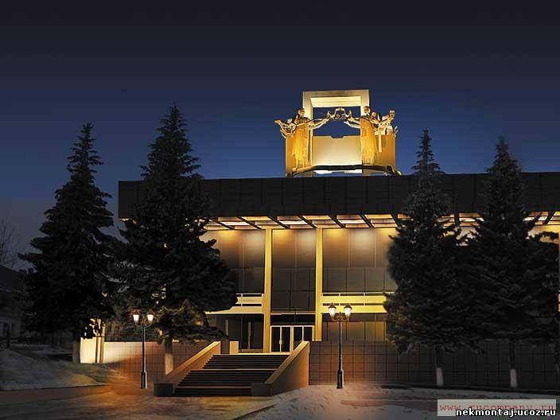
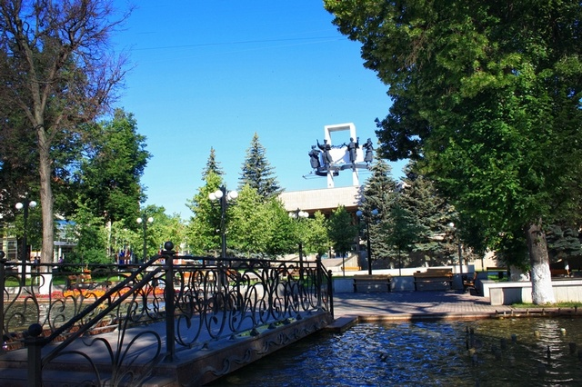

Slide 10
The Tula Kremlin — stone fortress in the center of Tula, a monument of architecture of the XVI century. It is constructed under the decree of the prince Vasily III in 1507-1520 as the southern outpost of the Moscow state. The Kremlin has 9 towers, four of them with gate: Spasskaya (with gate), Odoyevsky, Nikitsky, Ivanovo (with gate), Ivanovo (Taynitskaya), On a cellar, Water gate, Naugolnaya, Pyatnitsky (with gate). The history of the Kremlin is connected with Important soyuytiya in the history of Russia. In 1605 the bell informed inhabitants on False Dmitry I's arrival and Tula for two weeks turned into a psevdostolitsa of the Moscow state. Exactly here, to the Kremlin, came to swear on fidelity to the impostor boyars and noblemen. And in 1607 during peasant war, Ivan Bolotnikov found a shelter in the Tula Kremlin. After reunion of left-bank Ukraine with Russia in the middle of the XVII century the Kremlin absolutely loses the value and to Petrovsky time in registers of fortresses doesn't get any more.

Slide 11
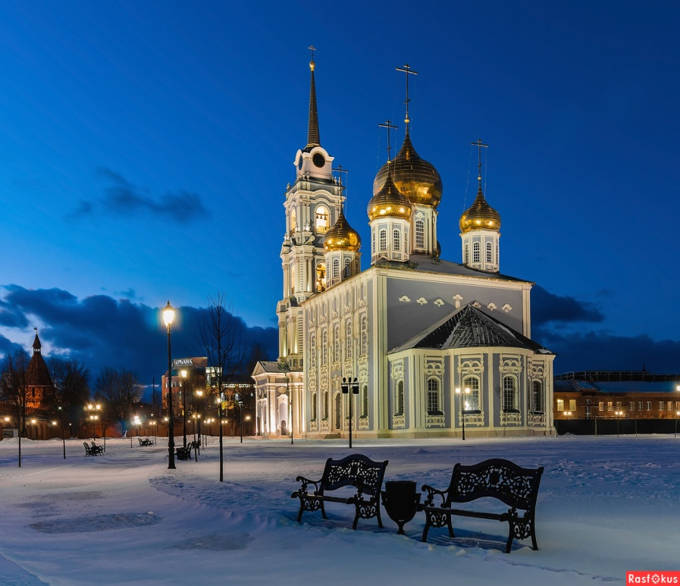
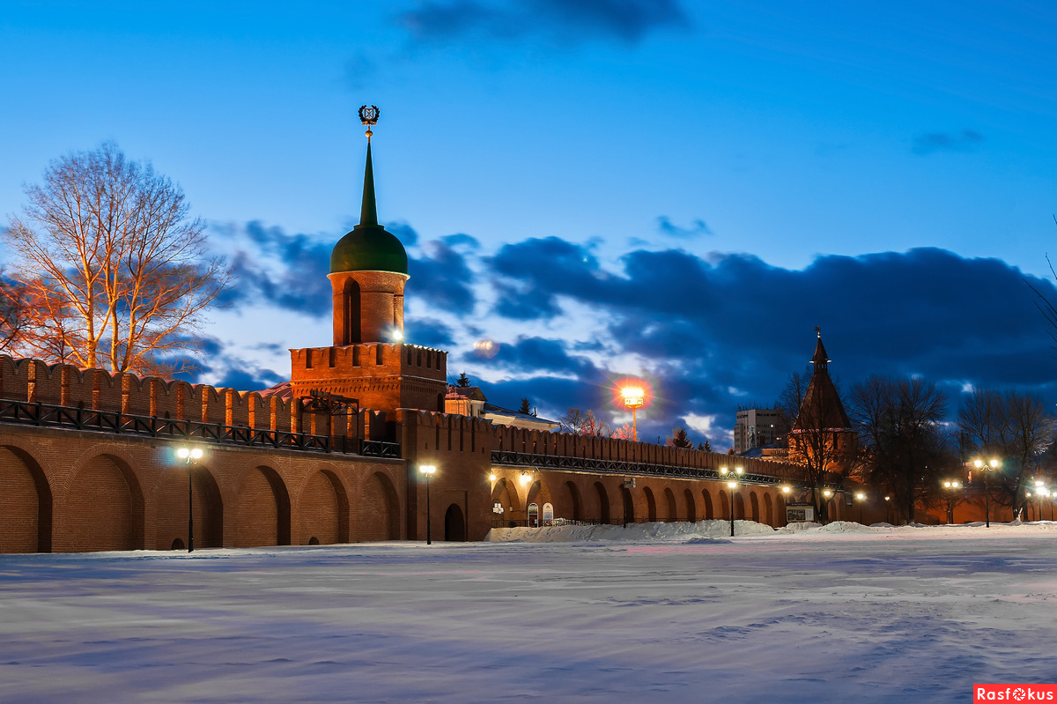

Slide 12
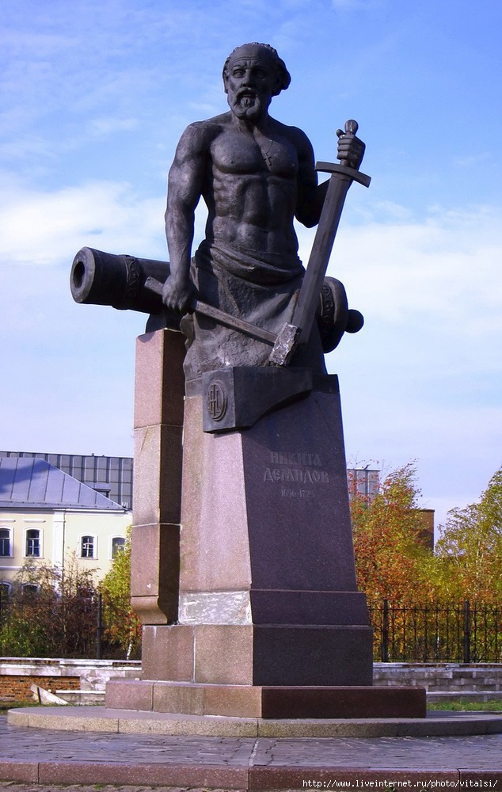
The museum complex "Demidov' Necropolis" includes showroom "Tula Metal", the introduction hall, a patrimonial tomb, a belltower, the memorial square - the former parish cemetery upon which is based to a third of armorers of the Kuznetsk settlement. A tomb of the well-known metalfactory owners, businessmen and philanthropists Demidov in the Nicolo-Zaretsky temple - the only thing the intra church burial of representatives of a sort which escaped so far. Here the first are buried legendary Demidova: Nikita Demidovich (an external necropolis), Akinfy Nikitich, his second wife - Evfimiya Paltsova, his son - Grigory Akinfiyevich with the wife Anastasia Pavlovna and others of Demidova.

Slide 13
list of literature:
http://www.komandirovka.ru/sights/tula/
https://ru.wikipedia.org/wiki/%D0%A2%D1%83%D0%BB%D0%B0

Slide 14
thank you for your attention

