Slide 1
Путешествие в волшебную страну Present Continuous.

Slide 2
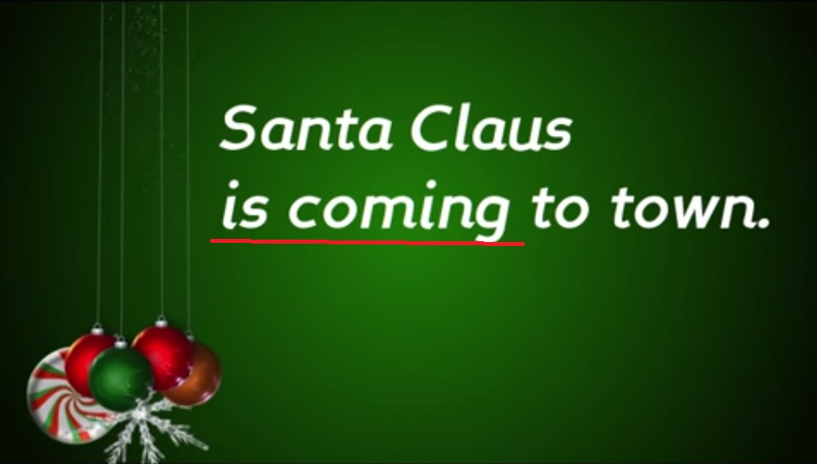

Slide 3
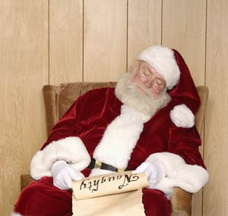

Slide 4
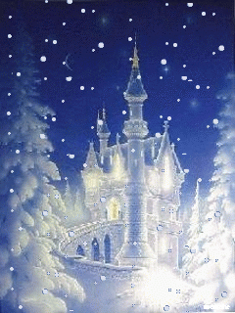
Present Continuous.

Slide 5
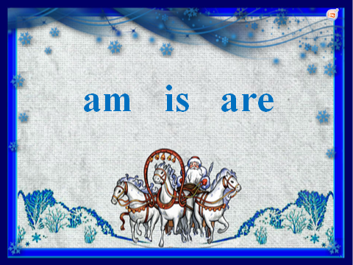

Slide 6
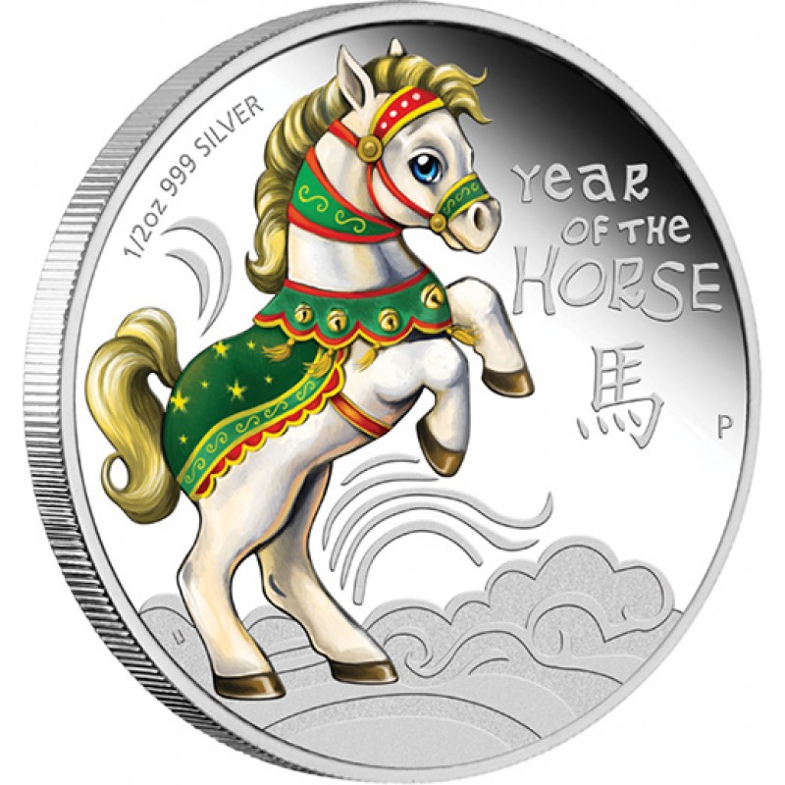
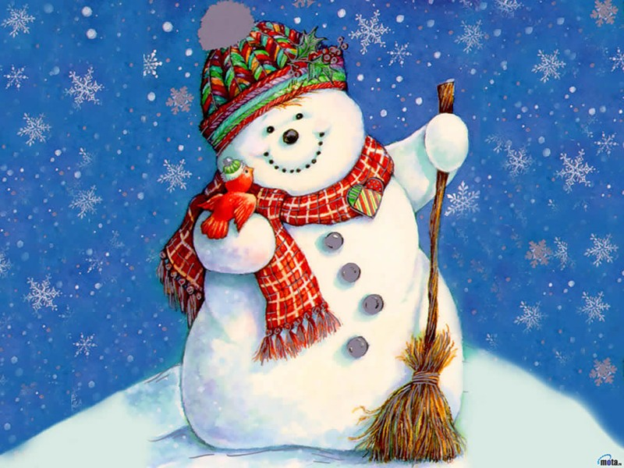
am
I

Slide 7

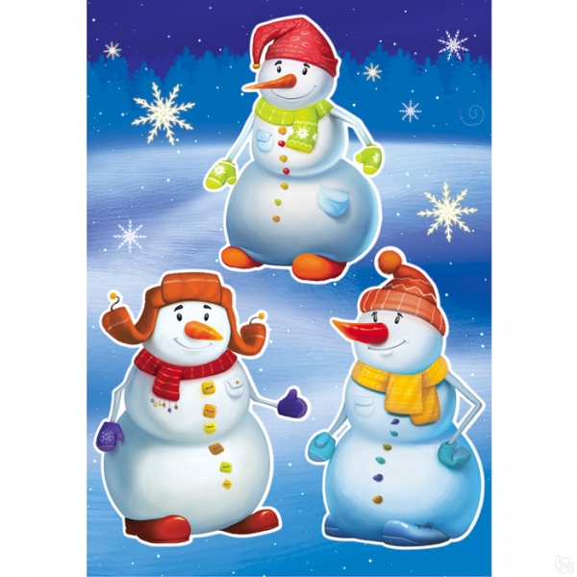
IS
It
She
HE

Slide 8
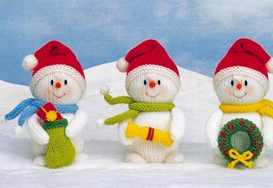
are
they
you
we

Slide 9

I am
He is
She is
It is
We are
You are
They are

Slide 10

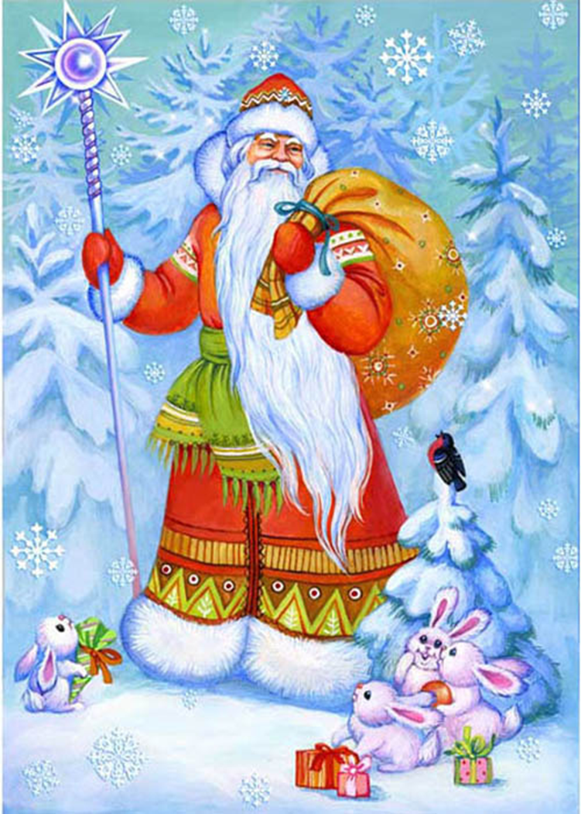
V
V

Slide 11
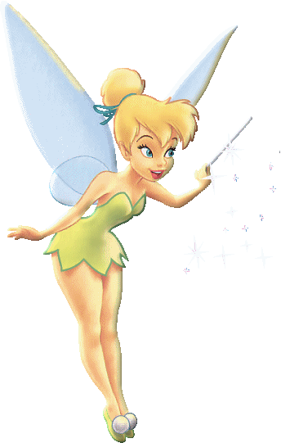
Magic words
now
at this moment

Slide 12
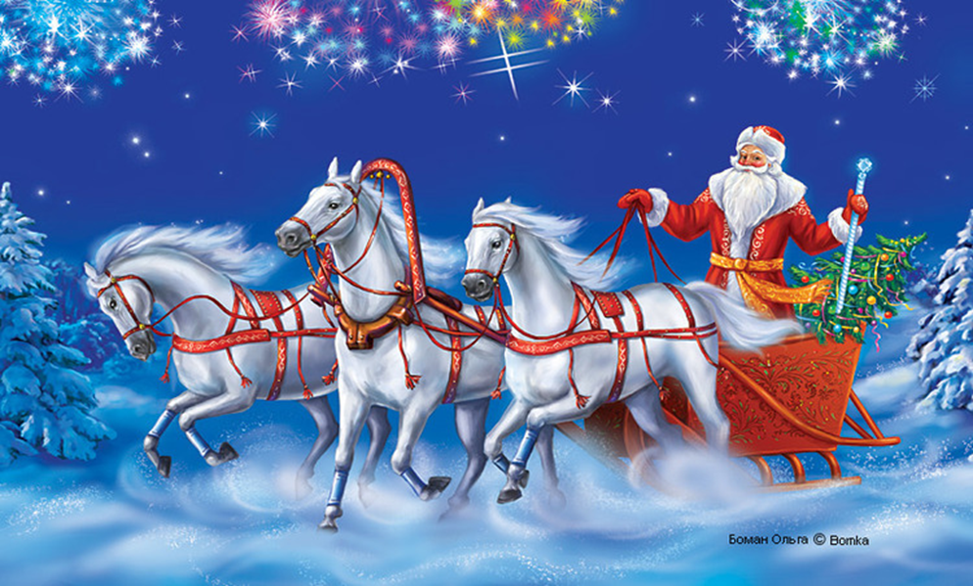
-ing, -ing, -ing

Slide 13


am
is
are
to be
V
ing

Slide 14

putting
making
flying
going
staying
swimming
running
reading
sleeping

Slide 15
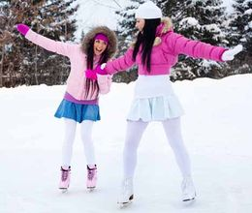
What are they doing now?
are
ing
They … skat… now!

Slide 16
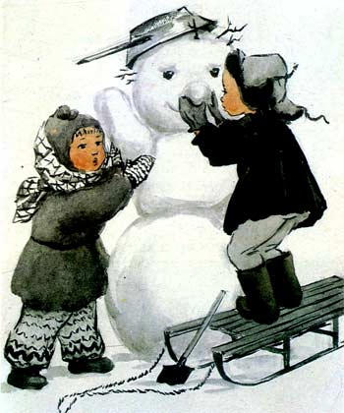
What are the children doing?
are
ing
The children …. mak… a snowman.

Slide 17
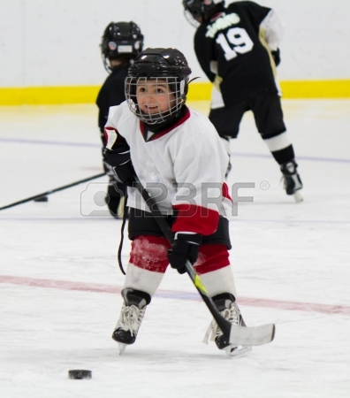
What is he doing now?
is
ing
He … play… hockey now.

Slide 18
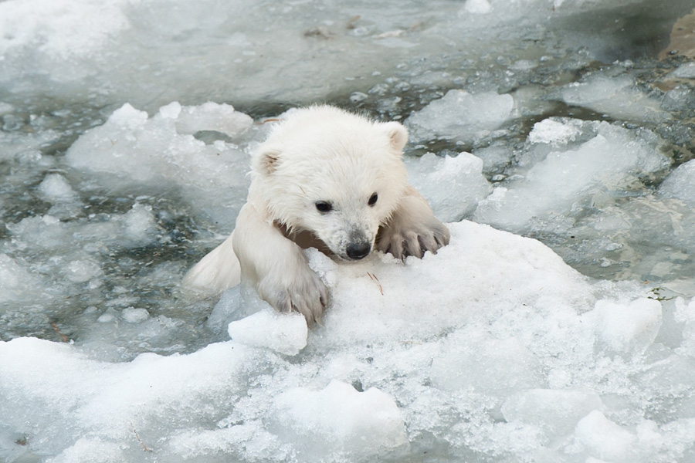
What is the bear doing now?
is
ming
The bear … swim … now.

Slide 19
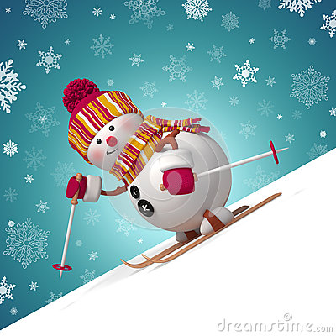
What is the snowman doing?
is
ing
A snowman … ski… at this moment.

Slide 20
Общий вопрос
I
am
singing.
Am I singing?
We
are
playing.
Are we playing?
She
is
flying.
Is she flying?

Slide 21
Специальный вопрос
Are we playing?
Where are we playing?

Slide 22
Am I singing?
When am I singing?

Slide 23
am
is
are
to be
V
ing

Slide 24
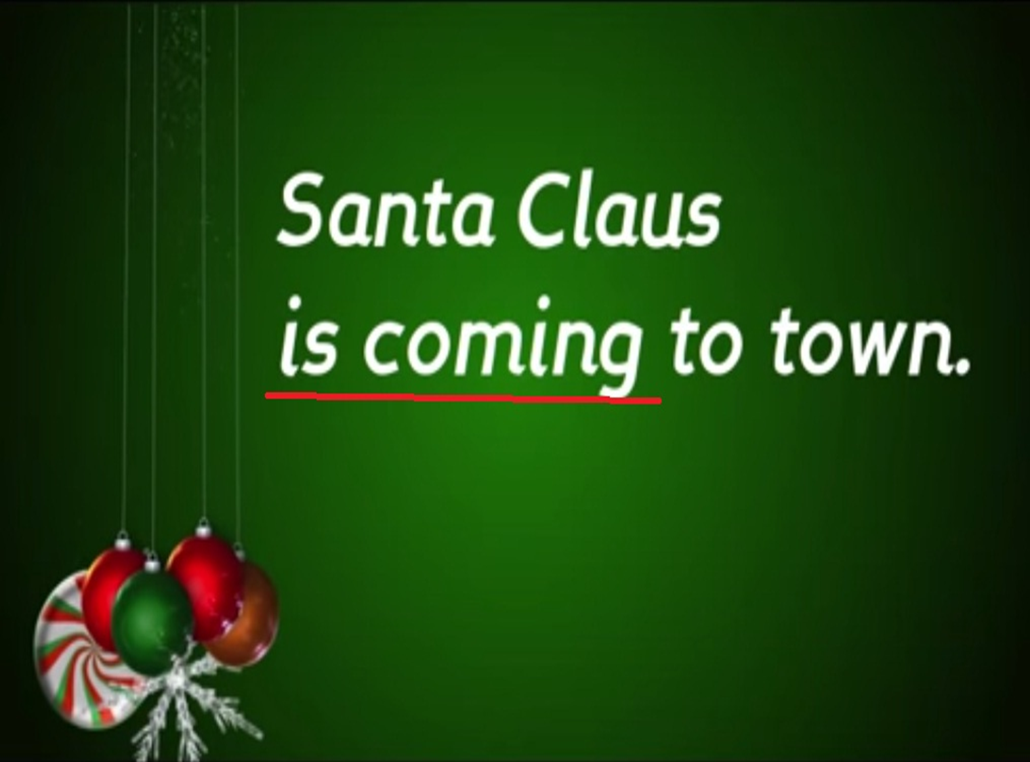

Slide 25



