Slide 1
Муниципальное бюджетное общеобразовательное учреждение СОШ с. Новый Батако
Презентация на тему
«Этот загадочный Майкл Джексон»
Работу выполнила:
Ученица 9 класса
Гочошвили Лика
Руководитель: Учитель английского языка
Кокаева А. М.

Slide 2
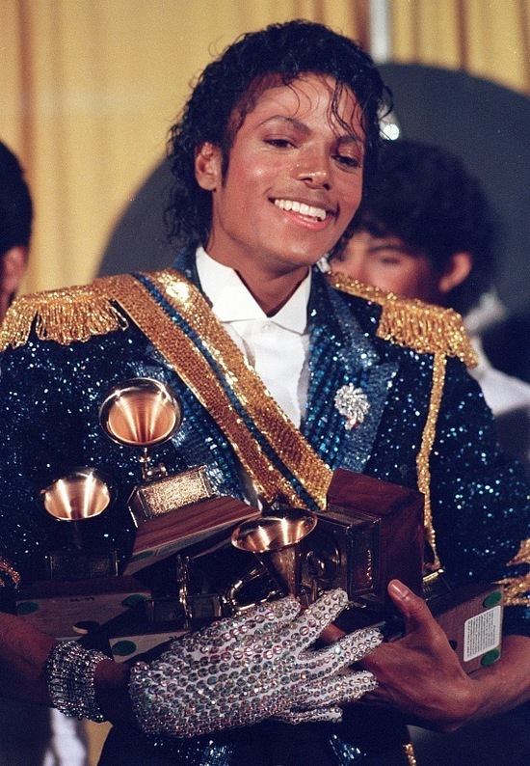
Michael Jackson is the king of pop. He did not call himself that. This title was given to him by millions of fans around the world and colleagues, among whom he had no equal. You ask, "how did he get the title?" He came to this in the old hackneyed way. He earned it! No other artist in the history of music has made such huge sales like him.

Slide 3
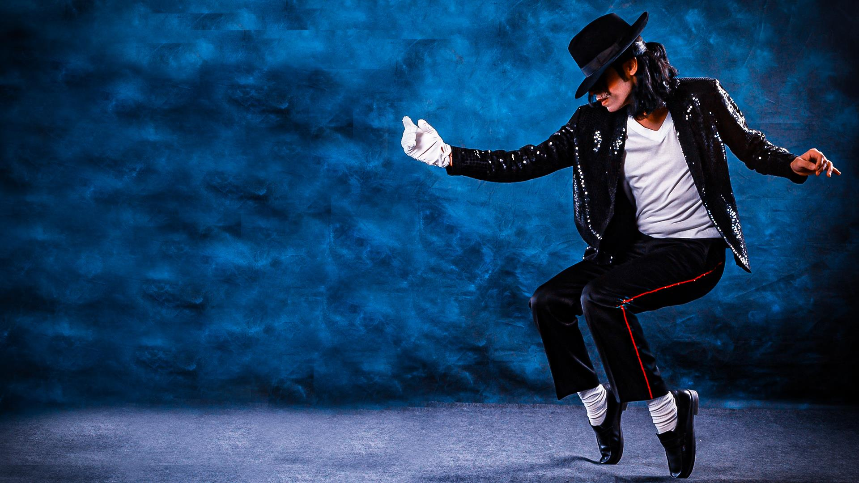
No performer in history has received as many awards and accolades as Michael Jackson.
No performer in history has attracted as much attention or created such mass hysteria as he did.
No other performer in history has done as much for charity as he has. There was no such thing before, it will not be later. He is one of a kind.

Slide 4
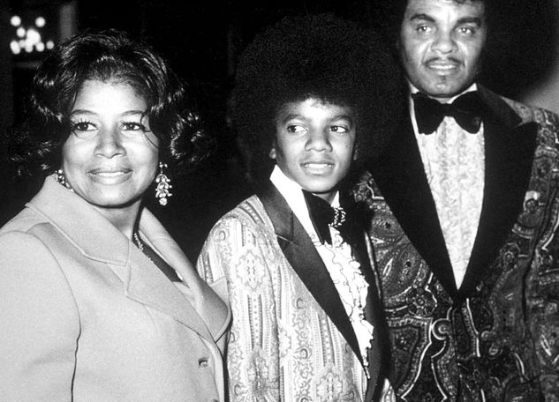
The boy, later recognized as the king of pop music, was born in the town of Gary, Indiana. The father of the family was a bluesman, played the guitar, and my mother, half Indian, half mulatto, a native of the countryside, was obsessed with country music.

Slide 5
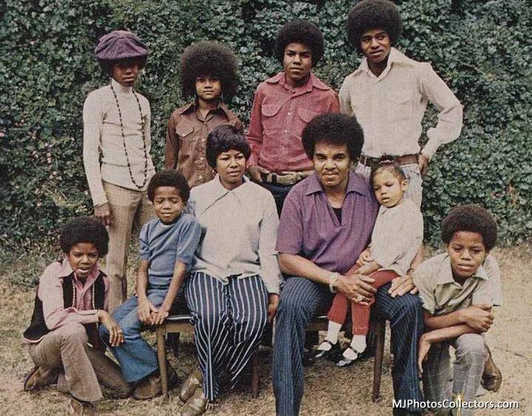
When Michael was born in 1958, there were already seven children in the Jackson family (there were 9 children in total). Joseph's approach to raising children was strict and harsh: he humiliated his children both mentally and physically.

Slide 6
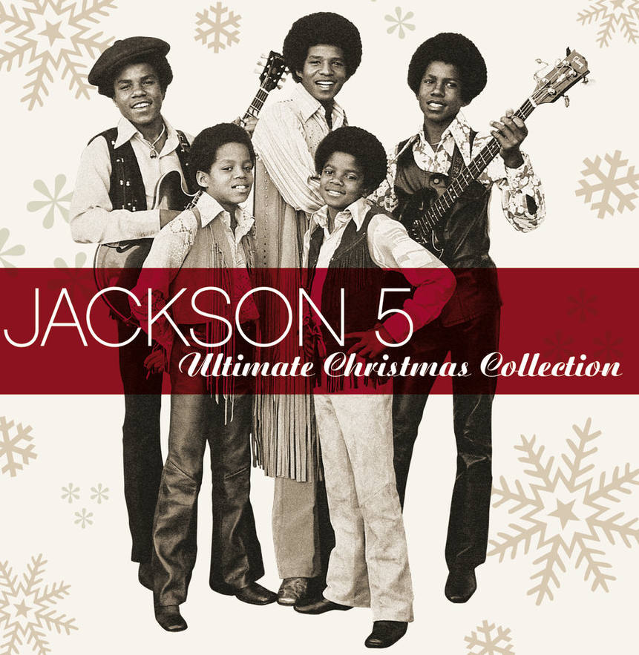
Michael and his older brothers were in the spotlight when their father, Joseph Jackson, in 1966. created a group of sons. He named them "The Jackson 5"

Slide 7
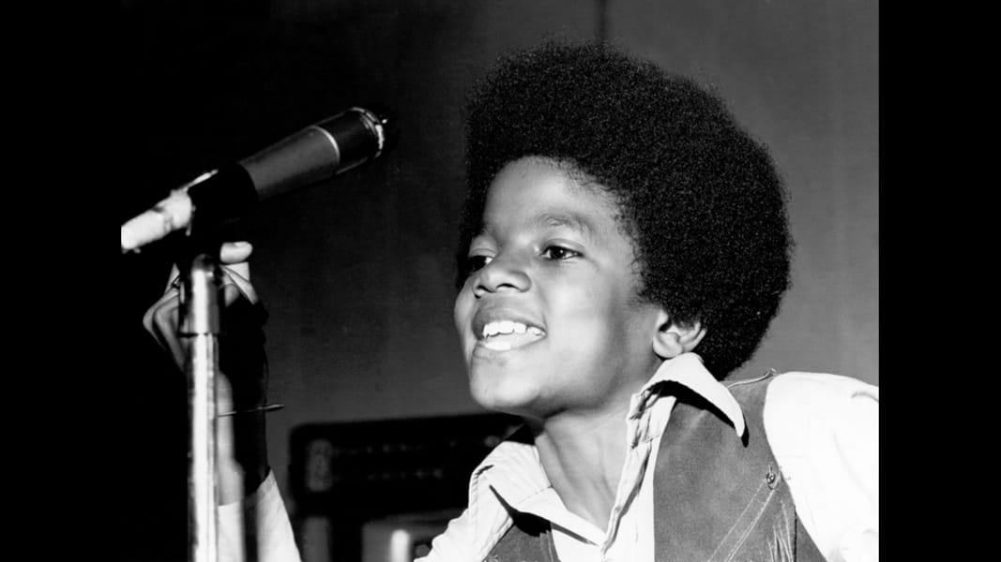
Despite the fact that Michael was the youngest (he has been performing on stage since the age of 5), it immediately became clear that there was something special about him. Armed with a magical voice, mature beyond his years, he captivated the crowd with a charm that rivaled any entertainer.

Slide 8
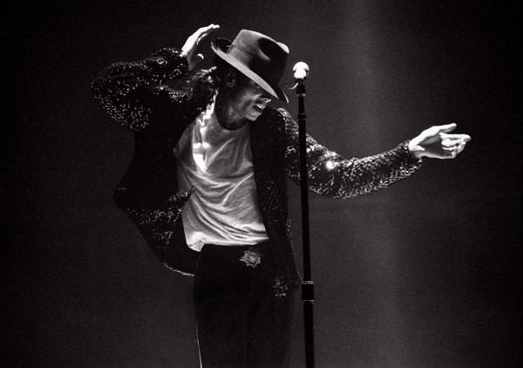
Little Michael and his brothers go from winning local competitions to a contract with Motown Records in the late 60s. The group began releasing hits one by one for their new recording studio and remained at their peak throughout the 70s. At the same time, in parallel to work in a group with the brothers, in 1972 at the age of 14, Michael began to record quite successful solo projects.

Slide 9
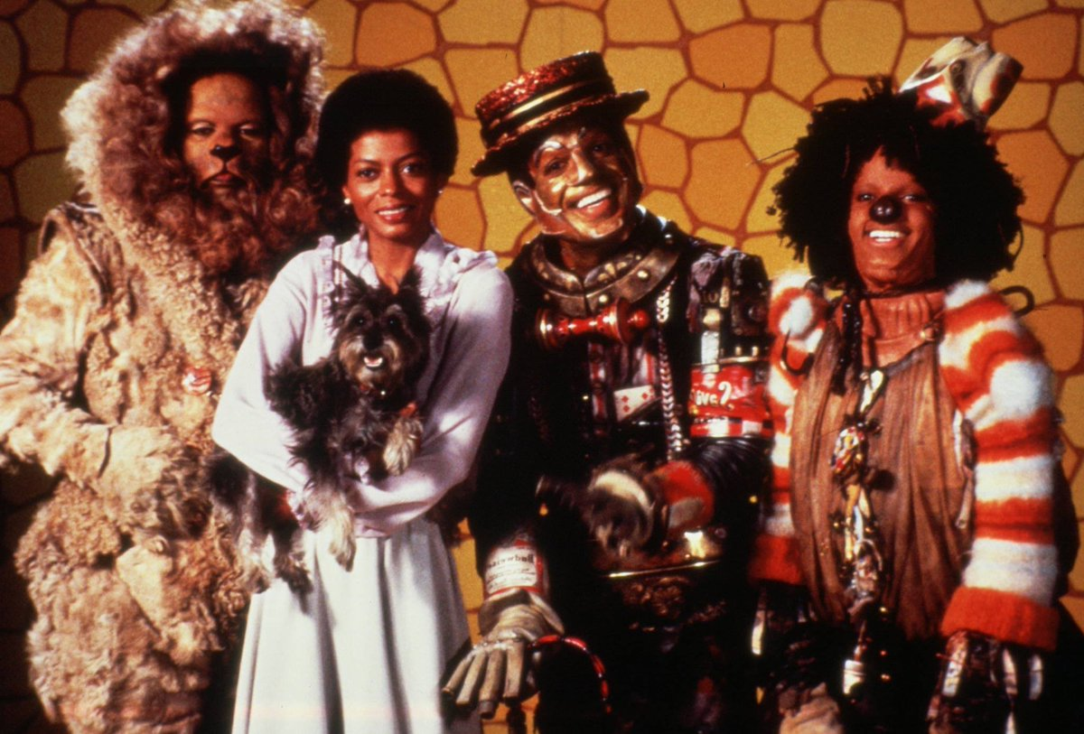
In 1978, Michael Jackson made his first film appearance as the Scarecrow in The Wizard, an adaptation of The Wizard of Oz with black actors in all roles.

Slide 10
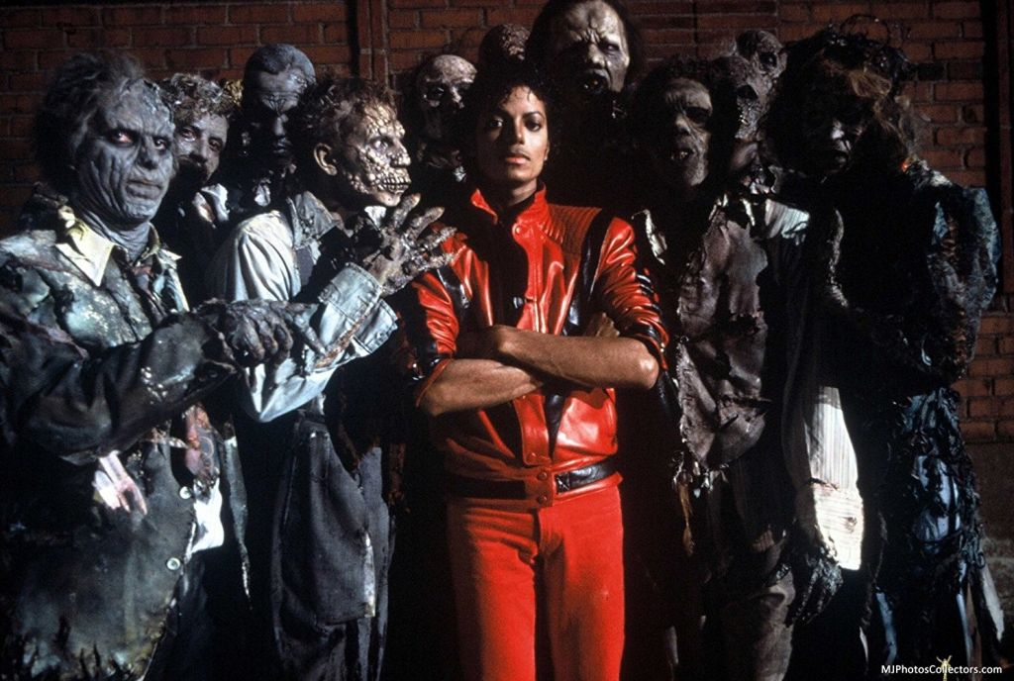
This work marked the beginning of a creative and commercial collaboration with Quincy Jones. Among their shared creations, Thriller is prominent and has had a tremendous impact on the music video industry.

Slide 11
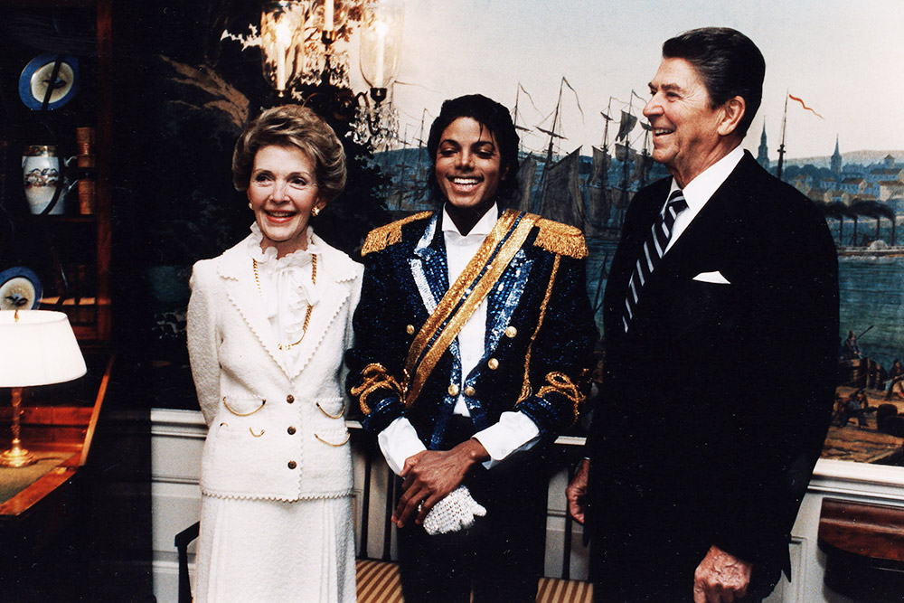
The success of this work helped Jackson negotiate what is believed to be the highest record royalties in history. And the musician was invited to the White House to meet with Ronald Reagan, the President of the United States.

Slide 12
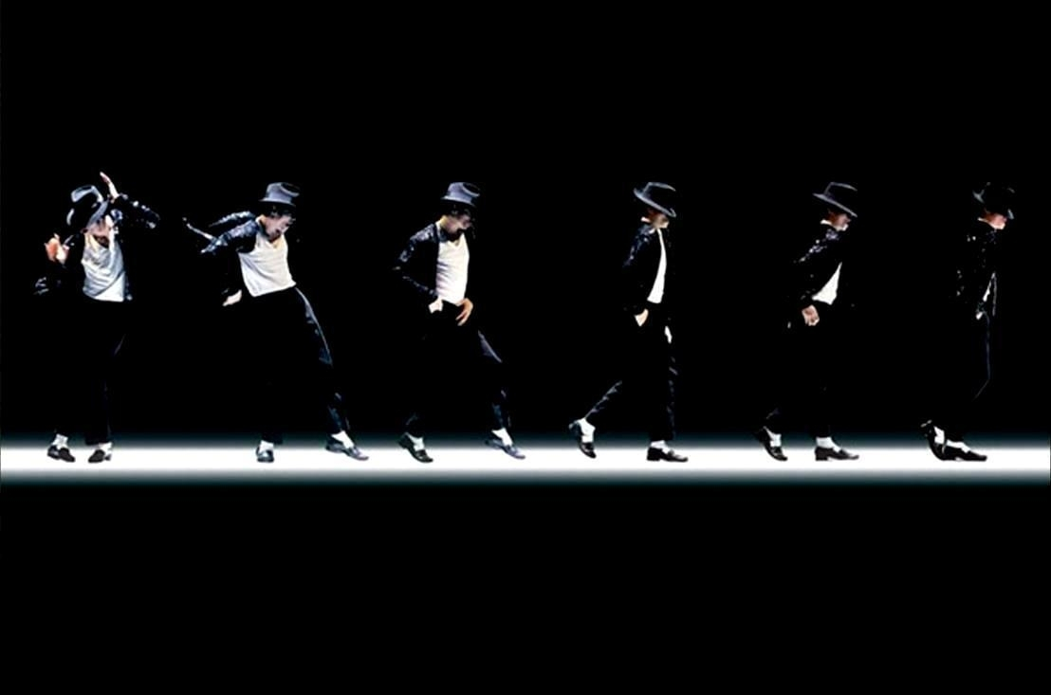
In 1983, on the 25th anniversary of Motown Records, Michael Jackson first introduced his famous moonwalker during a performance of "Billie Jean".

Slide 13
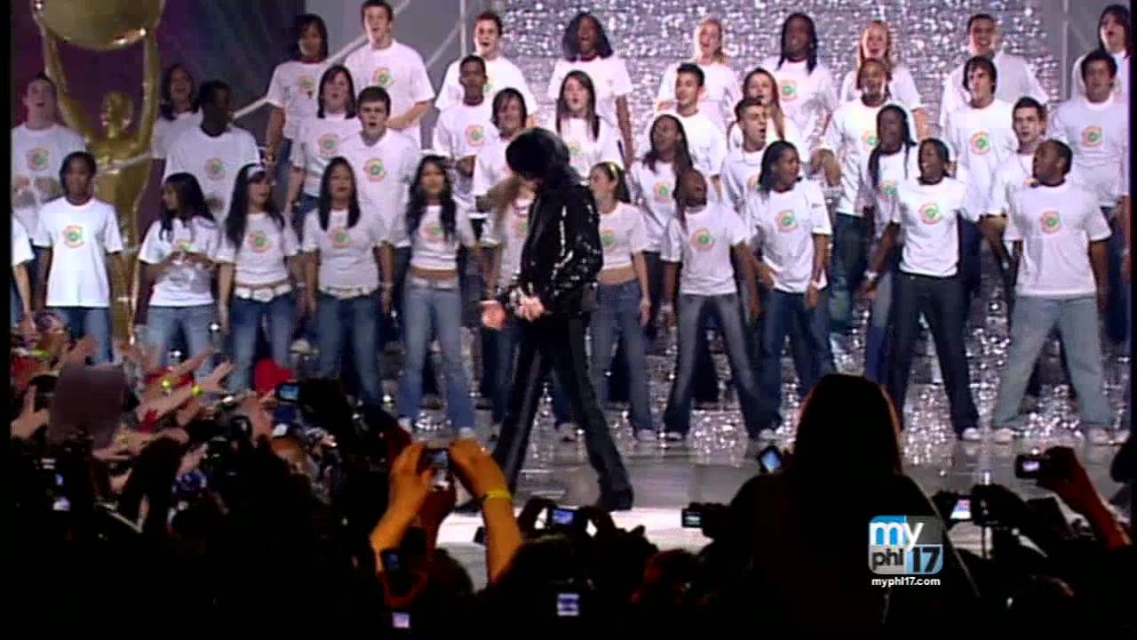
In March 1985, Michael Jackson and Lionel Richie recorded We Are the World. All fees exceeding $ 61 million were donated to help starving children in Africa.

Slide 14
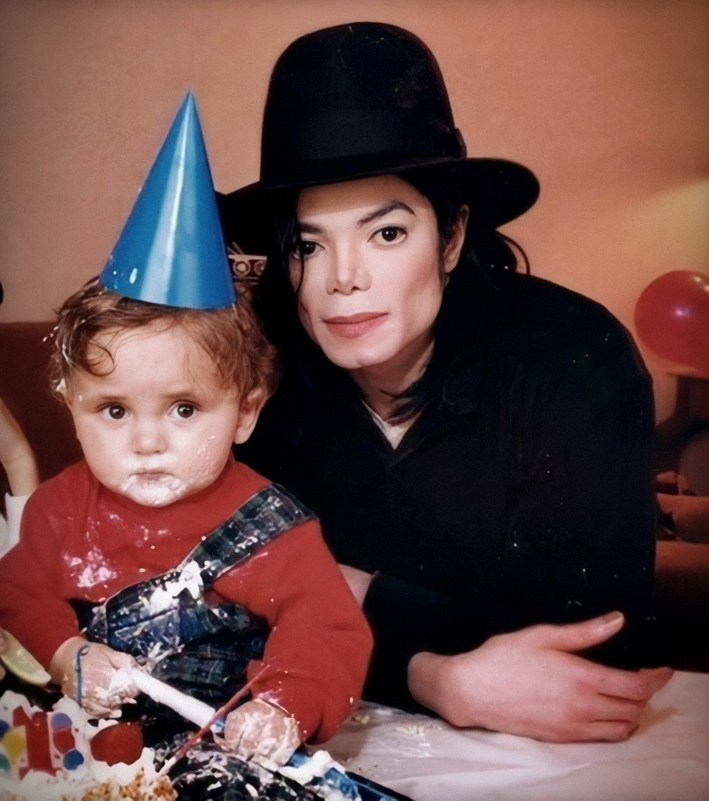
In addition to an unprecedentedly successful career in music, Michael Jackson has supported 39 charities, which he helped.

Slide 15
During his life, the King of Pop has starred in numerous promotional videos. But one of them drastically changed his life. In late January 1984, another Pepsi commercial was filmed in California, using pyrotechnic special effects. An accident occurred during the shooting. The fireworks exploded earlier than planned.
The burn and the stress suffered provoked the development of "vitiligo" - a disease transmitted to Michael through the maternal line and disrupting the pigmentation of the skin.
After that, he decided to send an impressive material compensation from the company to the creation of the Children's Burn Center.

Slide 17
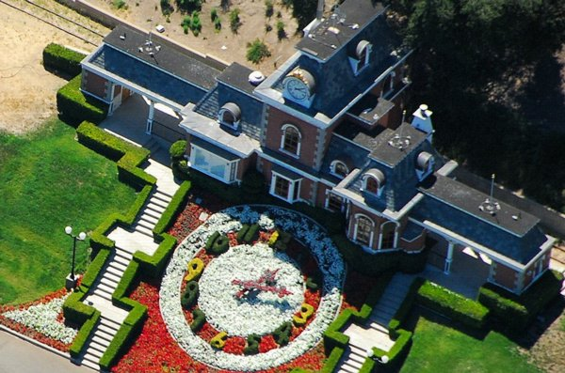
In 1988, Jackson bought land about 5 times the size of the Principality of Monaco and created a ranch on it, which he named after Peter Pen's country - "Neverland".

Slide 18
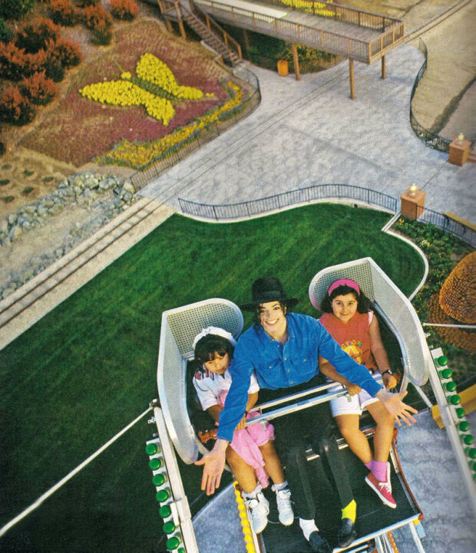
“When I created Neverland, I created the world the way I would like to see it. I wanted it to be a place where sick children, sick and disadvantaged, from all over the world could be brought ... A shelter for them, where they could feel safe and escape reality. Or children who have never seen such things in the central areas of the city, so that they can get some fresh air, see the mountains and all that. " - Michael Jackson.

Slide 19
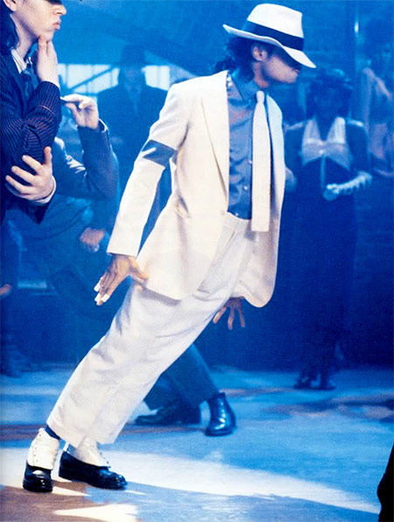
Michael Jackson is known for his innovative and unusual dance style. The king of pop continually wowed fans with new moves, from the break-dance-like moonwalk to confusing quick step combinations. But in 1987, the artist demonstrated in the music video "Smooth Criminal" something that seemed absolutely impossible: he leaned his whole body 45 degrees forward, while his body was straightened and fixed and held on the ground only by his feet.

Slide 20
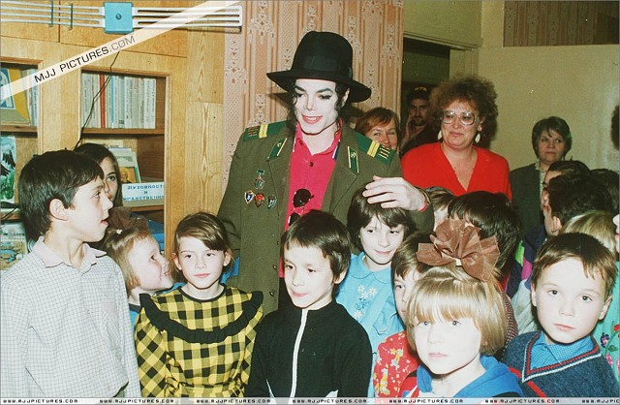
In September 1993, Jackson visited Russia for the first time. He arrived 3 days before the concert and took a luxury apartment in the Metropol. Instead of a press conference, the singer went to an orphanage.

Slide 22
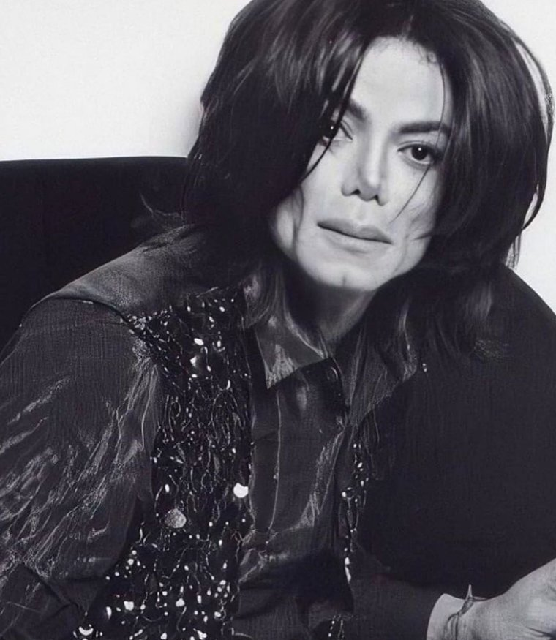
In March 2009 Michael announced that he was going to play the last series of concerts in London called “This Is It Tour”. The concerts were scheduled to begin on July 13, 2009 and end on March 6, 2010.

Slide 23
The tour announcement caused a lot of excitement among fans, especially considering that this would be Michael's first return to the stage after years of silence. In the first 5 hours, more than 750,000 tickets were sold. Jackson suffered from health problems throughout the 12 months before his death. In addition to insomnia, he tried to cope with constant disorientation and stress. He was so sleep deprived that he had to rely on prescription drugs like propofol.
Michael had been using propofol for 60 days, which means that for 2 months he did not fall asleep on his own at all. Dr. Charles Sizler believes that it was not only insomnia, but the drug also worsened the general condition of the star.

Slide 24
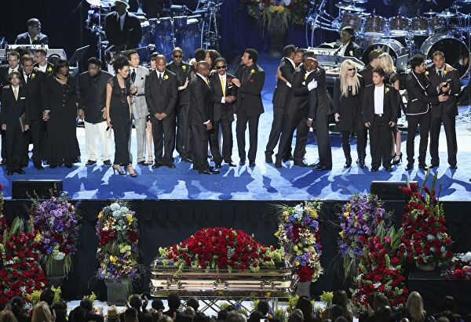
On June 25, Michael Jackson's heart stopped.

Slide 25
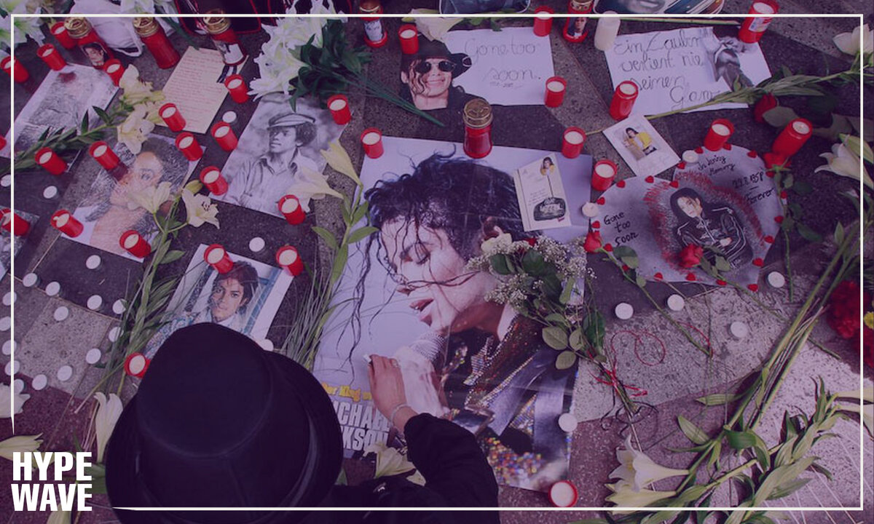
Millions of people around the world reacted to the death of the king of pop.

Slide 26
Michael wanted to help people see the problems that are destroying our world. This was his purpose, and this was the purpose of his planned shows. He tried to teach through the words of his songs, videos and performances. He wanted to use every part of himself to show us who we can become. His task was to demonstrate to people that if we all just try to make the world a better place, it will definitely come true.

Slide 27
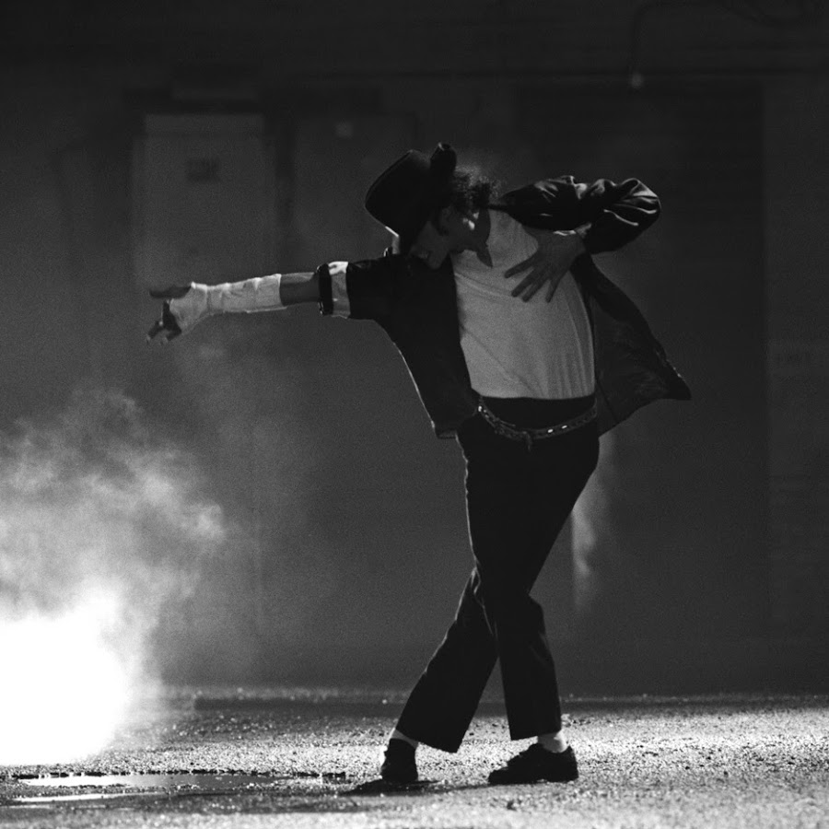

Slide 28
THANK YOU FOR YOUR ATTENTION!

