Slide 1
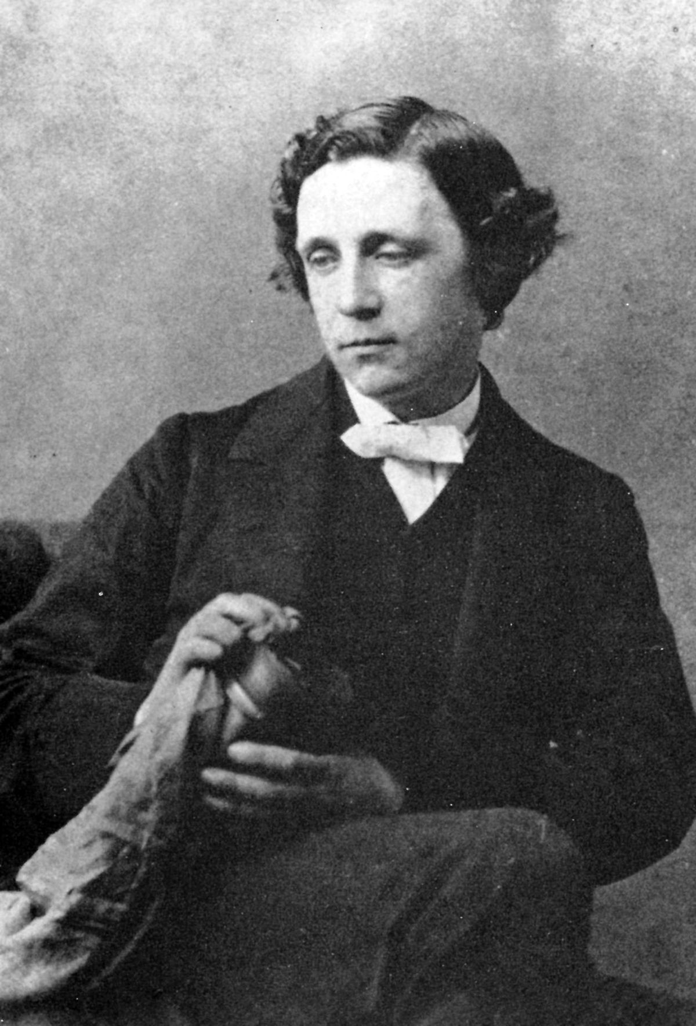
Lewis Carroll
a famous writer

Slide 2
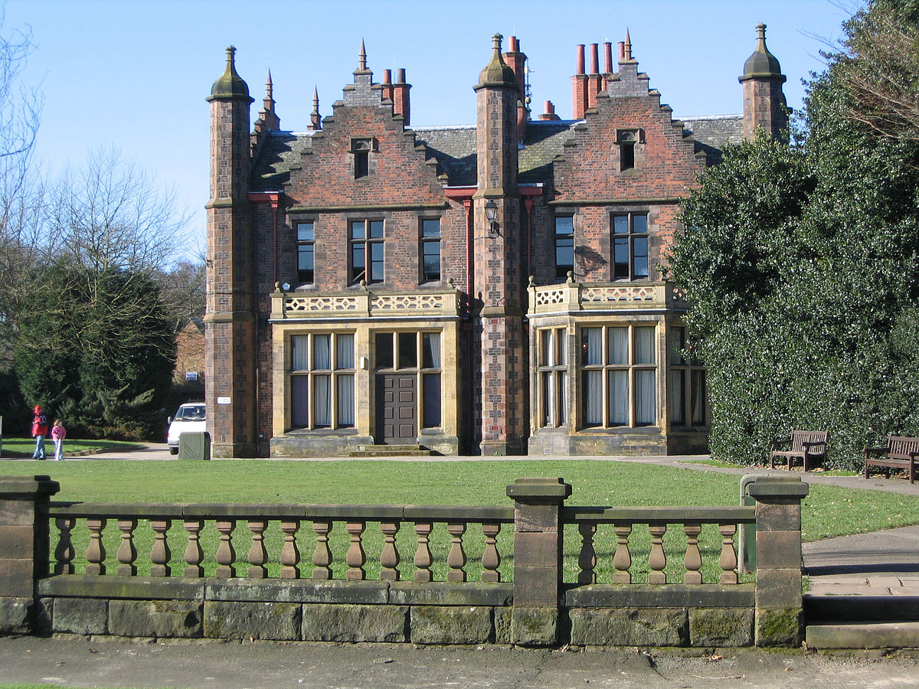
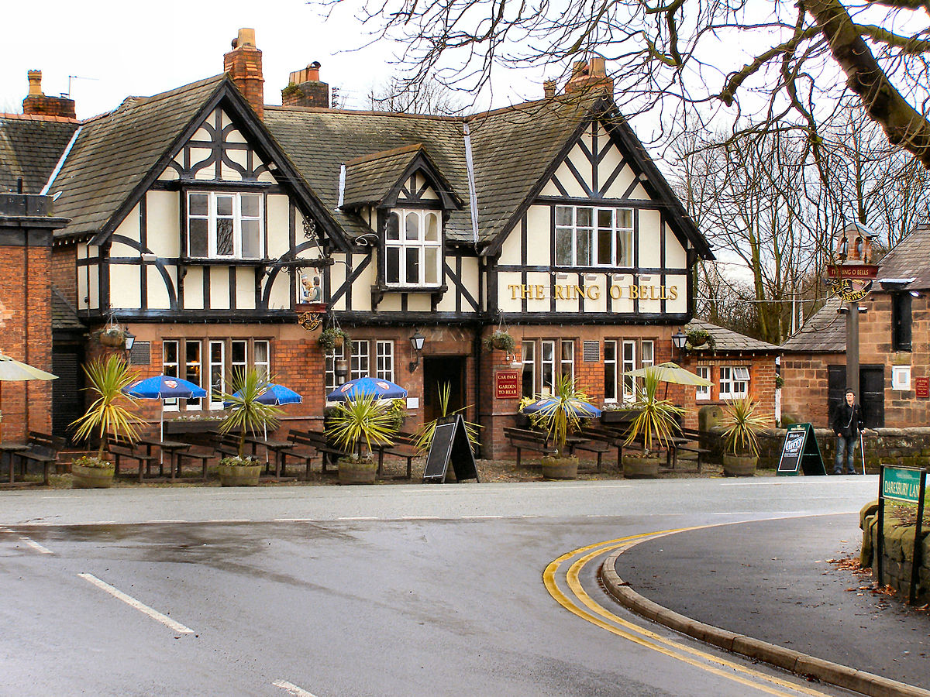
Where Lewis Carroll was born
Lewis Carroll was a writer and mathematician . His real name was Charles Lutwidge Dodgson. He was born on 27of January in 1832 in a small English village .

Slide 3
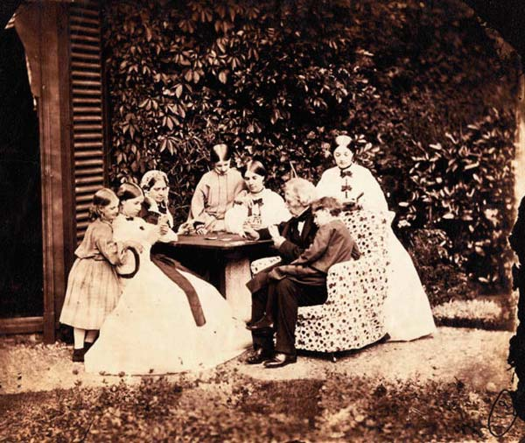
Family
His dad was a priest and Charles (Lewis) had ten brothers and sisters.
When Charles was a child, he was fond of literature. He had his own puppet theater and created plays for it. Lewis was very clever and talented. He also wrote the poems and made newspapers and
magazines for his brothers and sisters. He thought up the puzzles, riddles and some other things to entertain them.

Slide 4
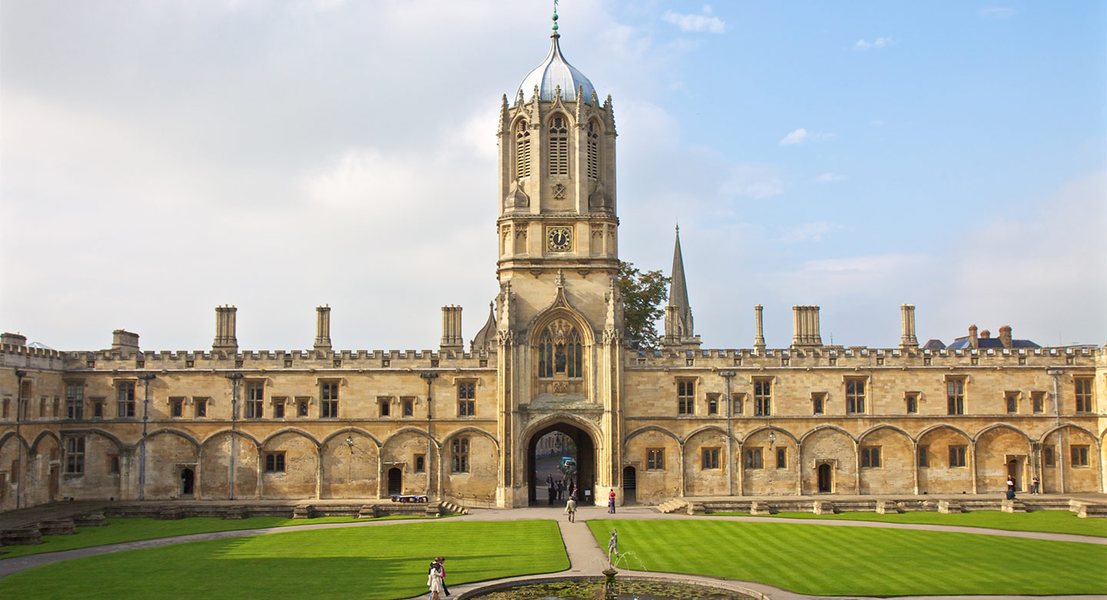
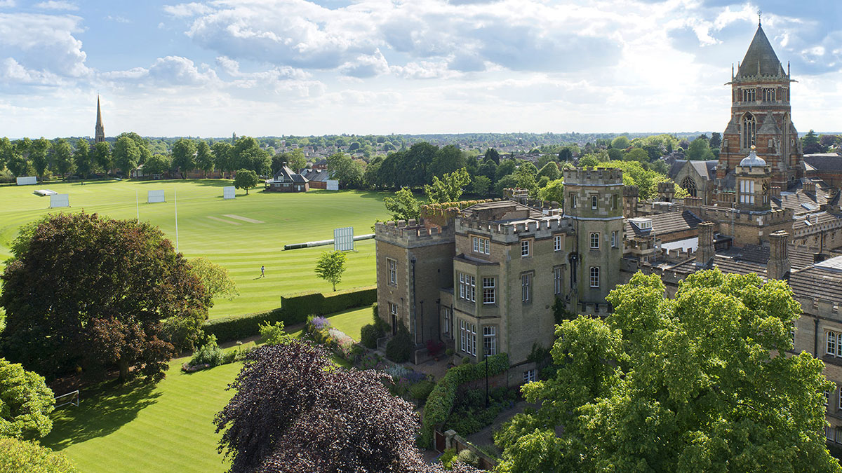
Education and job
He studied in Rugby School and then he got education in Christ
Church College in Oxford. He taught mathematics there after his
graduation.

Slide 5
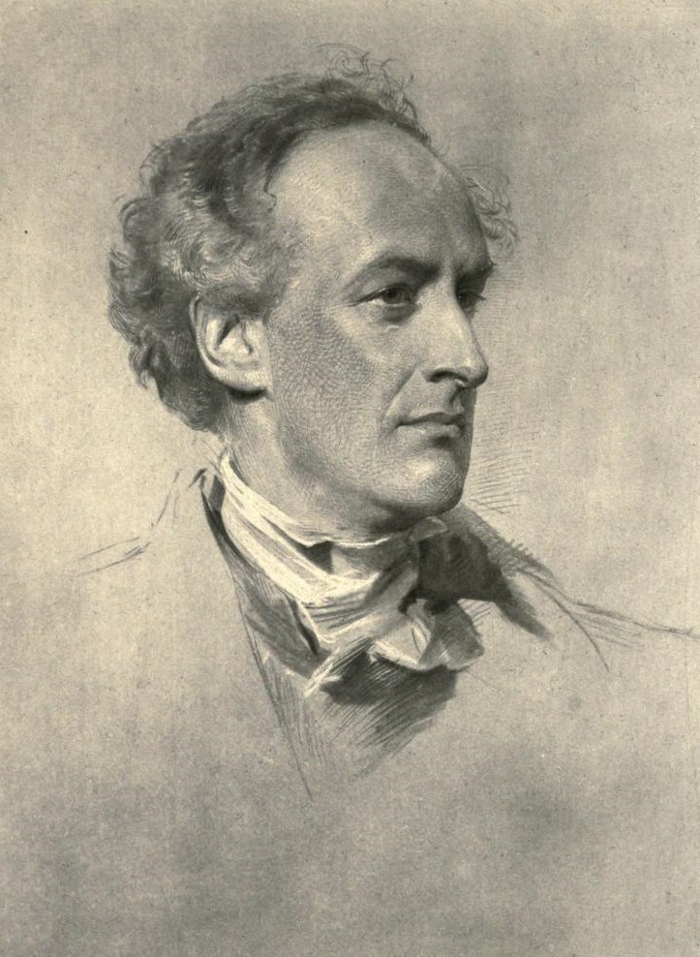
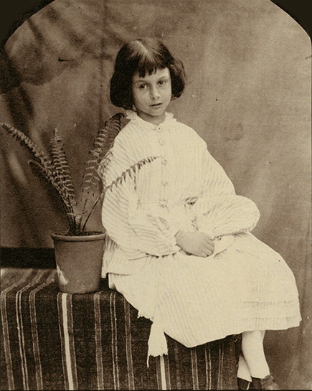
Friends
Lewis had a friendship with a family of Henry George Liddell . Henry had a wonderful daughter Alice. Lewis thought up and told the fairy tales about her adventures.

Slide 6
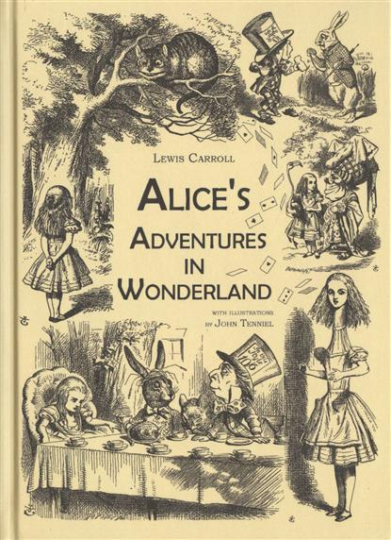
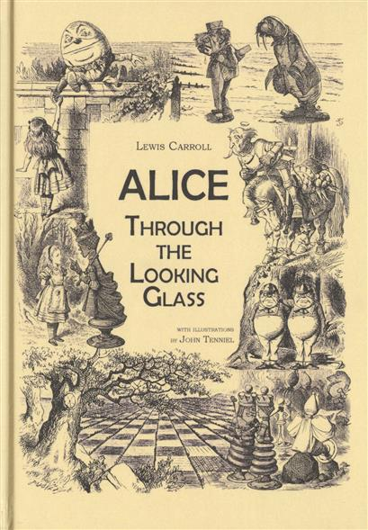
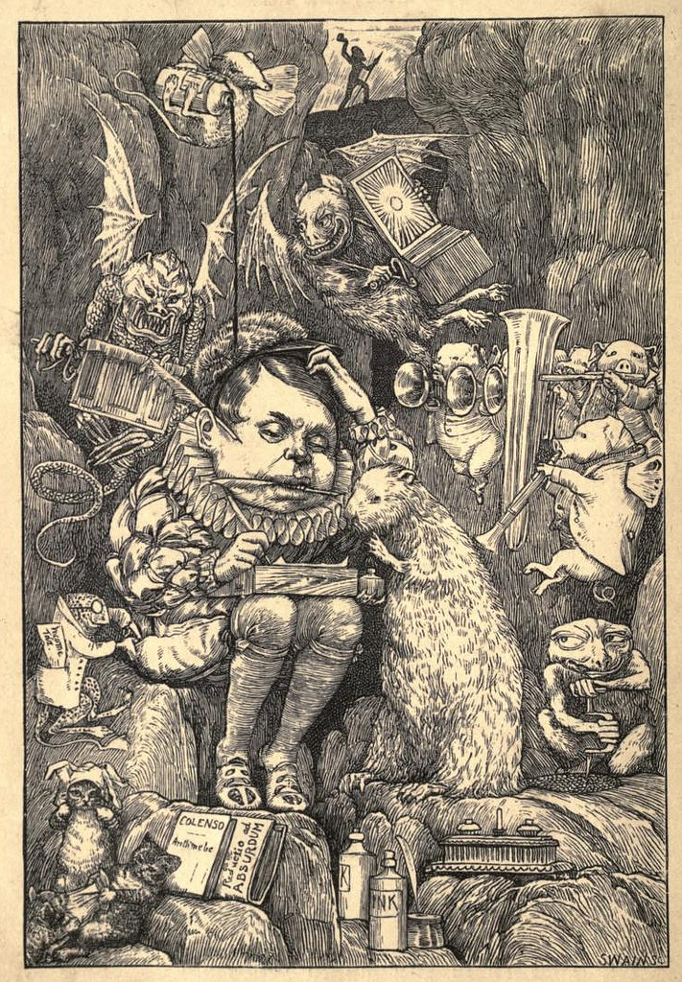
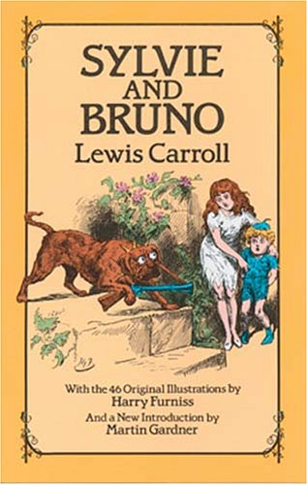
Creations
Then he wrote two books : “Alice’s Adventures in Wonderland” and “Alice Through the Looking Glass”.
Later he wrote humorous story “The Hunting of the Snark” .
Did you red his stories for children about Sylvie and Bruno?

Slide 7
Finish of life
Lewis Carroll died on 14 January in 1898 at his sister’s home.

Slide 8
Thanks for your attention

