Slide 2
th [θ]
thanks
[θæŋks]

Slide 3
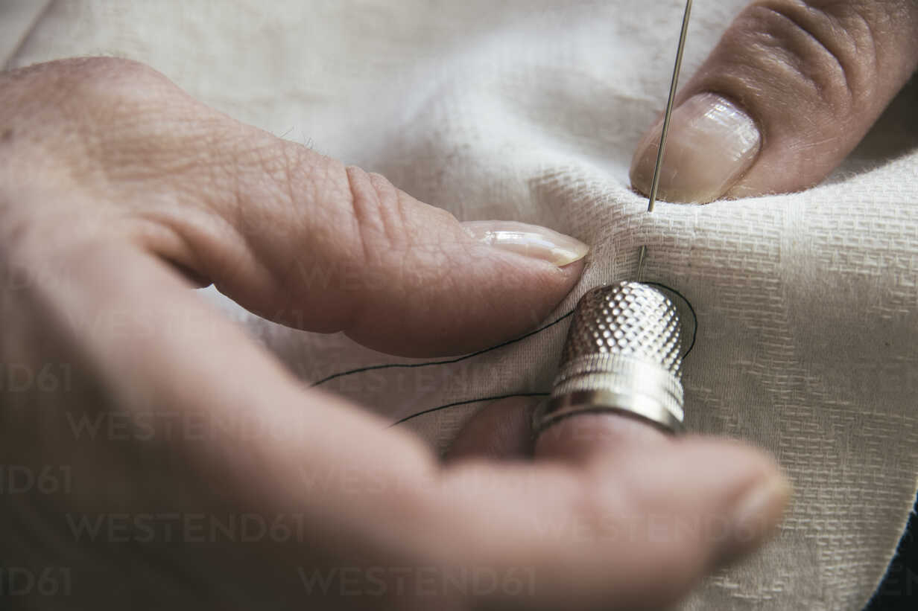
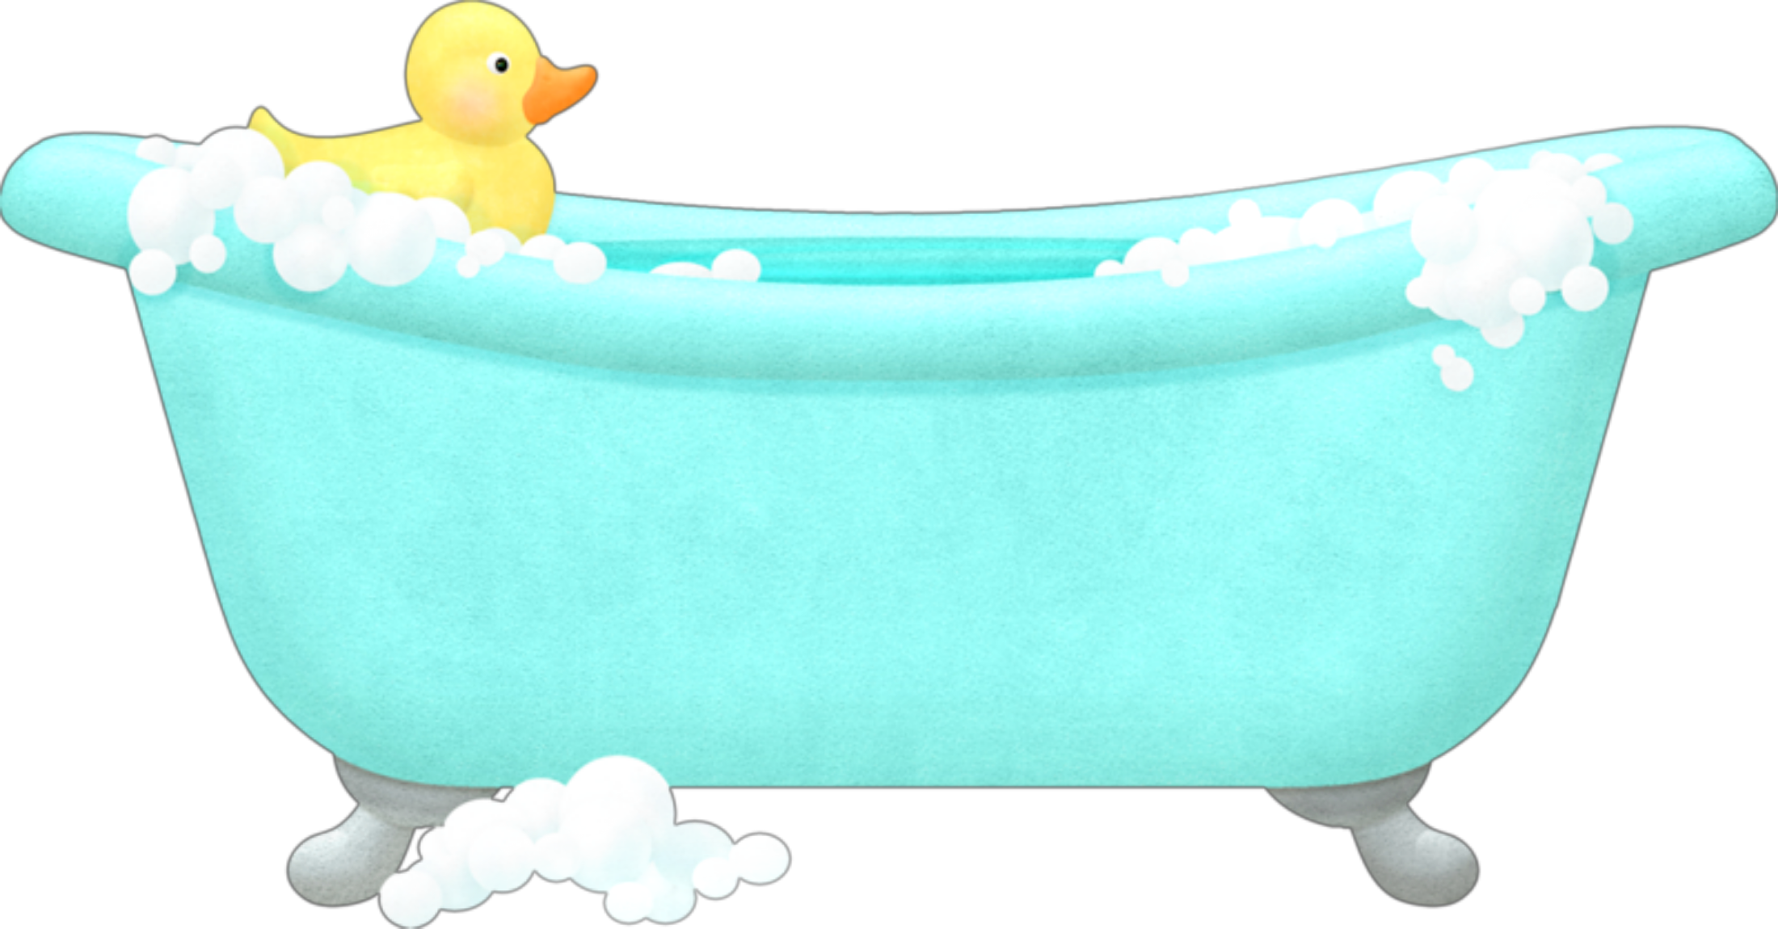
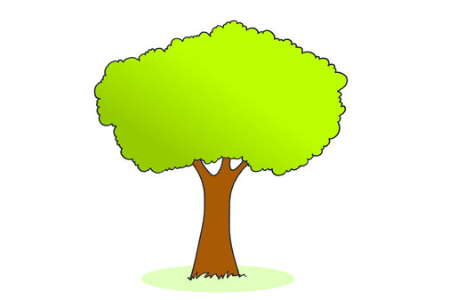
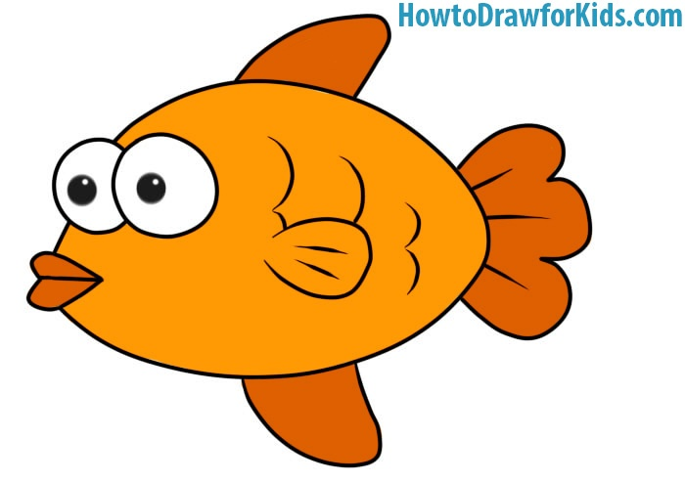
Clap you hands when you hear the sound [θ].
Thumb
Thimble
Bath
Flag
Tree
Fish

Slide 4
Listen and repeat.
a thousand thanks
əˈθaʊznd θæŋks

Slide 5
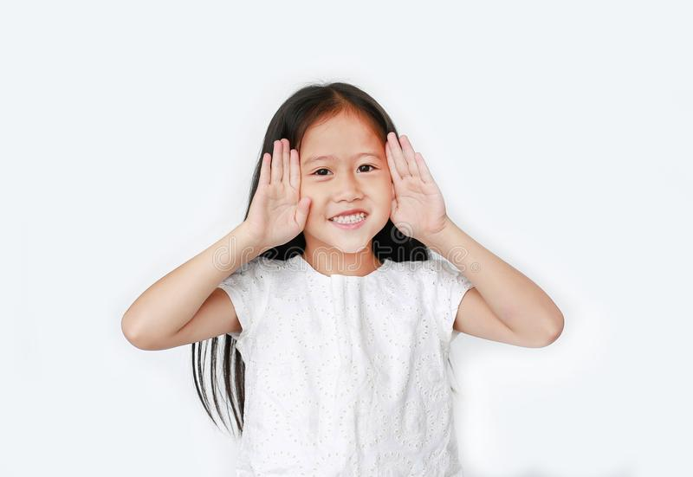
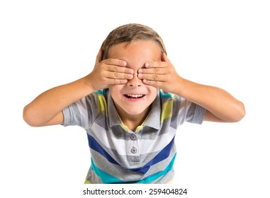
garden
house
kitchen
bedroom

Slide 6
garden
house
kitchen
bedroom

Slide 7
garden
kitchen
bedroom

Slide 8
garden
house
kitchen
bedroom

Slide 9
garden
house
kitchen
bedroom

Slide 10
garden
house
kitchen

Slide 11
garden
house
kitchen
bedroom

Slide 12
garden
house
kitchen
bedroom

Slide 13
house
kitchen
bedroom

Slide 14
garden
house
kitchen
bedroom

Slide 15
garden
house
kitchen
bedroom

Slide 16
garden
house
bedroom

Slide 17
garden
house
kitchen
bedroom

Slide 18
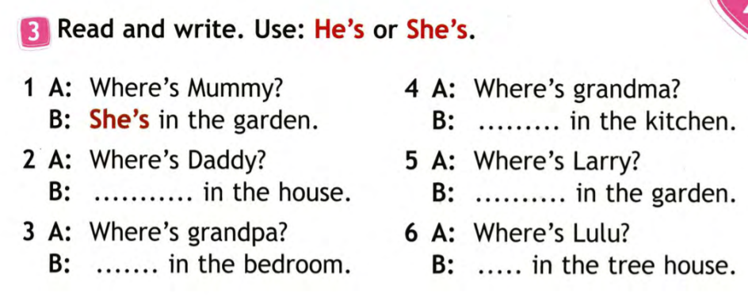

Slide 19
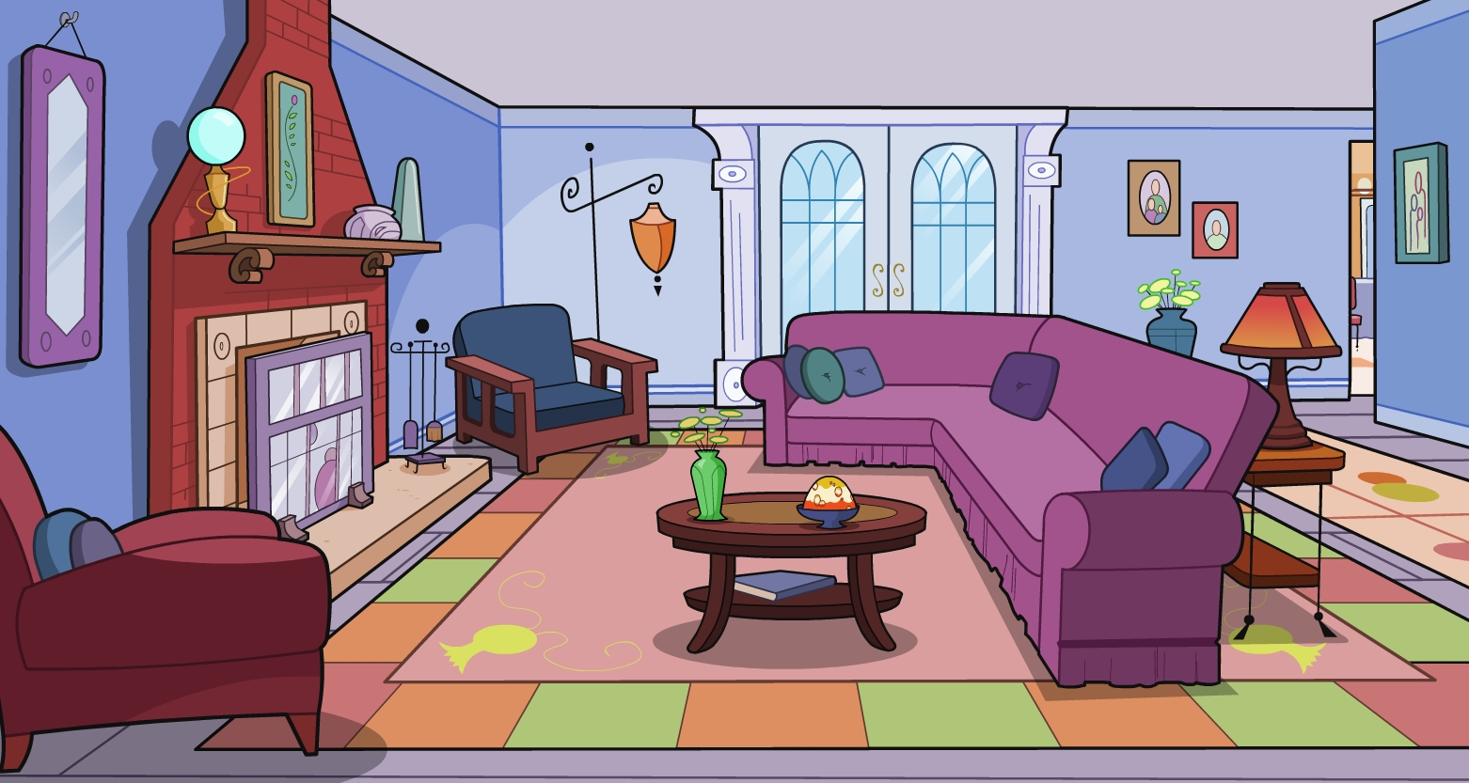
living room
[ˈlɪvɪŋ ruːm]
гостиная

Slide 20
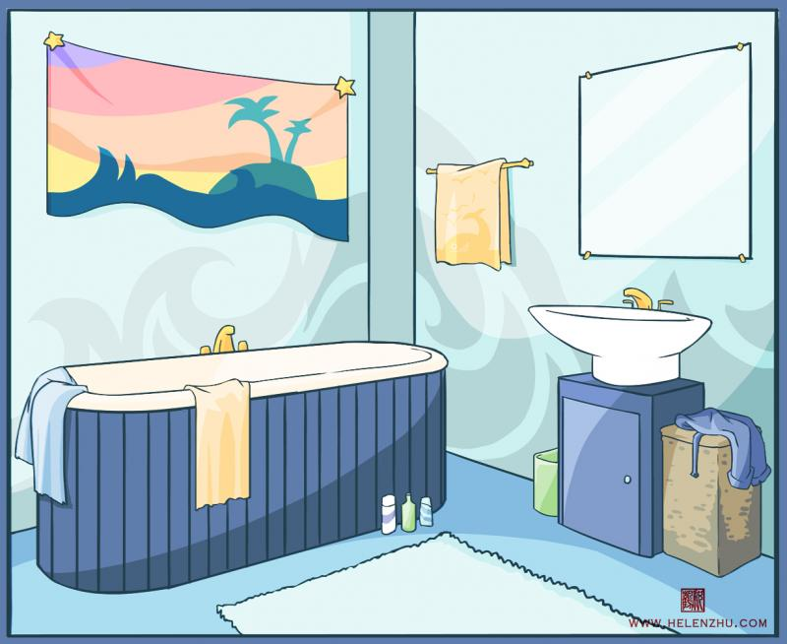
bathroom
[ˈbɑːθruːm]
ванная комната

Slide 21
bath
[bɑːθ]
ванна

Slide 22
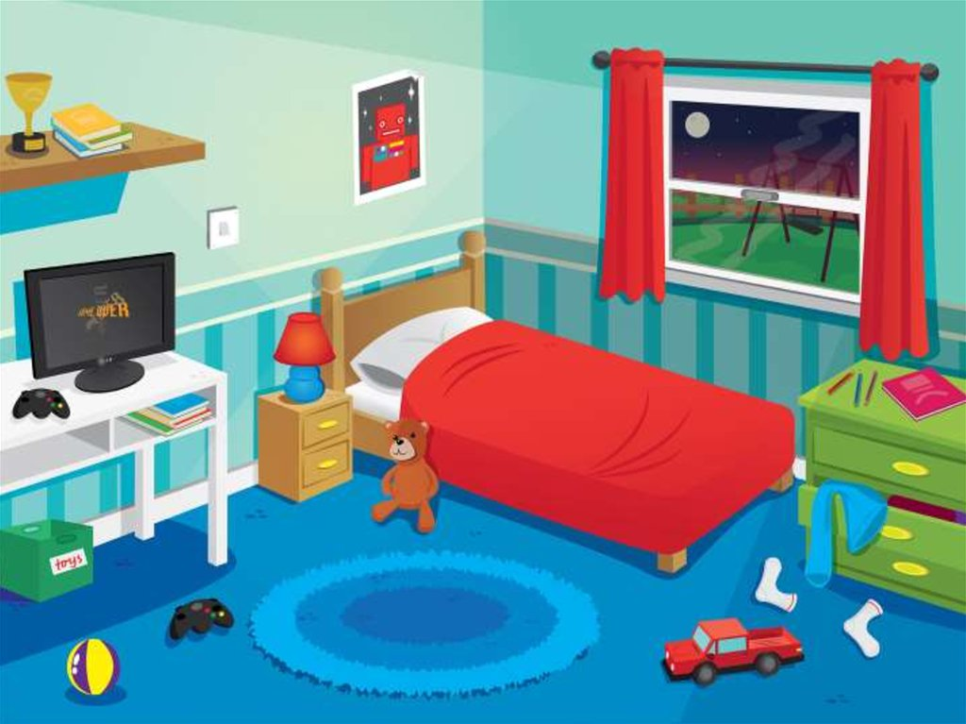
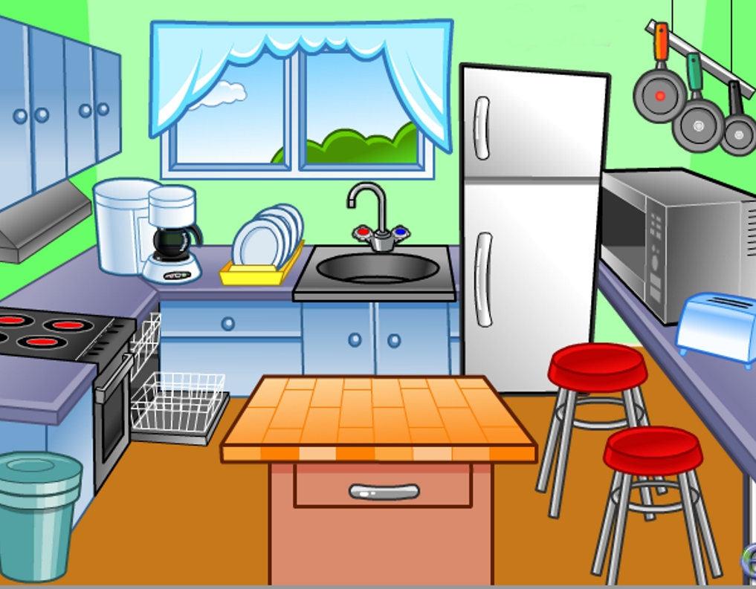
Show me …

Slide 23
Read, circle and write.
bathroomkitchenlivingroomgardenbathbedroom
1.
2.
3.
4.
5.
6.

Slide 24
Read, circle and write.
bathroomkitchenlivingroomgardenbathbedroom
1. bathroom
2. kitchen
3. living room
4. garden
5. bath
6. bedroom

Slide 25
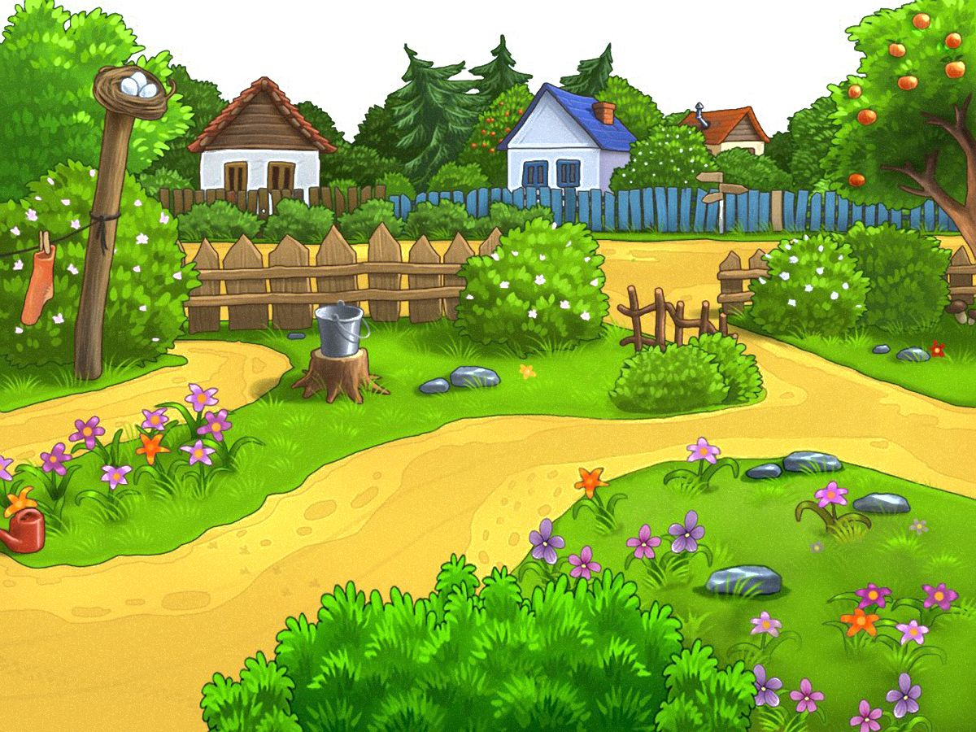
Read and choose.
bathroom | A | B
kitchen | A | B
living room | A | B

Slide 26
Read and choose.
bath | A | B
bedroom | A | B

Slide 27
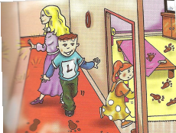
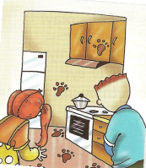
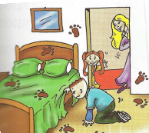
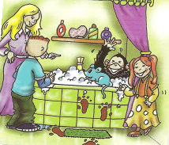
Larry: Is Chuckles in the living room?
Lulu: No, he isn’t.
Larry: Is he in the kitchen?
Lulu: No, he isn’t.
Lulu: Is he in the bedroom?
Larry: No, he isn’t.
Larry: Is he in the bathroom?
Lulu: Yes, he is! Look! He is in the bath!

Slide 28
«солнышко» – мне всё удалось,
«солнышко и тучка» – мне не всё удалось,
«тучка» – у меня ничего не получилось.

