Slide 1
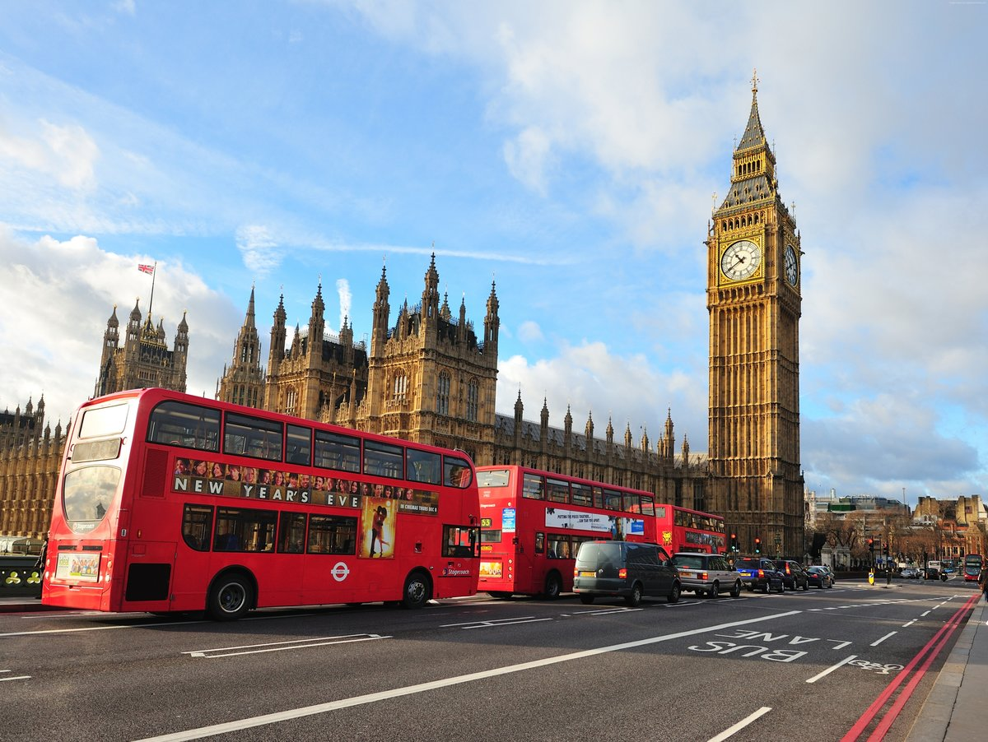
Welcome to London

Slide 2
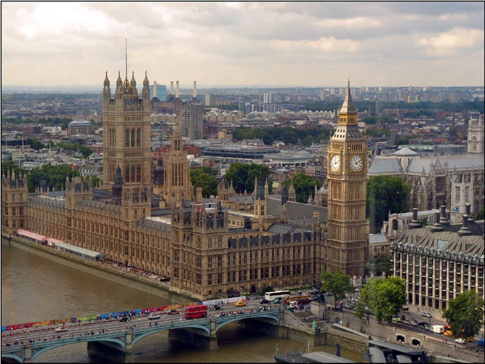
When a man is tired of London, he is tired of life.
Samuel Johnson

Slide 3
Phonetic exercises. Listen and repeat:
St. Paul’s Cathedral, Trafalgar Square, Double-decker bus, Thames river cruise, Covent Garden, Tower of London, Tower Bridge, Houses of Parliament, Buckingham Palace, London Eye.

Slide 4
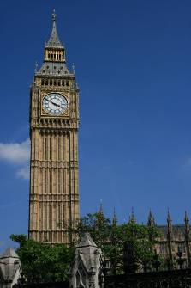
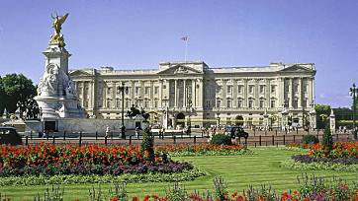
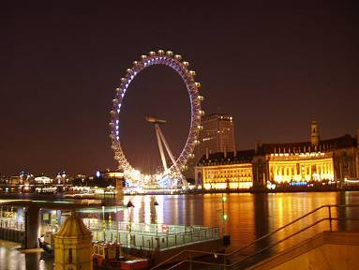
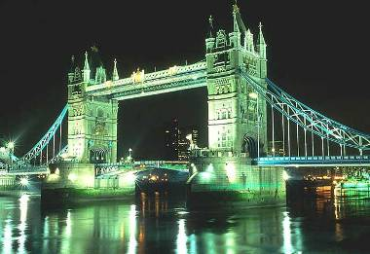
“London Treasures”.
Big Ben
Buckingham Palace
London Eye
Tower Bridge

Slide 5
How did London begin?
The name London comes from the Romans. In 43 AD they made a town next to the river Thames. The town`s name was Londinium. There was a bridge over the river, and ships came to Londinium from the sea.
Soon after 400 AD, the Romans went away from Londinium and nobody lived in the town for many hundreds of years.
In 1066 William the Conqueror came to England from France to be the king.
Soon after, he began to build the Tower of London to impress and frighten the English.
William the Conqueror – Вильгельм Завоеватель
AD (Anno Domini) – н. э. (наша эра)
Romans – римляне
Frighten - пугать

Slide 6
How did London begin?
Who founded the city? When was it?
(Romans. In 43 AD)
2. What was the first name of the city?
(Londinium)
3.Who began to build the Tower of London?
(William the Conqueror)

Slide 7
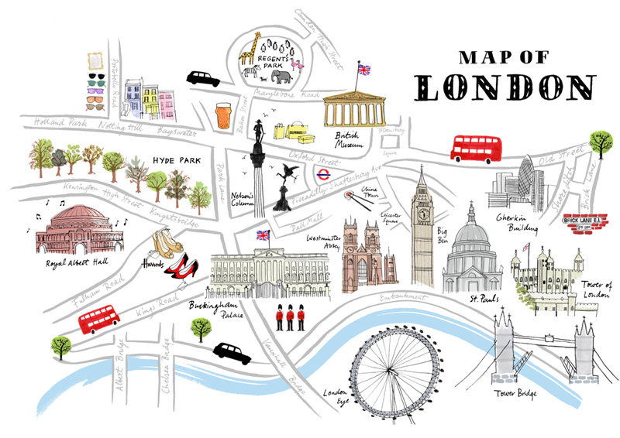
The map of London places of interest.

Slide 8
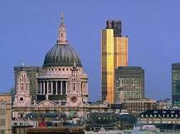
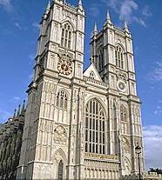
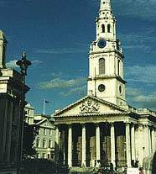
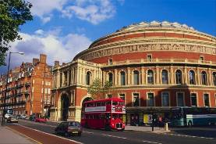
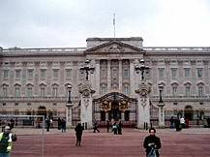
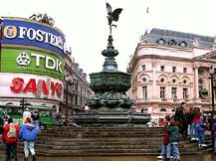
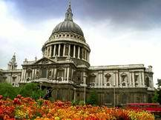
London places of interest.

Slide 9
“London Treasures”(сокровища)
Trafalgar Square (площадь)
The Tower of London (башня)
The Houses of Parliament (палаты)
Big Ben bell (колокол)
Westminster Abbey (аббатство)
St. Paul's Cathedral (собор)
National Gallery (галерея)
Tower Bridge (мост)
Buckingham Palace (дворец)

Slide 10
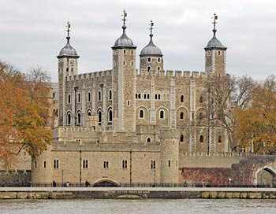
The Tower of London
This fortress was built
by William the Conqueror
at the end of the 11th century.
He built it to keep the unruly
Londoners in fear.
Later the kings began to use
it as a royal residence.
Then it was used as a prison and a place for executions for
the greatest political leaders of the country.
Now it’s the museum.

Slide 11
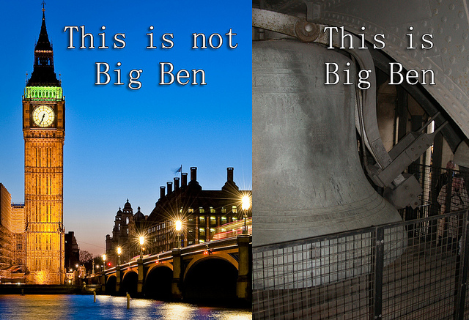
Big Ben
Big Ben is the name
of the largest bell
on the Clock tower
and a part of the Great
Clock of Westminster.
Its official name is the
Great Bell
of Westminster.
It is 13,5 tons.

Slide 12
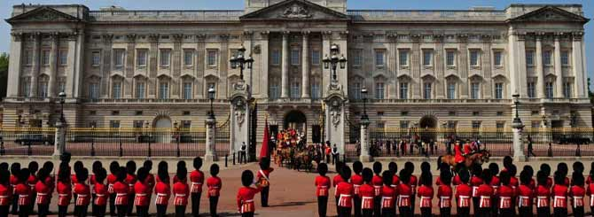
Buckingham Palace
Buckingham Palace is the official London residence of the Queen and the Royal family.
When the Queen is at the residence the flag is flying on top of Buckingham Palace.
The Changing of the Guard is the ceremony that you can see in front of Buckingham Palace.
It dates back to the 17th century. The ceremony takes place every morning at 11.30
and lasts for 30 minutes. It is a real theatrical performance.
The Queen’s Guard wear traditional uniforms and tall black fur caps.

Slide 13
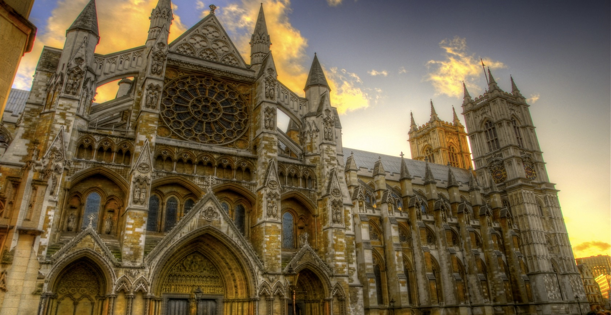
Westminster Abbey
Westminster Abbey is a large, mainly Gothic, church.
It is one of the most notable religious buildings in the United Kingdom
and has been the traditional place of coronation and burial site for
English and, later, British monarchs.
Also famous statesmen, scientists, writers, poets and musicians are buried there.

Slide 14
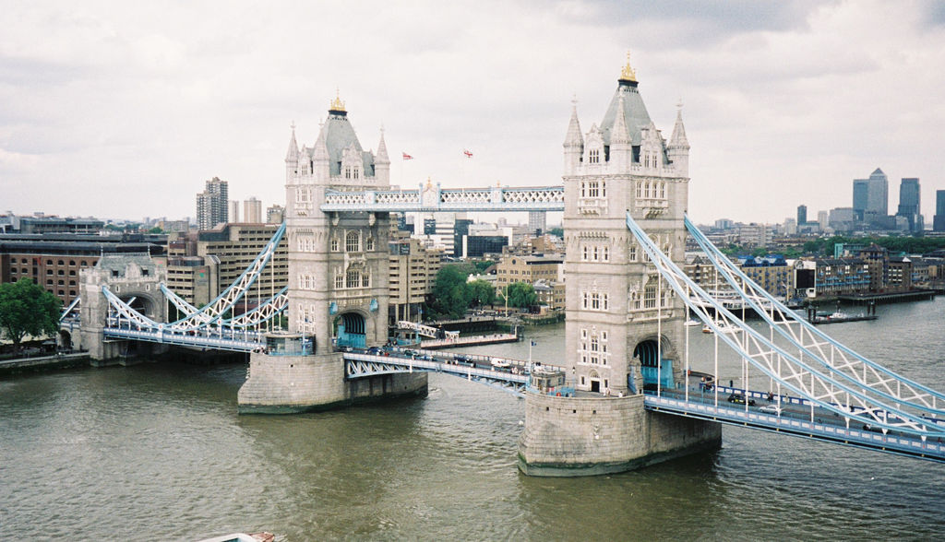
Tower Bridge
Tower Bridge is a masterpiece of engineering skill.
Tower Bridge was built at the end of the 19th century to match
the medieval style of the fortress.

Slide 15
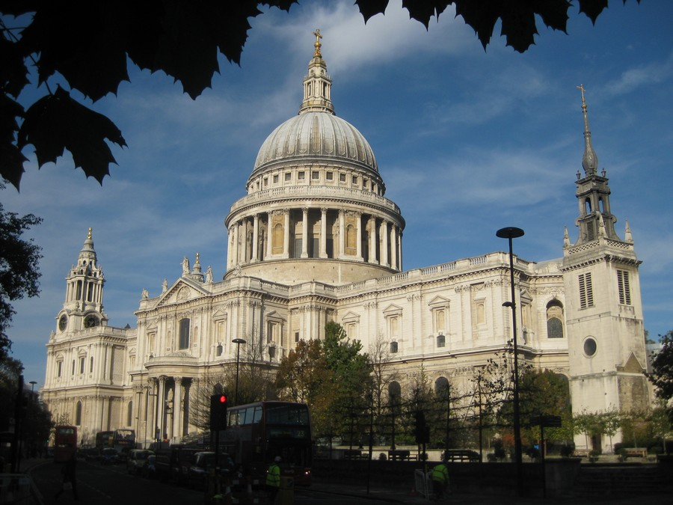
St. Paul’s Cathedral
St. Paul’s Cathedral is a church
in the centre of London
and is considered to be an
architectural masterpiece.
On top of St. Paul’s Cathedral is
a high dome, which contains
the Whispering Gallery,
where whisper can be heard
at a great distance.

Slide 16
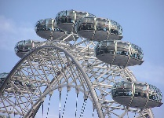
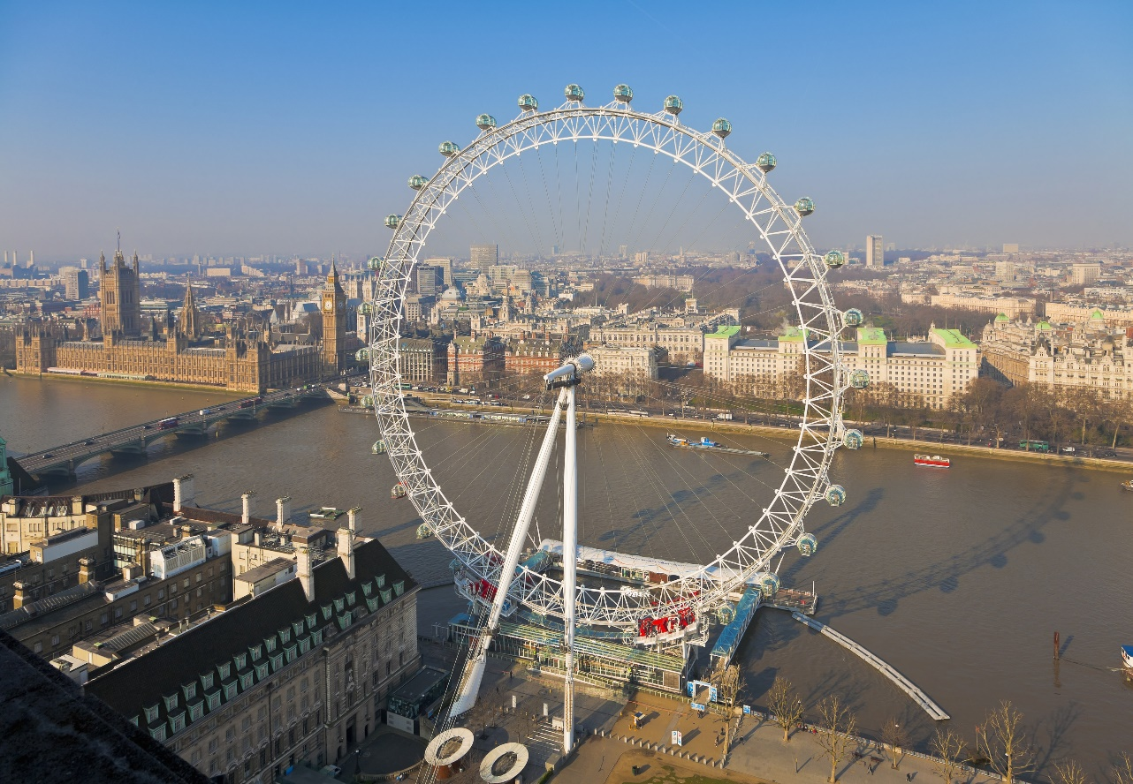
London Eye
London Eye - a Ferris Wheel,
which at 137 metres is one
of the world’s tallest one,
offering amazing views
from its enclosed capsules.

Slide 17
Reading. “London”

Slide 18
LONDON
London is the capital of Great Britain. It is situated on the Thames. It is a large industrial and cultural centre. Its population is over 8 million people. The Thames divides London into two parts: the West End and the East End.
The West End is the district of the rich. There are many famous museums and theatres here.
The City is a part of London, where nobody lives and which is the commercial centre of the country.
Whitehall – the political centre of Great Britain is also situated in the West End.
The East End is the district of the working class. There are many plants and factories.
London is known all over the world for its places of interest such as: the Tower, The Houses of Parliament, St. Paul`s Cathedral, Westminster Abbey, Buckingham Palace, Piccadilly Circus, Trafalgar Square, the British Museum.
London is not only a large city but also a seaport.

Slide 19
Give the English equivalents:
столица Великобритании, район богачей, большой индустриальный и культурный центр, район рабочего класса, известные музеи и театры, коммерческий центр страны, политический центр Великобритании, известен во всем мире, достопримечательности Лондона.

Slide 20
Answer the questions:
What is London?
What is the population of London?
Where is London situated?
How does the Thames divide London?
What can you say about the West End of London?
What can you say about the East End?
What is London known all over the world for?

Slide 21

Well done!

Slide 22
Put in the missing words
London is the … of Great Britain. It is a very … city. It was founded about two thousand … ago. London is one of the most … and interesting … in Europe. There are ... of … to visit in London. There are a lot of …, art …, cinemas, theatres and … parks in London.
cities, capital, famous, places, museums, years, popular, old, lots, galleries.

Slide 23
Put in the missing words
London is the capital of Great Britain. It is a very old city. It was founded about two thousand years ago. London is one of the most popular and interesting cities in Europe. There are lots of places to visit in London. There are a lot of museums, art galleries, cinemas, theatres and famous parks in London.

Slide 24
Match the proper names with their definitions:
1. London a) is the official residence of the Queen
2. St. Paul’s Cathedral b) is the capital of the country
3. Palace of Westminster c) is the geographical centre in London
4. Buckingham Palace d) is the seat of the British Parliament
5. the City e) is the greatest church in Britain
6. Trafalgar Square f) is the heart of London
7. Tower Bridge g) was a castle, a palace, a prison, a museum
8. The Tower of London h) is the church where many great people were buried
9. Westminster Abbey i) is a bridge which rises in about one and a half minute and offers a nice view of London

Slide 25
Excellent!

Slide 26
Listening.
William the Conqueror – Вильгельм Завоеватель
Fortress - крепость
King – король
Treasure - сокровище
Crown – корона
Right - правый
Left – левый
Bank - берег
Century - век
Prison- тюрьма
Raven - ворона
Palace- дворец
Museum – музей
Oaken - дубовый
Monastery – монастырь
Government – правительство
To crown - короновать
Church – церковь
To bury – хоронить
To weigh - весить

Slide 27

Listen to the text attentively, be ready to answer the question:
What sights have you heard about?
(the Tower of London,
Westminster Abbey,
the Houses of Parliament,
Big Ben)

Slide 28
Well done!

Slide 29
How well do you know London now?
Buckingham Palace
1) is the residence of kings and queens of Britain.
2) is the famous ceremony near Buckingham Palace.
3) is a place where Prince Charles and Princess Diana were married.
4) was a prison for the enemies of the king.
5) is a state mechanism to show the time of all sides of the world.
The Changing of the Guard
St. Paul's Cathedral
The Tower of London
Big Ben

Slide 30
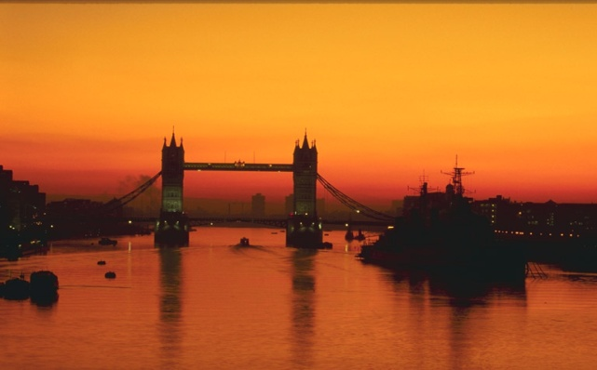
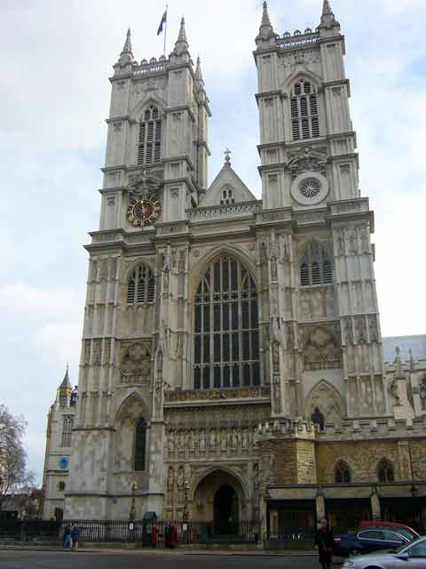
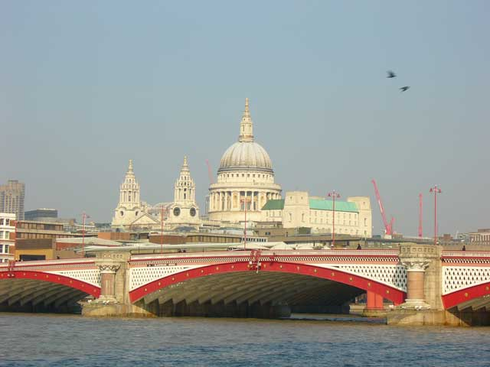
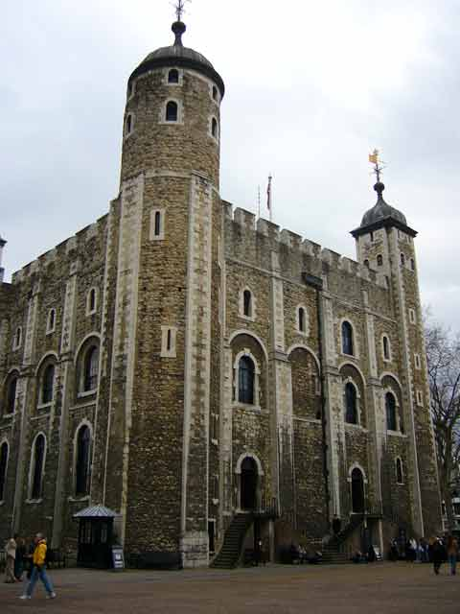
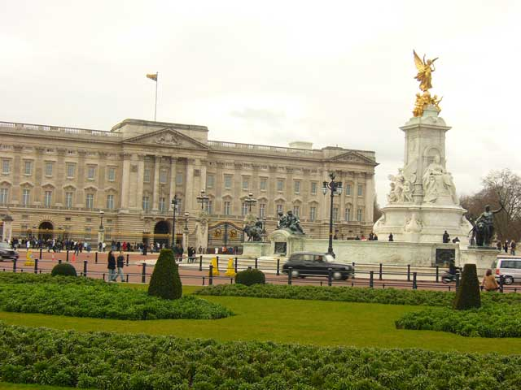
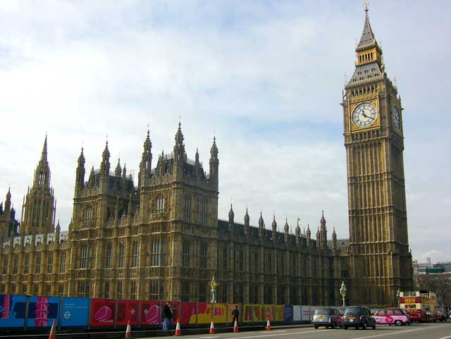
What are these?
Tower Bridge
Westminster Abbey
St. Paul's Cathedral
The Tower of London
Buckingham Palace
The Houses of Parliament

Slide 31
Good Job!

Slide 32
What places of interest would you like to see?
If I were in London I’d visit… Westminster Abbey
If I had a chance I’d visit… Houses of Parliament
I’d like to visit… Trafalgar Square
I am looking forward to
visiting… National Gallery
Hyde Park
Buckingham Palace
Big Ben
The Tower of London

Slide 33
Great!

Slide 34
What have we done?
we have seen a lot of places of interest of London;
we have read and learnt new words;
we have listened and spoken about the capital of Great Britain.

Slide 35
Home task:
1. Read the text “London”
2. Learn the new words
К 2
Good luck!

Slide 36
Thank You for Attention!!!

