Slide 1
Past Continuous
Учитель: Позднякова О.В.

Slide 3
HOBBIES
Collect stamps/coins
Paint/draw
Knit
Play football/volleyball/tennis/chess
Play computer games
Swim
Ski /skate
Read books/magazines

Slide 4
What? Who?

Slide 5
What? Where?

Slide 6
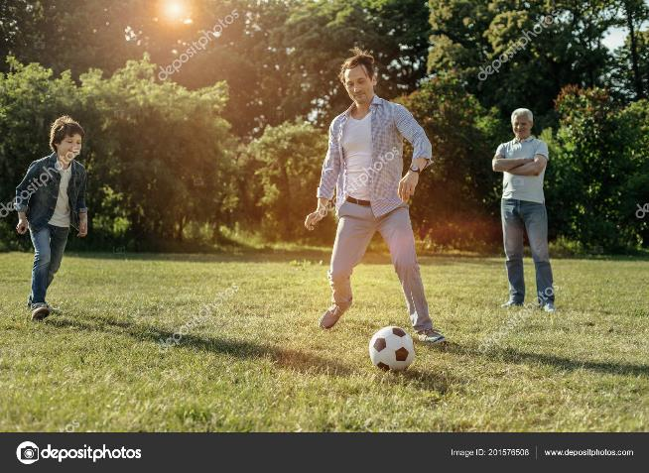
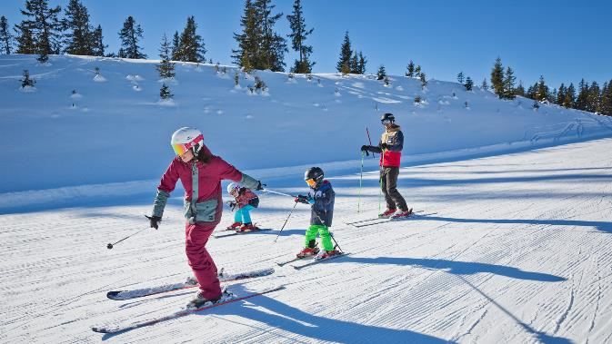
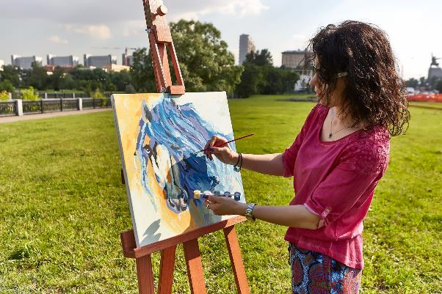
Yesterday, at 5 o’clock pm

Slide 7
Can you ask the questions?
I CAN’T ASK THE QUESTION
I CAN’T ANSWER THE QUESTION

Slide 8
Why can’t you ask and answer the questions?
WE DON’T KNOW THIS ENGLISH TENSE

Slide 9
What should we do?
WE SHOULD LEARN A NEW GRAMMAR TENSE

Slide 11
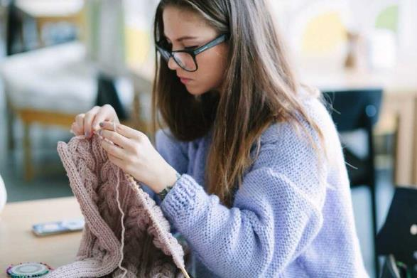
Yesterday, at 5 o’clock pm

Slide 12
It was interesting, I worked very well. I’m happy!
I wasn’t difficult, I worked well.
It was difficult for me.

