Slide 1
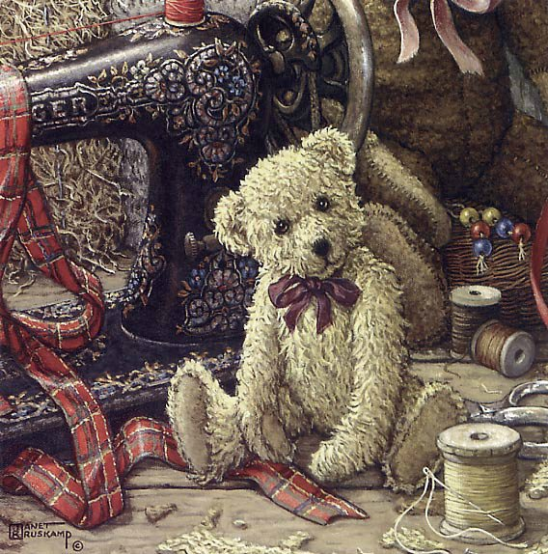
Teddy Bear
Ильина Е.Ф. Учитель английского языка ГБОУ СОШ 247 г.Санкт-Петербурга

Slide 2
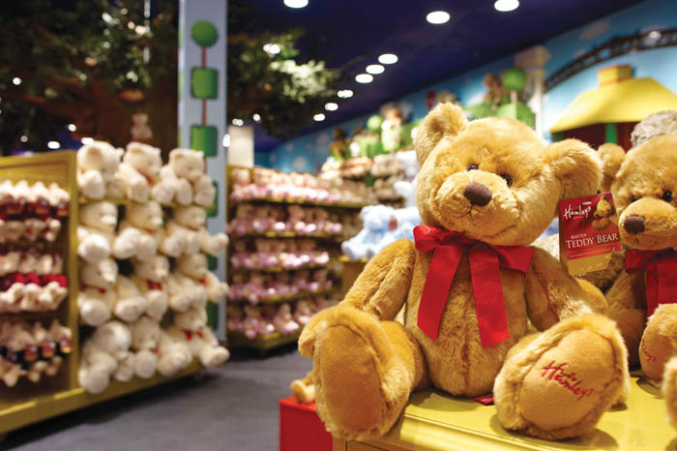
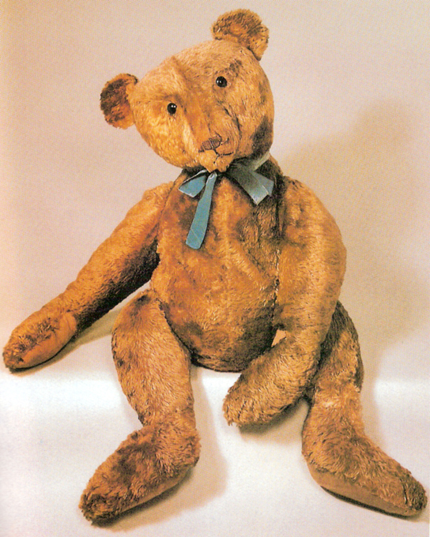
Teddy Bear is a soft toy bear, which is especially popular with children.
Toy bears are over 100 years old. They were first created in 1902 in two countries: Germany and the United States of America.

Slide 3
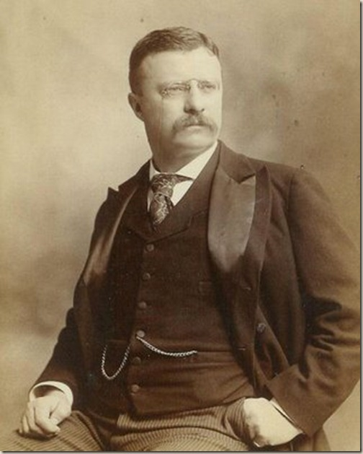
Teddy Bears got their name from Theodore Roosevelt, the 26th president of the United States.
Theodore Roosevelt
(1858 – 1919)

Slide 4
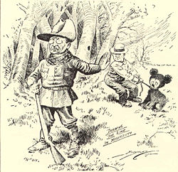
In 1902, the president went bear hunting in Mississippi without success, so members of his party caught a bear cub, tied it to a tree, and offered it to the president as an easy trophy. The president refused.

Slide 5
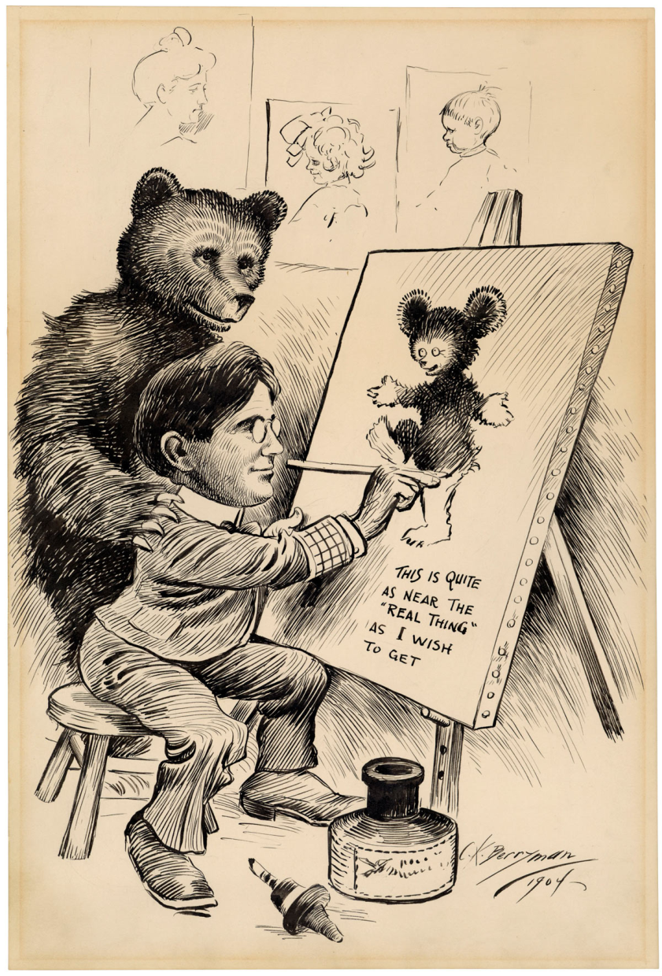
The event was drawn by a cartoonist for the Washington Post the next day. (November,16 1902)
The cartoon emphasized the helplessness of the bear and conveyed the message that Roosevelt would not make decisions for the wrong reasons.

Slide 6
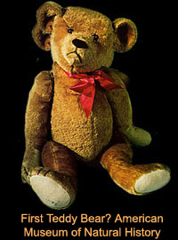
A Brooklyn store owner, Morris Michtom, saw the cartoon and he created a little stuffed bear cub.
Morris Michtom put the toy in his shop window with a sign that read "Teddy's bear” after sending a bear to Roosevelt and receiving permission to use his name.

Slide 7
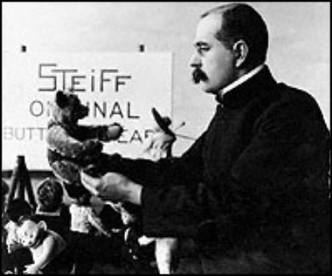
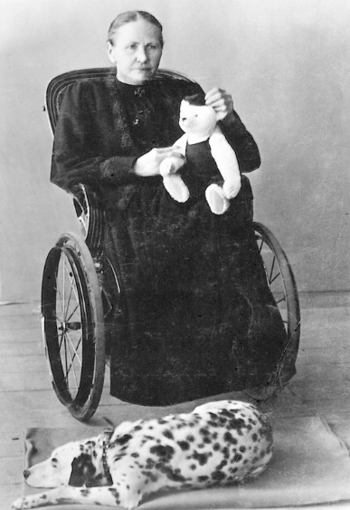
At the same time in Germany Richard Steiff and his aunt Margarett Steiff began making a soft plush, jointed bear - with a trademark button in the left ear.
In 1903, the company exported 3,000 bears to America.

Slide 8
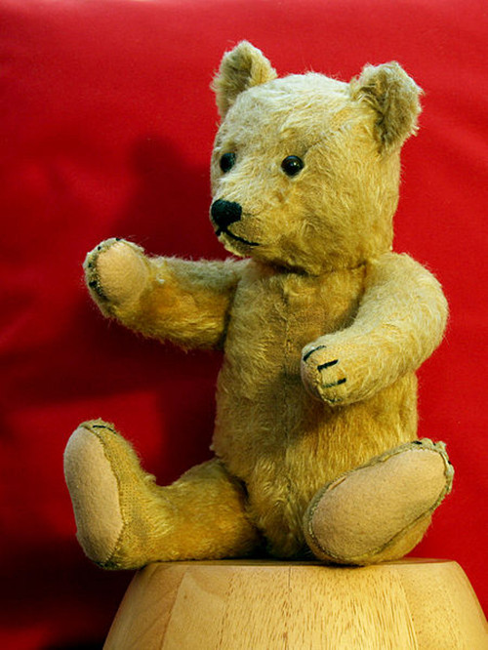
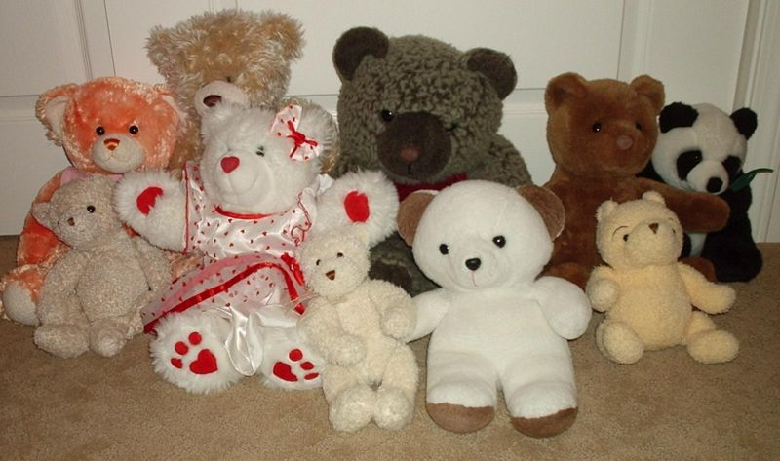
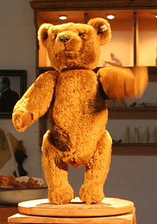
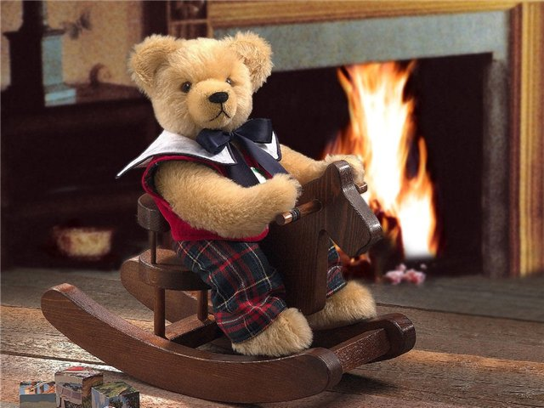
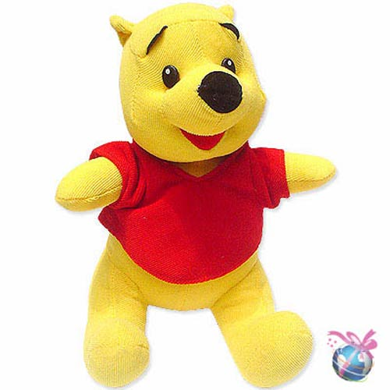
Since the creation of the first teddy bears which sought to imitate the form of real bear cubs, "teddies" have greatly varied in form, style and material.

Slide 9
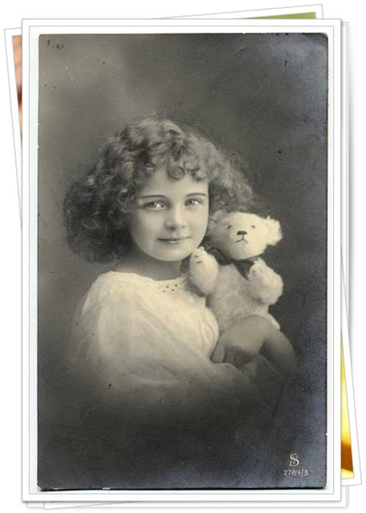
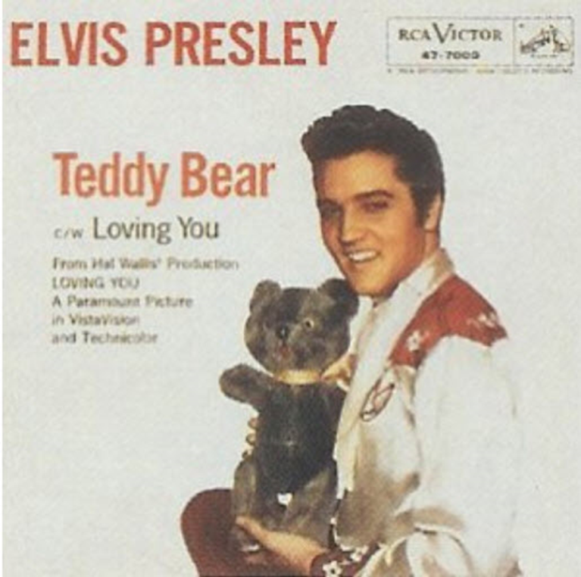
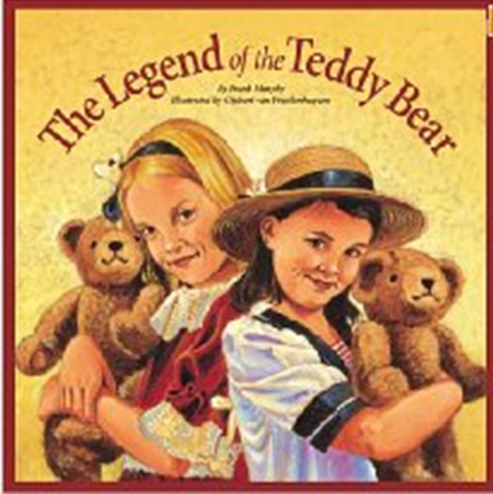
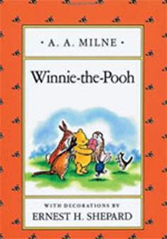
Teddy bear became an iconic children's toy, celebrated in stories, songs, and films.

Slide 10
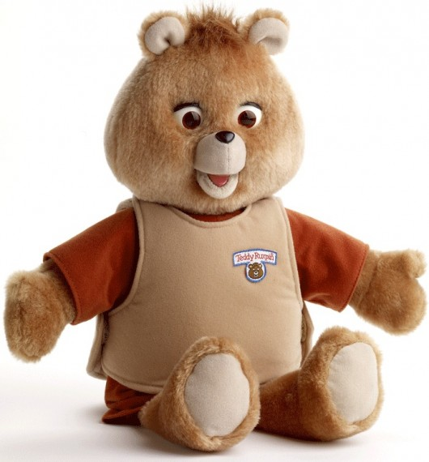
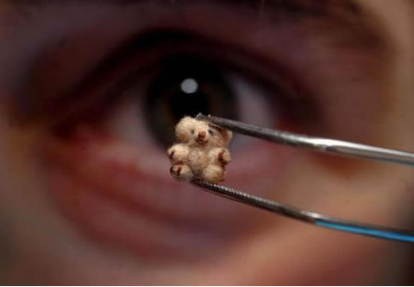
Famous Teddy bears:
The most expensive bear
Teddy Ruxpin
The smallest bear

Slide 11
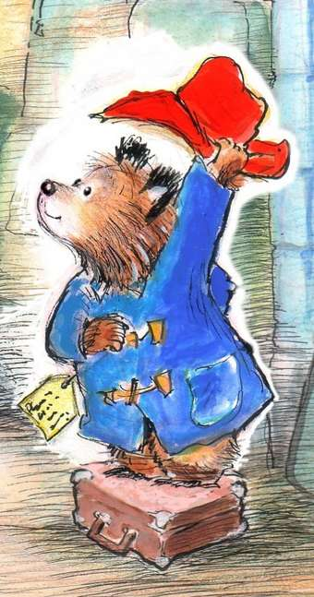
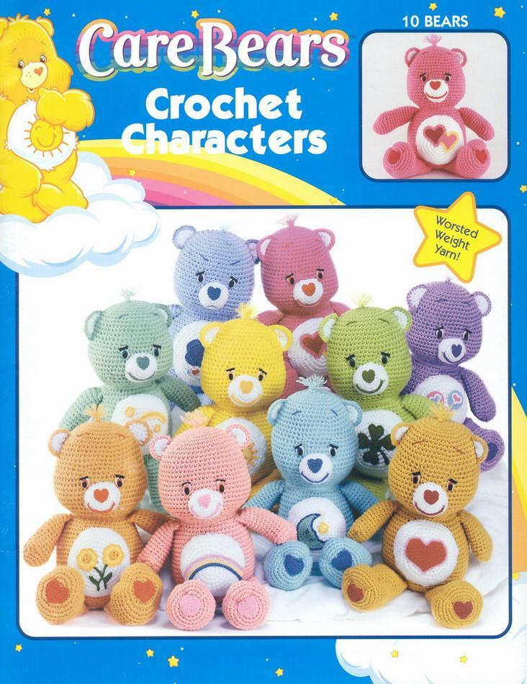
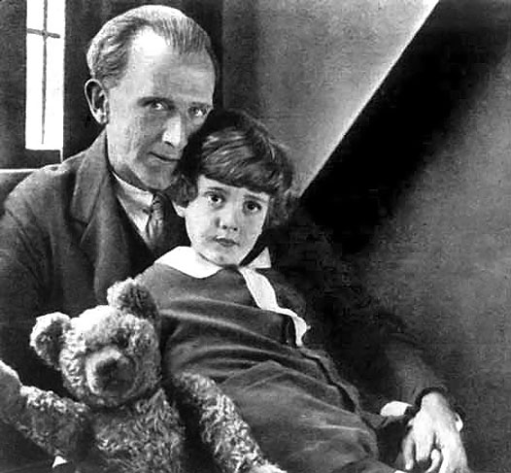
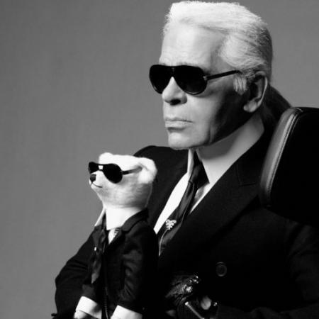
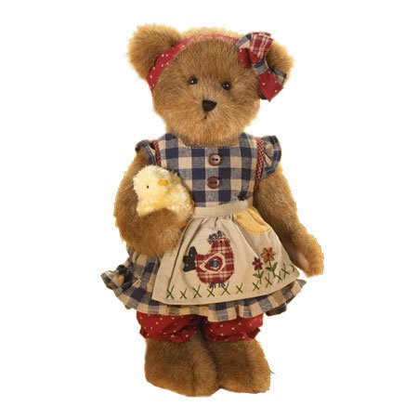
Paddington Bear
Winnie the Pooh
Care Bears
Teddy Me to You
Steiff Bear
Boyds Bears

Slide 12
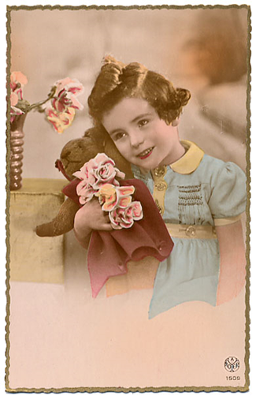
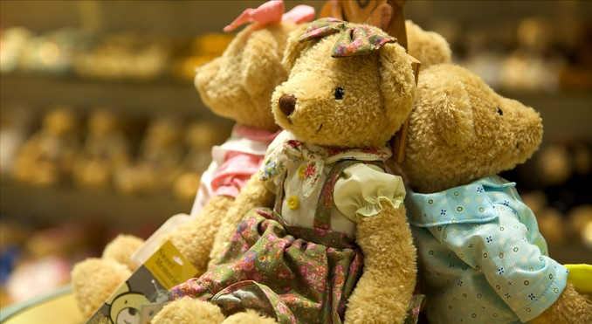
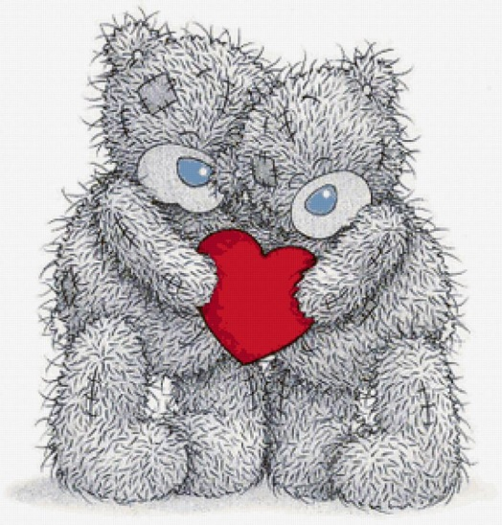
Teddy bears are among the most popular gifts for children and are often given to adults to signify love, congratulations, or sympathy.

