Slide 1
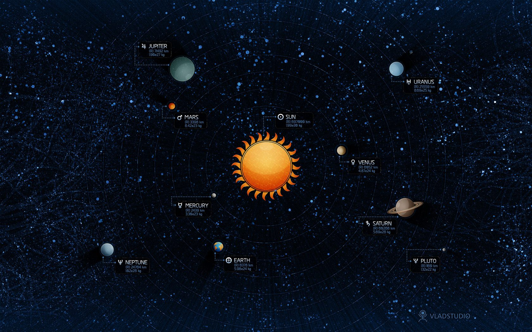
The solar system

Slide 2
The most bigger star in solar system is the Sun.

Slide 3
First planet is Mercury.

Slide 4
The second planet is Venus.

Slide 5
The third planet is the Earth.

Slide 6
The fourth planet is Mars.

Slide 7
The fifth planet is Jupiter.

Slide 8
The sixth planet is Saturn.

Slide 9
The seventh planet is Uranus.

Slide 10
The eighth planet is Neptune.

Slide 11
And Lilliput's Pluto.

Slide 12
The end

