Slide 1
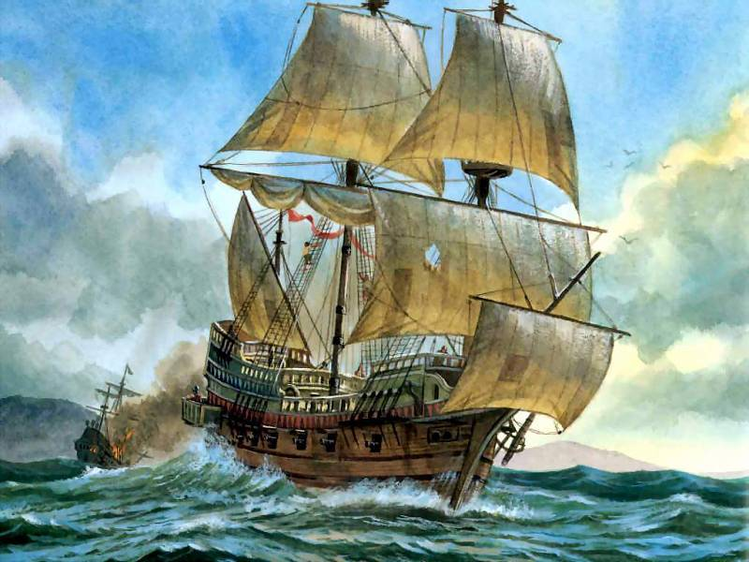
The Game "Sea Battle"
Topic “London”
составила Дмитриева Е.А.
МОУ «Новокрымская школа»

Slide 2
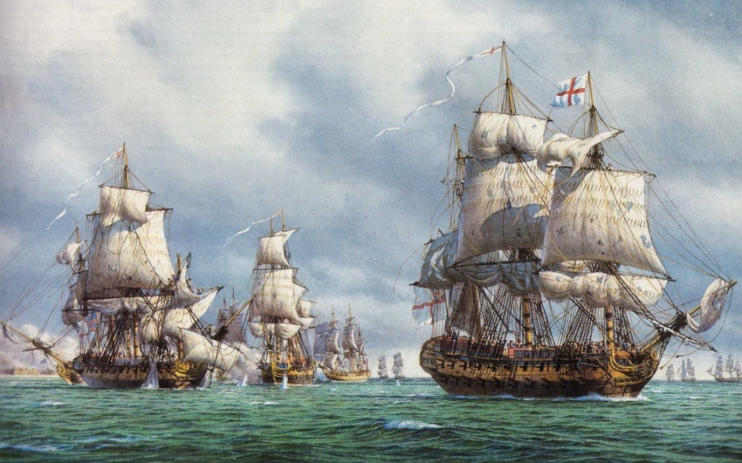
 | A | B | C | D | E
1
2
3
4
5

Slide 3
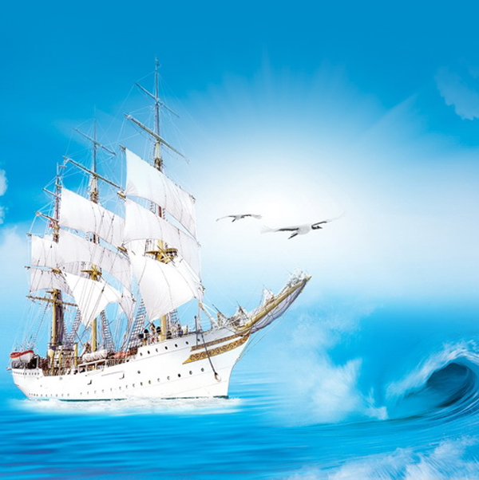
Корабль А3 I want you to answer my questions on the topic “London”.
What is the biggest city in Britain?
(The biggest city in Britain is London.)
How many people live in London?
More than seven millions people live in London.)
What is the oldest part of London?
(The oldest part of London is the City.)
What is the political centre of London?
(The political centre of London is Westminster.)
What language do the people in Britain speak?
(They speak English.)
How many people live in Britain?
(More than 56 millions people live in Britain.)
What are the parts of Great Britain?
(They are: England Wales, Scotland and Northern Ireland.)
Where does the British Prime Minister live?
(The British Prime Minister lives in the official residence, № 10 Downing Street, London.)
What river does London stand on?
(London stands on the River Thames.)
10. How many bridges are there over the Thames in London?
{There are 27bridges over the Thames in London.)

Slide 4
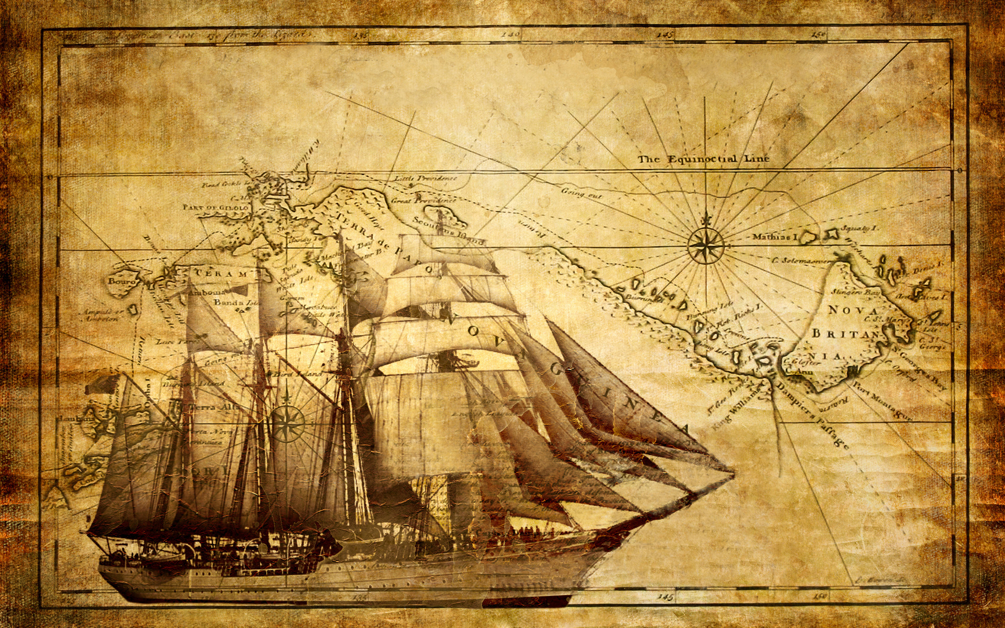
Корабль В2 Listen to some stories about the places of interest of the capital of Great Britain.
They say it is the most beautiful place in London. In the middle of it a monument to Admiral Nelson is situated. The monument includes four bronze lions. There are two fountains in it.
(It is Trafalgar Square.)
It is a wonderful building. The Queen Victoria Memorial is in front of it. It takes you ten minutes to get from this building to Trafalgar Square, the centre of London. The Queen of Great Britain lives there.
(Buckingham Palace.)
It was a fortress, a palace, a prison and the King’s Zoo. Now it is a museum. You can see a lot of interesting things in the halls of this building. William the Conqueror built it in the eleventh century. Twelve black ravens live in it. People believe that London will be rich while the ravens live there.
(The White Tower.)
It is one of the greatest English churches. It is not far from the Tower of London. The famous English architect Sir Christopher Wren built it in the 17th century after the Great Fire. It is a fine building with many columns and towers. In one of the towers there is one of the largest bells in the world.
(St. Paul’s Cathedral.)
It is more than nine hundred years old. There are many monuments and statues there, many English kings and queens are buried there. It is famous for the Poet’s Corner. It is one of the most famous and beautiful churches in London. This church has two tall towers.
(Westminster Abbey.)
They are long grey buildings with towers. The large clock in one of the towers is “Big Ben”. You can hear the sound of “Big Ben” every hour in London. The clock and the bell got their names after Sir Benjamin Hall. The members of the British Parliament work in these buildings.
(The Houses of Parliament.)

Slide 5
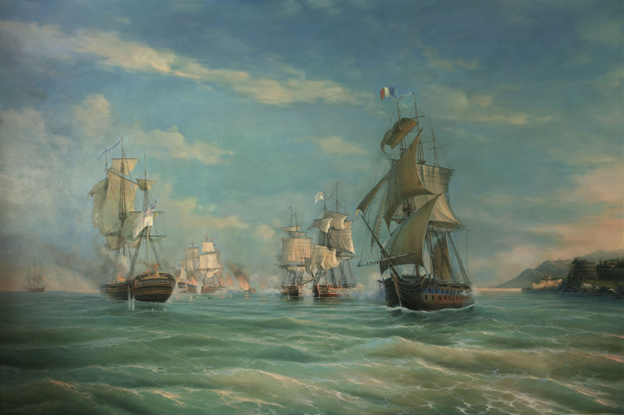
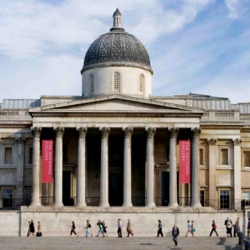
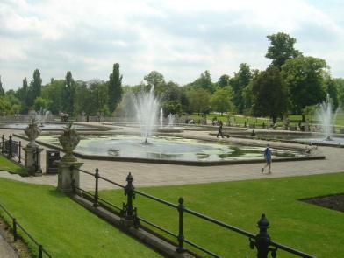
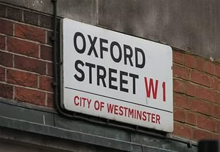
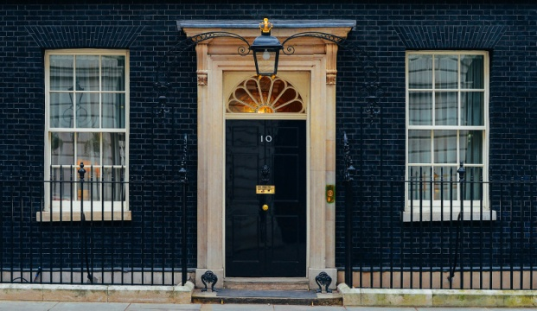
Корабль С5 Will you look at the blackboard? You will see the pictures of the interesting places of London. You must tell us about these places in 2 minutes.
the National Gallery
Hyde Park
Oxford Street
number 10 Downing Street.

Slide 6
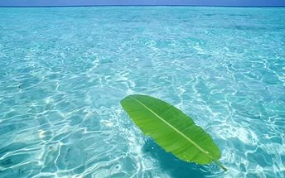
Корабль D4 Now each team will have the task on the cards. Use the definite article where it’s necessary. You will have 2 minutes to do the task.
... Westminster
... Poet’s Comer
... Buckingham Palace
... Big Ben
... Thames
... Whitehall
... Parliament Square
. St. Paul’s Cathedral ... Tower of London ... England ... City
... Trafalgar Square ... London
... Westminster Bridge

Slide 7
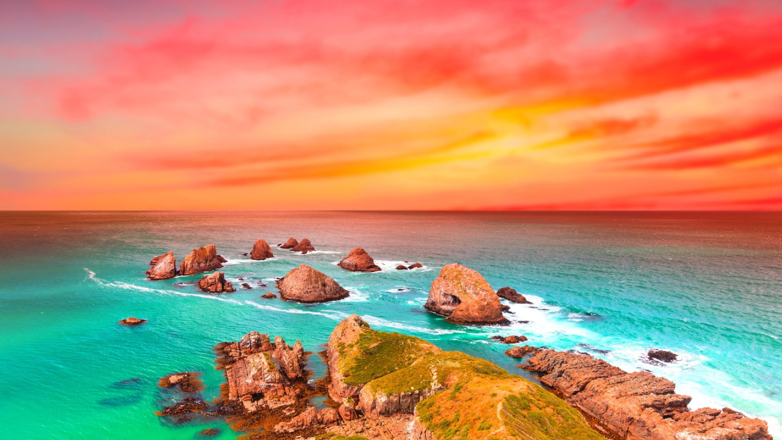
Корабль E1 Игра «Составь слова» It’s time to play the game. You will make up the English words using the parts of the words.
buil
ture
um
squ
di
rist
nu
sta
ace
wn
tou
pal
eum
to
ment
mo
ding
mus

Slide 8
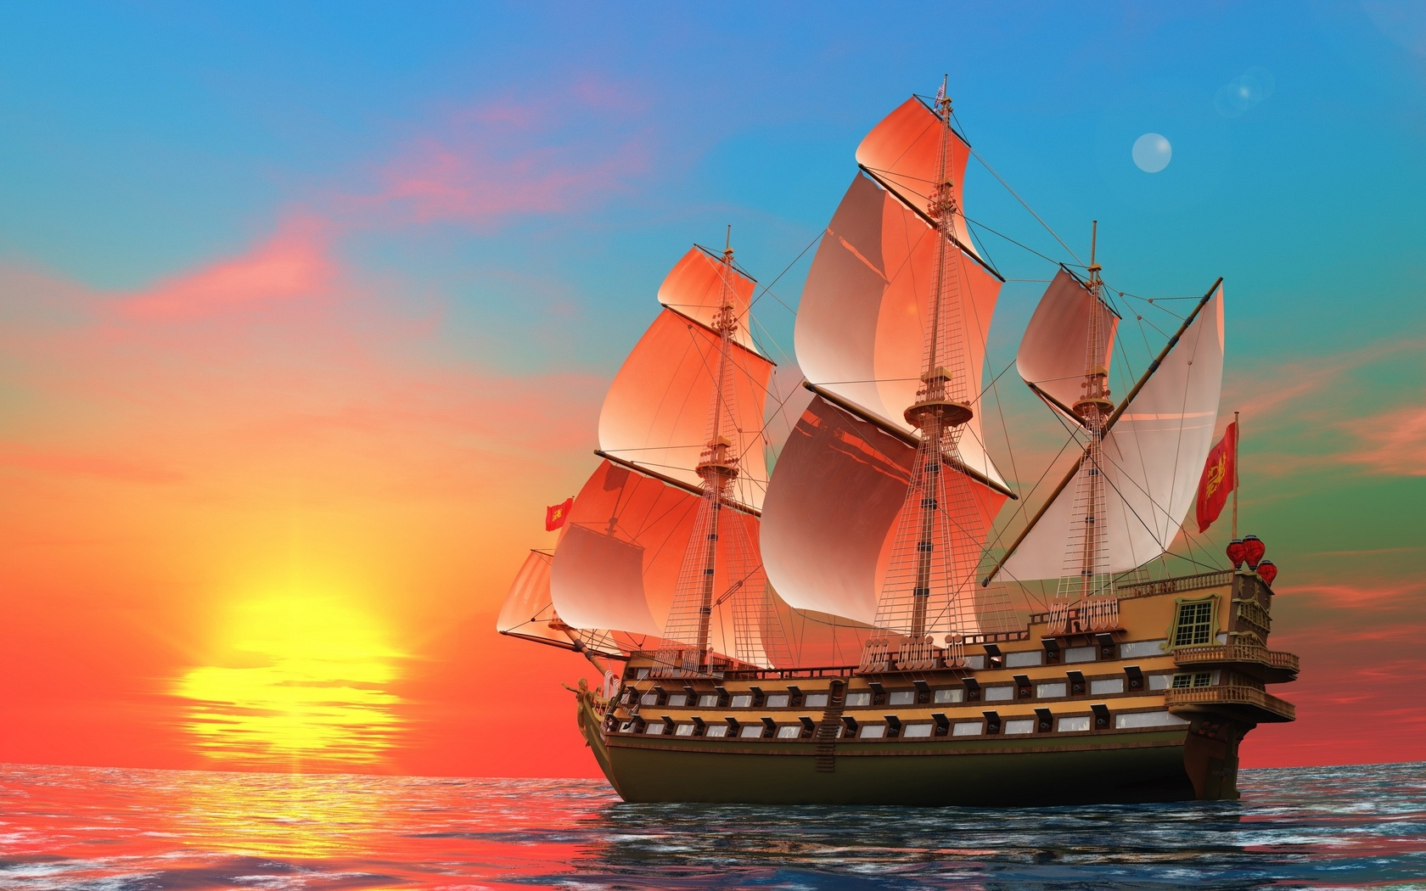
Thank you for your work.

Slide 9
Список источников
Дзюина Е.В.Игровые уроки и внеклассные мероприятия на английском языке 5-9 классы [Текст]: монография /Дзюина Е.В.: ООО «Вако», 2007. – 140 с.;
Мюллер В.К. Англо-русский словарь [Текст]/ В.К.Мюллер – М.: «ЮНВЕС», 2004. – 768 с.

