Slide 1
A booktrailer on the book
“A Tale of Two Cities”
by Charles Dickens
ГБОУ СОШ № 180
Учитель английского языка
Васильева Е.В.
Санкт-Петербург
2016 год

Slide 2
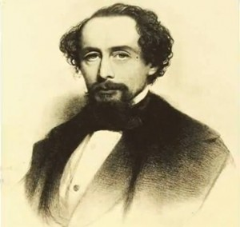
Charles Dickens, an English classical writer, lived in the 19th century, the era of the Queen Victoria (1819-1901).
He is loved by many people all over the world for his unforgettable stories full of kindness and sympathy for the poor. His contribution to the English literature is great.

Slide 3
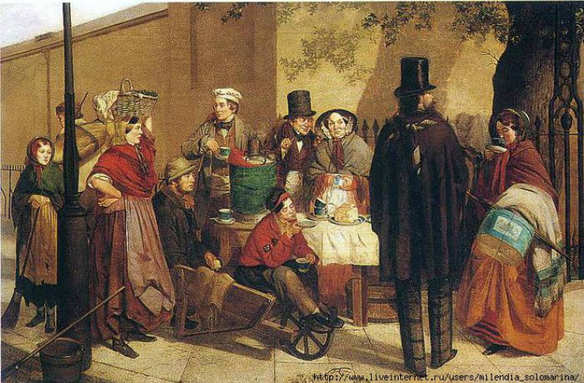
" The plot of «A Tale of Two Cities" Dickens takes us into the eighteenth century.

Slide 4
“It was the best of times, it was the worst of times, it was the age of wisdom, it was the age of foolishness, it was the epoch of belief, it was the epoch of incredulity, it was the season of Light, it was the season of Darkness, it was the spring of hope, it was the winter of despair, we had everything before us, we had nothing before us, we were all going direct to Heaven, we were all going direct the other way— in short, the period was so far like the present period, that some of its noisiest authorities insisted on its being received, for good or for evil, in the superlative degree of comparison only.”

Slide 5

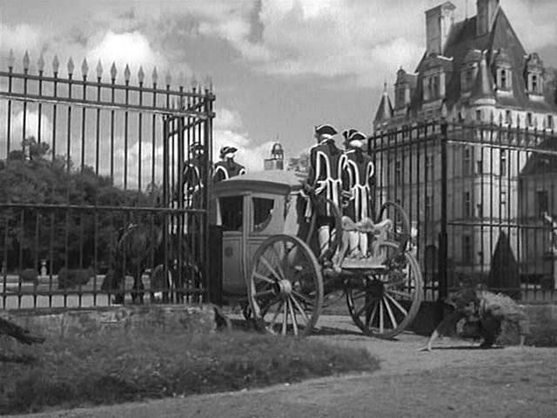
It was the year of Our Lord one thousand seven hundred and seventy-five.
In both countries (England and France) it was clearer than crystal to the lords of the State preserves of loaves and fishes, that things in general were settled for ever.

Slide 6
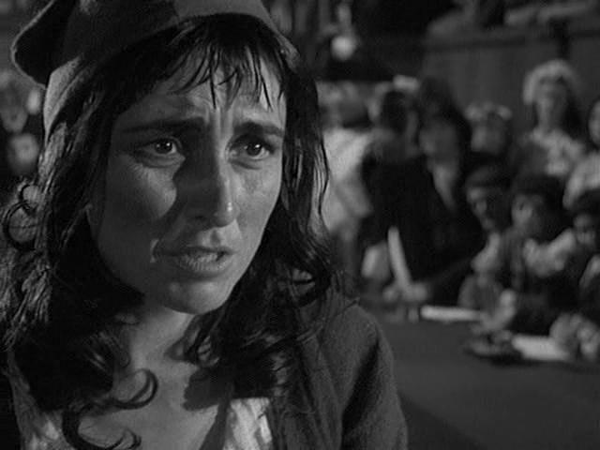
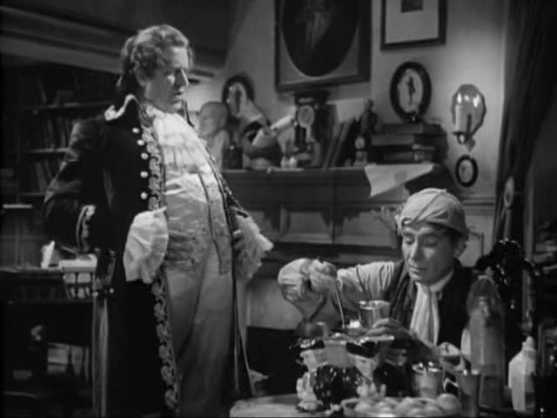
In the novel "a Tale of two cities" Charles Dickens criticizes the established way, when the aristocracy gripped the nation until the last drop.

Slide 7
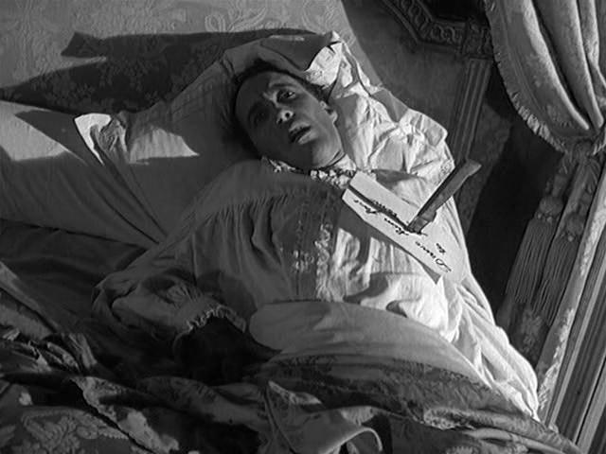
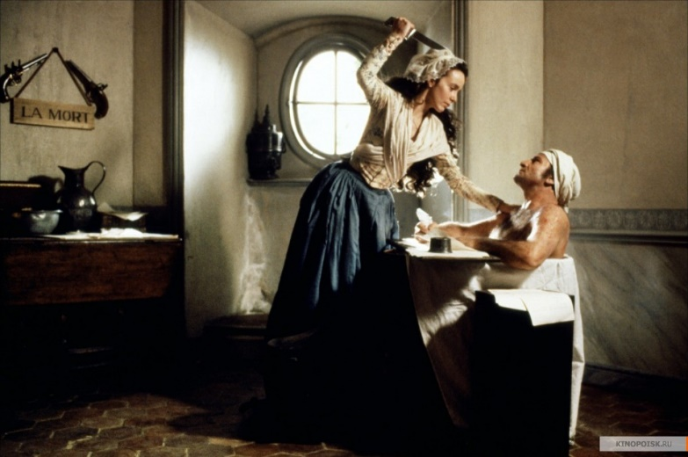
Portraying the poverty and powerlessness of the masses, Dickens hotly resents their oppressors, believes a revolution is inevitable, however, condemns the active involvement of people from the standpoint of the Christian ideal

Slide 8
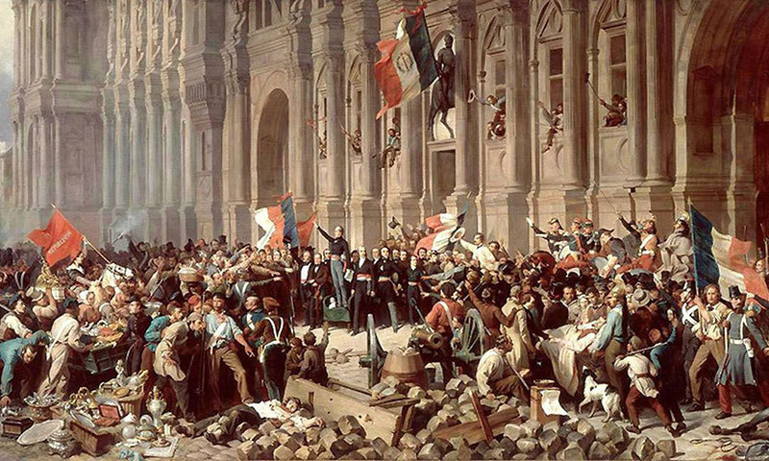
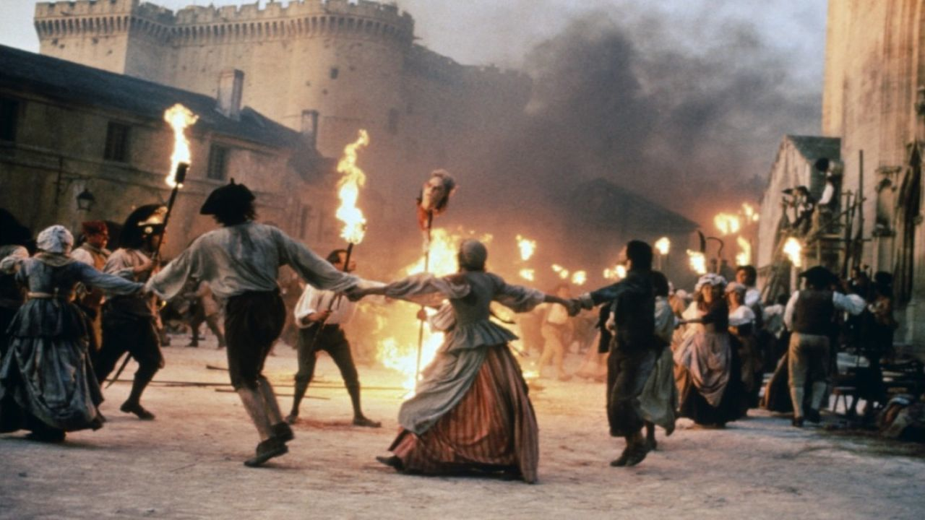
Dickens tells about the events of the people's revolution, that set the country.

Slide 9
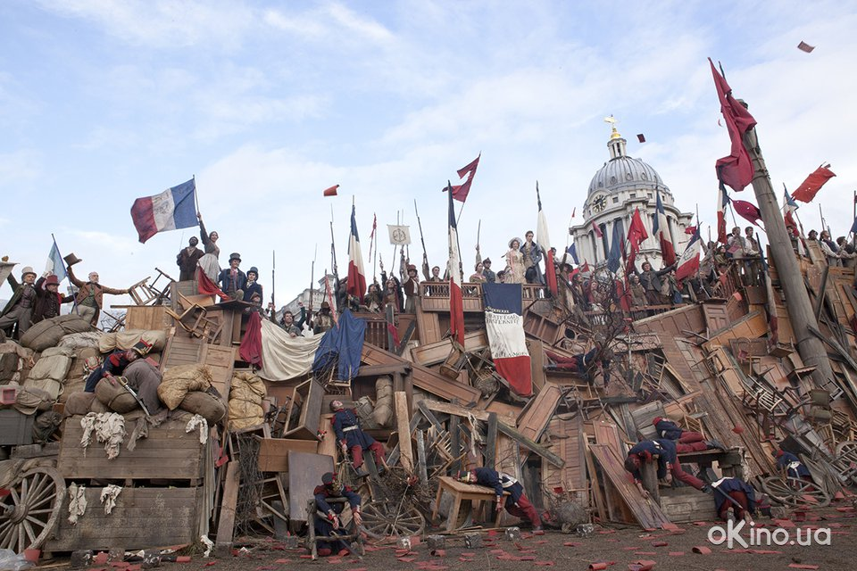
Dickens shows that this would inevitably end in a storm that will sweep away all that was built over the centuries

Slide 10
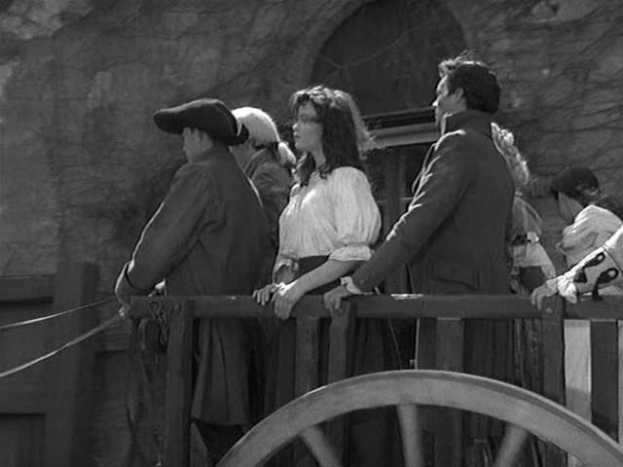
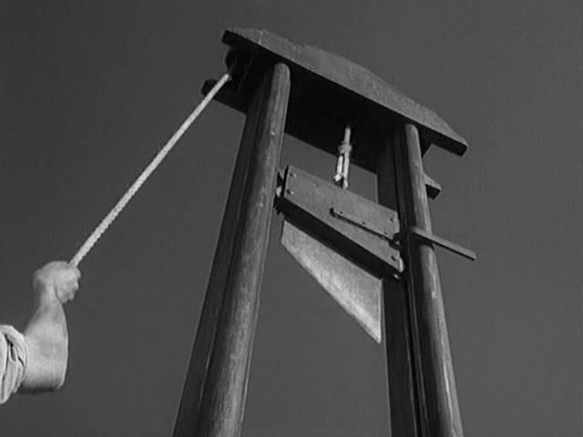
The book “A Tale of Two Cities" by Dickens ends with a brief description of subsequent events: a large number of "patriots" soon followed their victims to the guillotine.

Slide 11
The theme of love and sacrifice in “A Tale of Two Cities" Dickens reveals Sydney Carton, a talented but degraded lawyer, who twice rescues Charles from the execution, once from professional considerations, the other from a desire to sacrifice everything for his love to Lucy, wife of Charles.

Slide 12
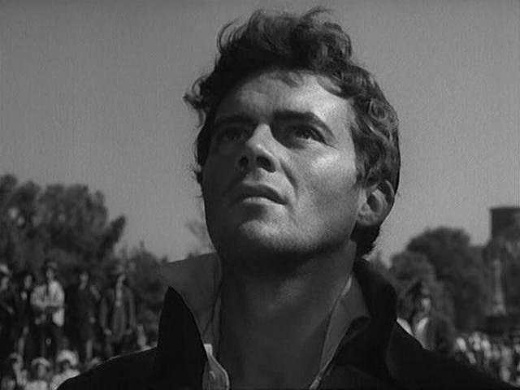
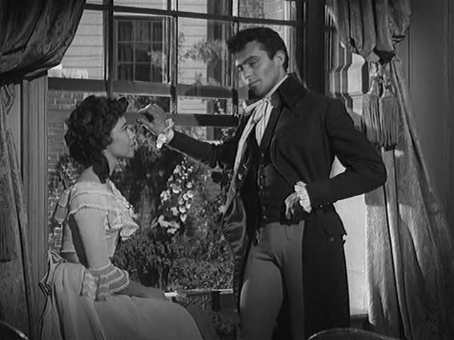
By doing this he realizes that for the first time in his life he can do something important and that his actions will forever leave his name in memory of the family Garnaev

Slide 13
The book “A Tale of Two Cities" by Dickens to read was very interesting.
Discover Dickens to yourself!
I recommend this book for reading

