Slide 1
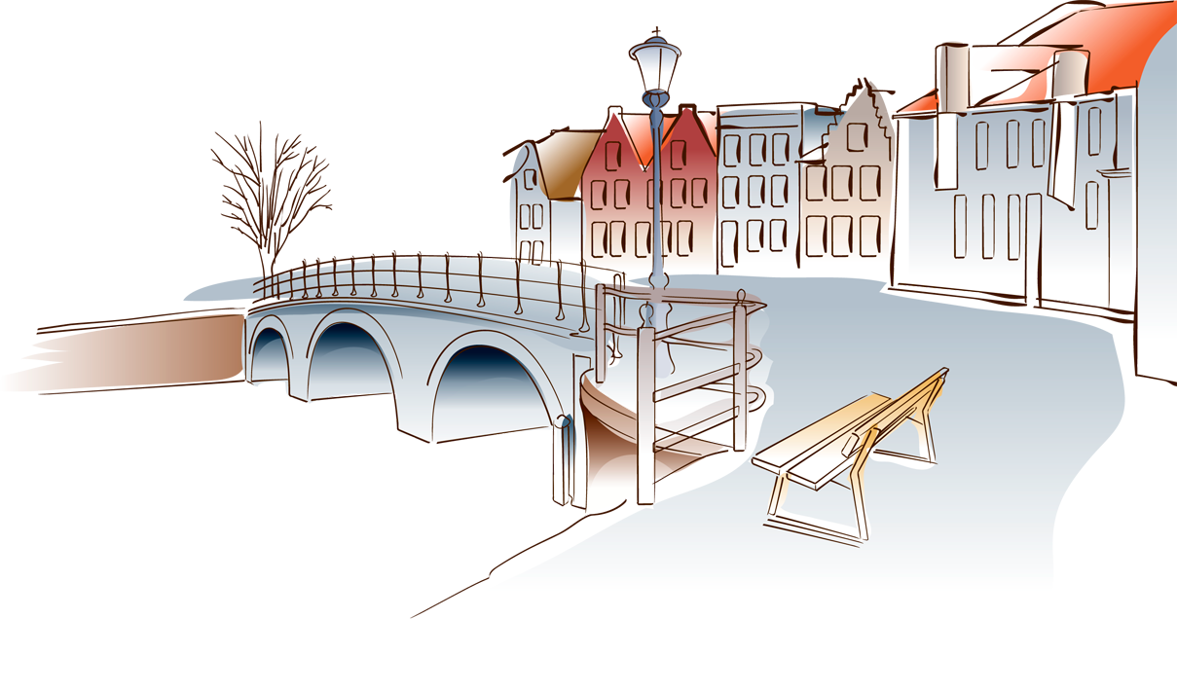
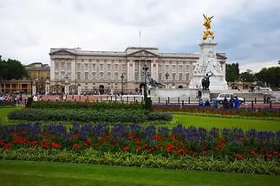
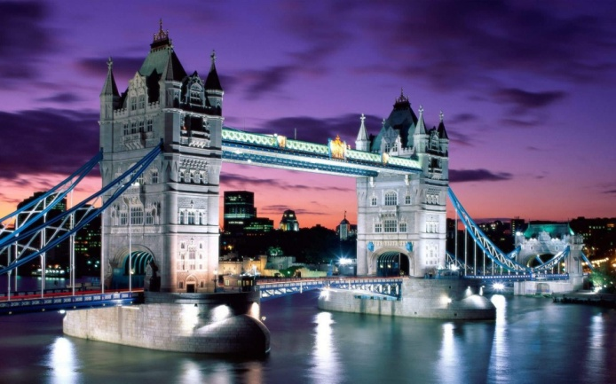
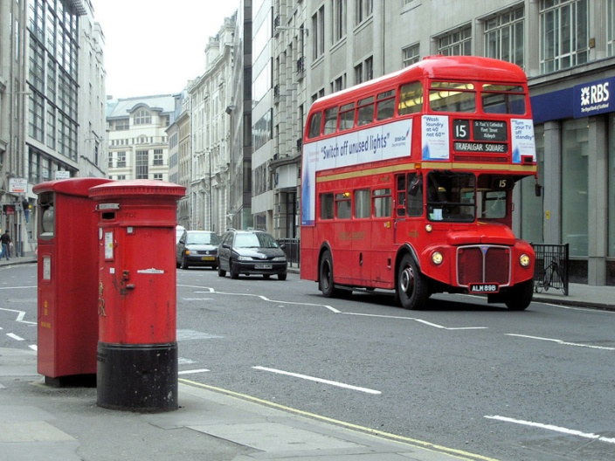
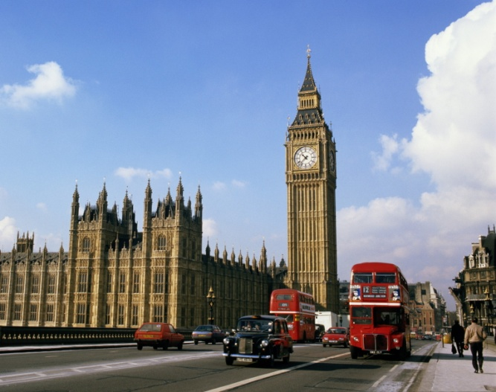
The 11 th of March It’s Friday today

Slide 2
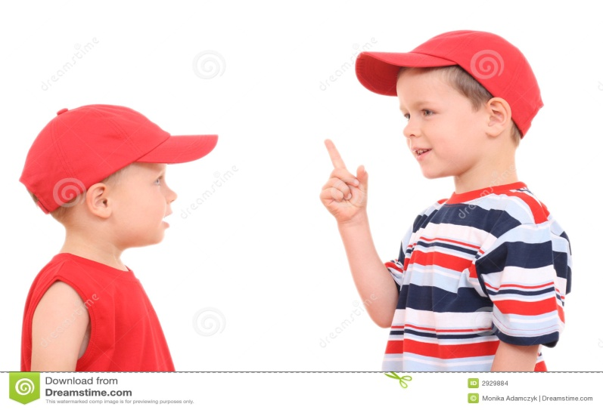
Town Life. London.
Town Present Perfect
Cit tense
Main
Cinema
Theatre
Church
Road
Traffic lights
Turn to the left
Turn to the right

Slide 3
Where are you going, my little cat?
I am going to town to buy a hat.
What? A hat for a cat?
A cat in a hat? Who ever saw a cat in a hat?

Slide 4
Town
City
Square
Main
Cinema
Theatre
Church
Road
Traffic lights
Turn to the left
Turn to the right

Slide 5
Translate the sentences:
There are a lot of small towns in England.
Are the roads in your city very good?
A cinema is a place where people can watch films.
What is the main idea of the book?
Do you Know the Main Theatre well?
What is the main square in your town?
And then walk two blocks to the traffic lights.
There were many people in the church.
Walk to the corner and turn to the left.

Slide 6
Present Perfect tense
Already
Yet
Just
Ever
Since

Slide 7
Подлежащее
Have V3 ( V1 + ed) .
Has

Slide 8
I have hurt my leg. I can’t go.
We have cleaned the window. The window is clean.
He has locked the door. The door is closed.
Mary has already read the book. You can take it.
Mother has cooked the dinner. The dinner is on the table.

Slide 9
Home task
1. words – to learn for dictation
2. ex. 11 p. 130 ( read and translate)
3. ex. 15 p. 125 ( in written)

