Slide 1
MY TRIP TO SCOTLAND
Автор: Попов Сергей, ученик 7 класса Руководитель: Захарьина Ольга Валерьевна, учитель английского языка
МБОУ «Лицей №17» г. Северодвинск Архангельской области.

Slide 2
Edinburgh-the capital of Scotland

Slide 3
Edinburgh Castle

Slide 4
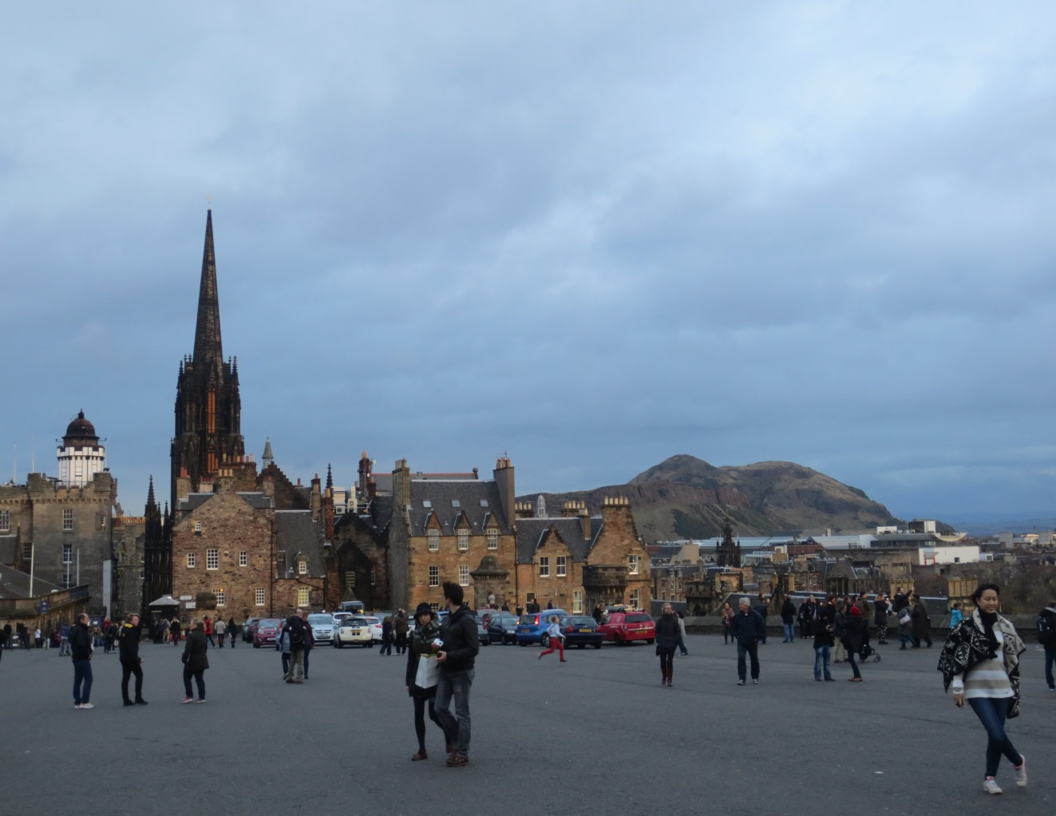
Edinburgh Castle

Slide 5
Mons Meg

Slide 6
A monument to king Robert the Bruce

Slide 7
Stone of Destiny

Slide 8
The Crown of Scotland, The Scepter of Scotland, and The Sword of State of Scotland

Slide 9
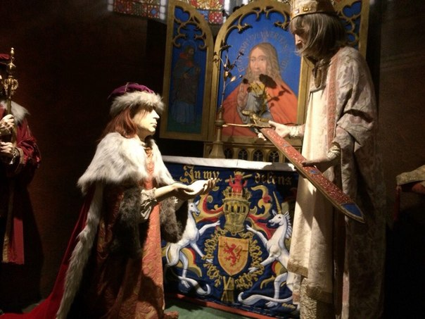
National War museum in Edinburgh Castle

Slide 10
View from the Castle

Slide 11
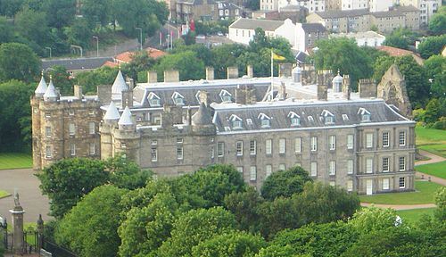
Holyrood Palace

Slide 12
Holyrood Palace (Central Entrance)

Slide 13
The Royal Mile

Slide 14
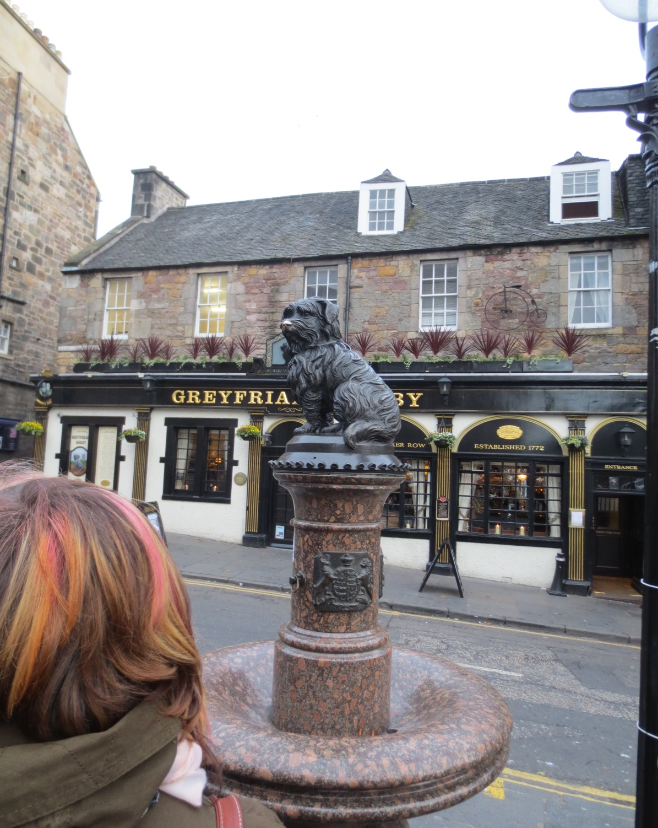
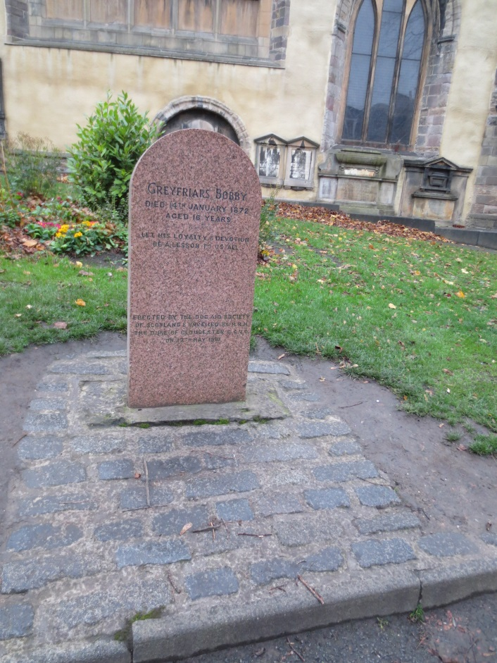
The monument to Bobby, symbol of devotion

Slide 15
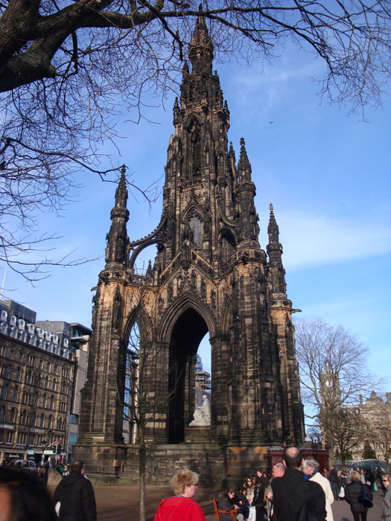
Scot Monument in Princess Street

Slide 16
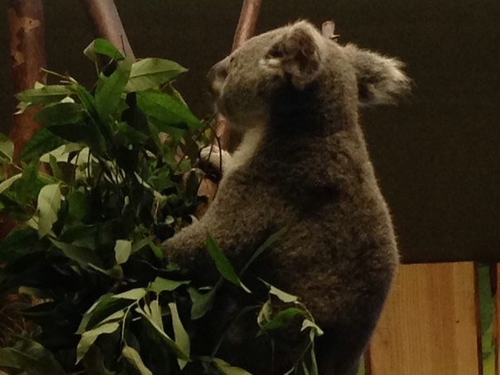
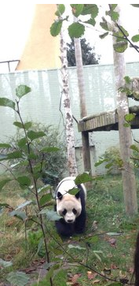
Edinburgh Zoo

Slide 17
My heart in the Highlands

Slide 18
Trip to Loch Lomond

Slide 19
Lochs and Highlands

Slide 20
Loch Lomond

Slide 21
Boat trip

Slide 22
Loch Lomond

Slide 23
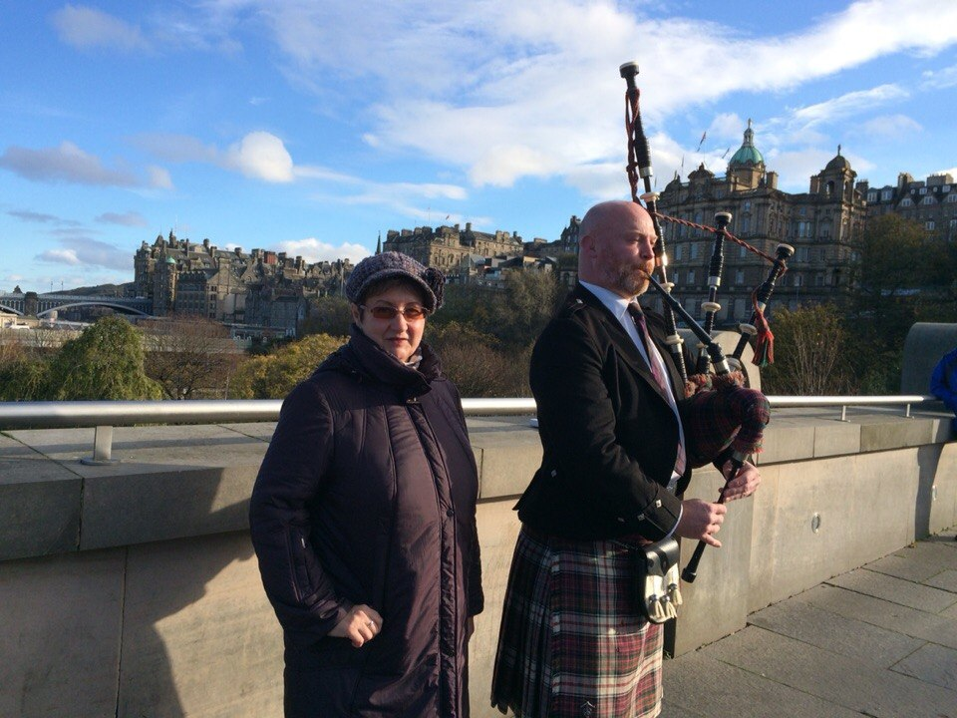
Welcome to
Scotland!

Slide 24
Links.
Литература.
Экскурсионные буклеты.
https://en.wikipedia.org/wiki/Holyrood_Palace
http://edinburgh-places.co.uk/visitin/
Фотографии из личного архива автора.
ссылки на фотографии
http://trip-together.ru/wp-content/uploads/2013/06/edindurg21.jpg?edf5c8
http://travel-child.ru/wp-content/uploads/2012/05/mesto-rozdeniya-garri-pottera.jpg
http://www.stuckonscotland.co.uk/pictures/princes_street_edinburgh_scotland_G5466.jpg
https://lh3.googleusercontent.com/y_Exp4BPes61YZRmq-JJWVJewC4Z7ls1LMlReWQPZ-9-lGNRvw4-GFNtl7QYvrEHOb8YDlk=s127
http://www.kinneffoldchurch.co.uk/images/regalia.jpg
https://encrypted-tbn2.gstatic.com/images?q=tbn:ANd9GcSQbu8GxlIeydMJQEux1tsuh-TTK6vTCLjSn4WhQJQn3O0YRdC0_Q
https://encrypted-tbn2.gstatic.com/images?q=tbn:ANd9GcTC3V9lCSfUOoL052iXGUUraRgbrPvYNKnsZsCUQCSGLmf0IAtAsg

