Slide 1
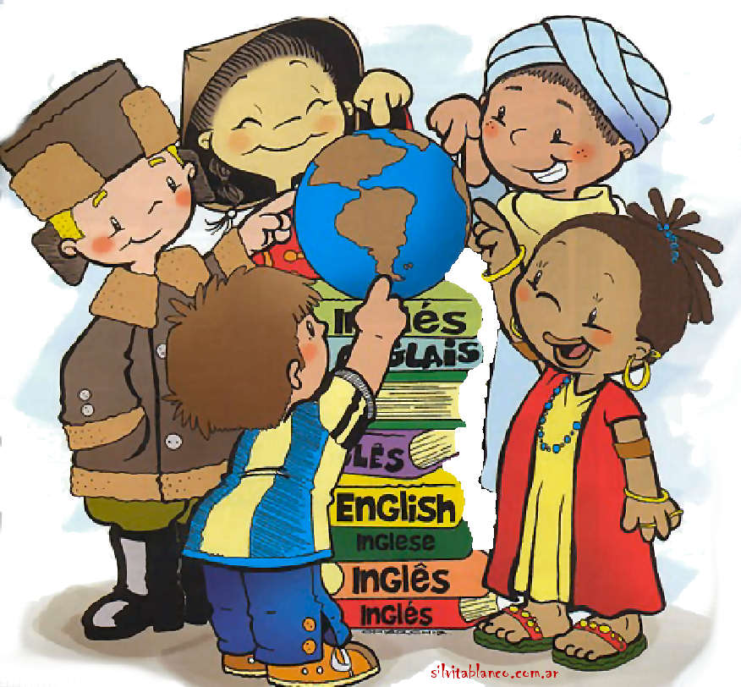
Countries and continents

Slide 2
Fill in the gaps
France | Norway | the USA
Paris | Oslo |  | Moscow
Russia
Washington, D.C.
Africa | Asia | North America
Egypt | China |  | France
Europe
the USA
Canada
Mexico

Slide 3
Agree or disagree with the statements
1) Spain is in Europe.
+
2) Russia is the biggest country in the world.
+
3) Italy is not in Asia.
+
4) Washington, D.C. is the capital of Australia.
4) Washington, D.C. is the capital of the USA/ Canberra is the capital of Australia.
5) The USA is in Australia.
5) The USA is in North America
6) Sochi is in the south of Russia.
+
7) Samara is the capital of Russia.
7) Moscow is the capital of Russia.

Slide 4
Group the places into 4 columns
Countries Seas and oceans Continents Rivers and lakes
the Thames
the Atlantic
South America
Portugal
the Pacific
Belgium
the Nile
the Baikal
China
the North Sea
the Volga
Australia
Norway
Europe
India
The Niagara River/Niagara Falls
the Amason
Japan
the Netherlands
Africa
Asia
the Black Sea
the Arctic
Switzerland
the Yellow Sea

Slide 5
Let’s have a rest!
Hands up! Hands down!
Hands on hips! Sit down!
Hands up! To the sides!
Bend left! Bend right!
One, two, three! Hop!
One, two, three! Stop.
Stand still.

Slide 6
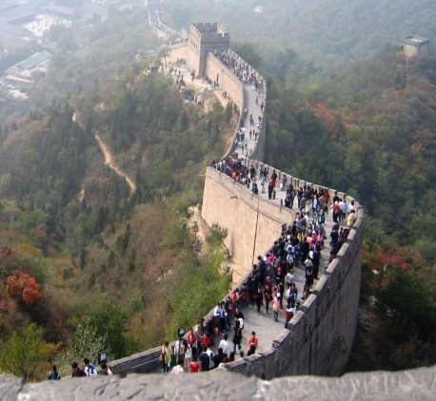
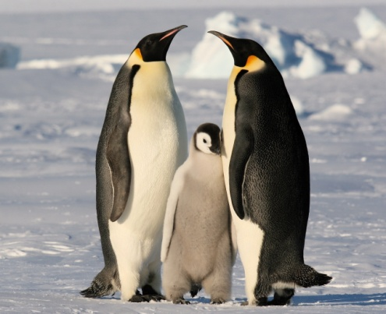
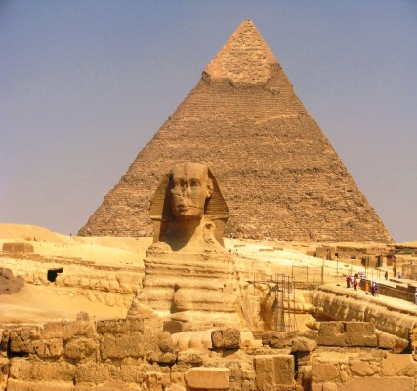
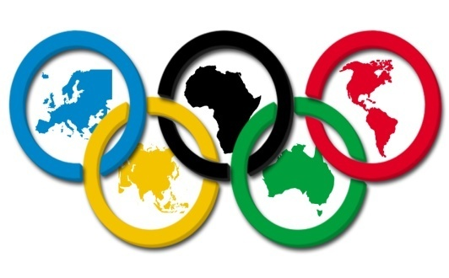
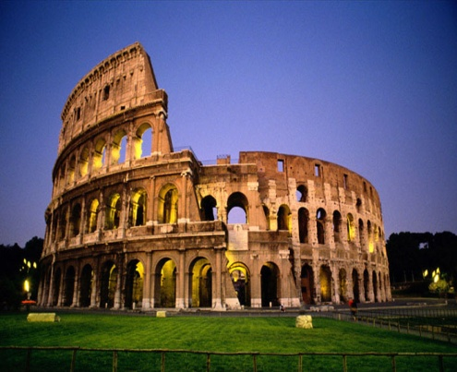
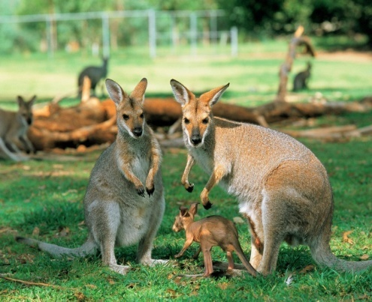
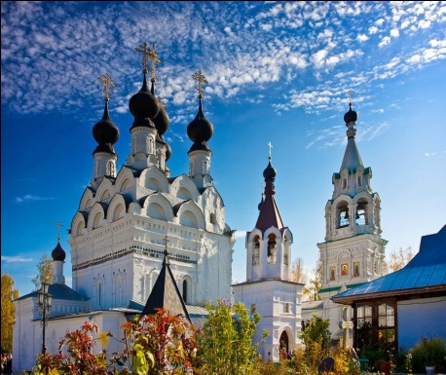
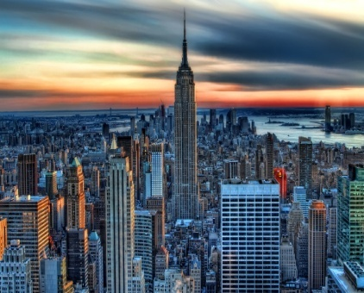
What are the following places famous for?
Egypt, Australia, Antarctica, Greece, Italy, China, the USA, Russia.
penguins
the Pyramids
Olympic Games
the Great Wall of China
churches
skyscrapers
Colosseum
kangaroos

Slide 7
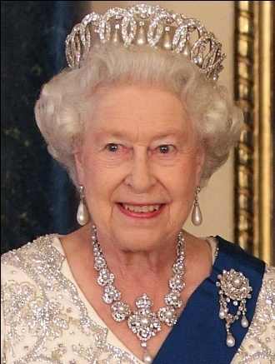
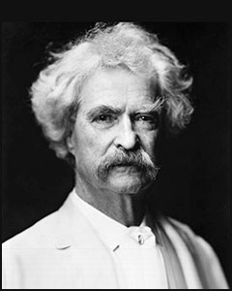
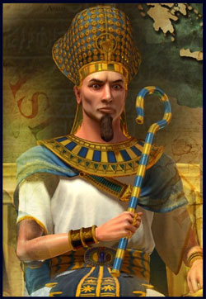
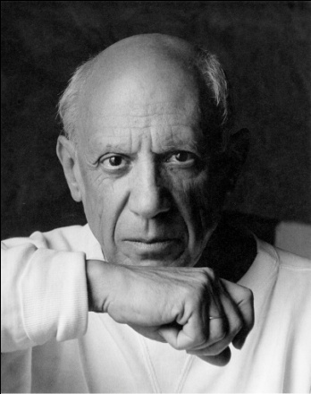
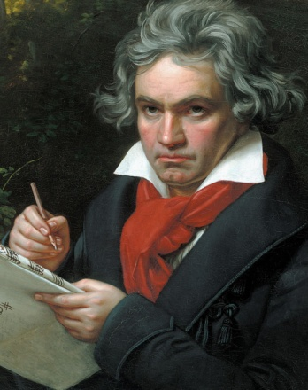
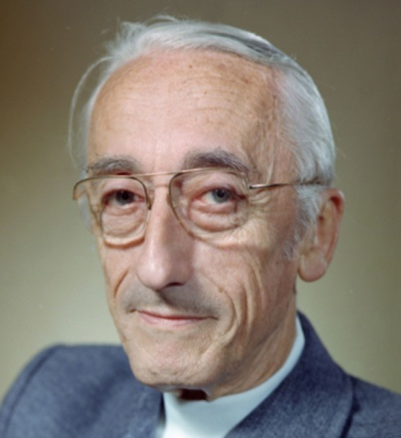
Match the person, his/her occupation, and the country where he/she is from
Elizabeth II | painter | ancient Egypt
Mark Twain | pharaoh | Germany
Ramses the Great | wild life (esp. sea life) researcher | the USA
Pablo Picasso | composer | the UK
Ludwig van Beethoven | the Queen | France
Jacques Cousteau | writer | Spain

Slide 8
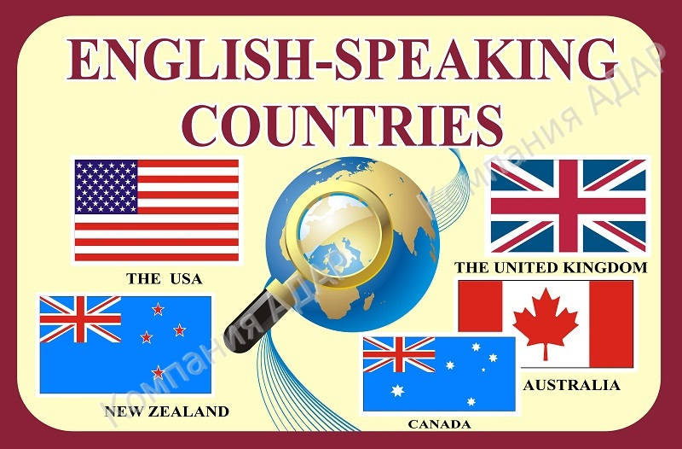

Slide 9
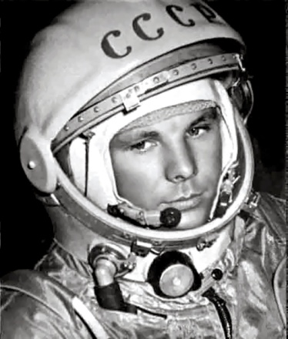
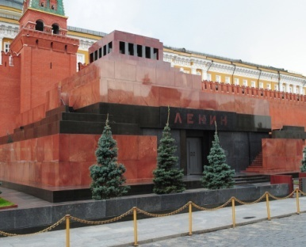
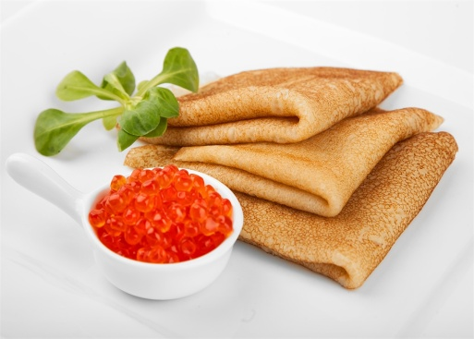
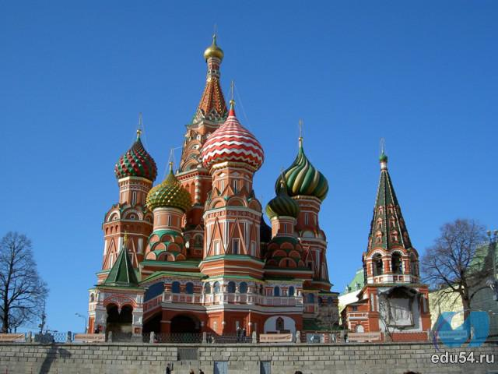
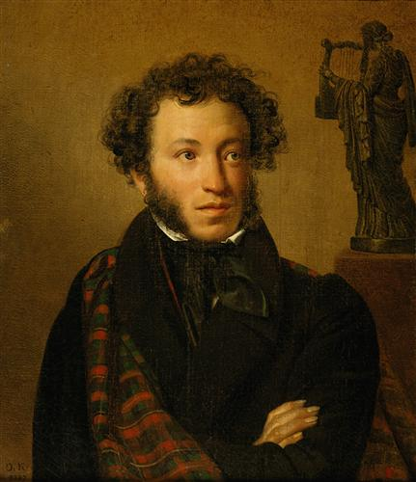
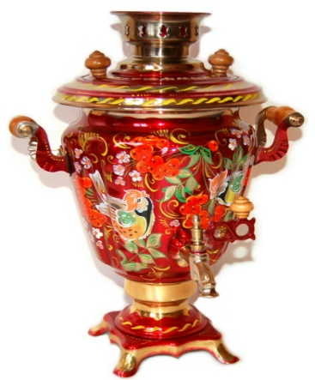
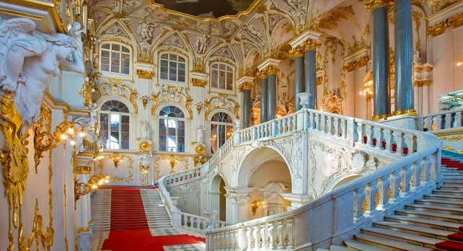
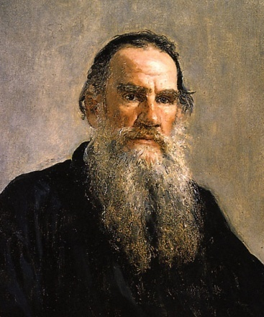
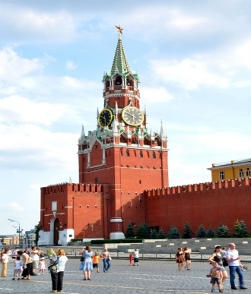
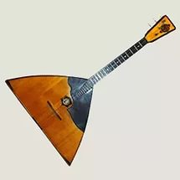
What is our country famous for?

Slide 10
Thank you for your attention!

