Slide 1
Муниципальное бюджетное образовательное учреждение
«Ляминская средняя общеобразовательная школа»
д. Лямина, Сургутский район,
Ханты-Мансийский автономный округ-Югра, Тюменская область
Т: 8(3462)-736-751
Учитель английского языка:
Садретдинова Вафира Бадиевна
Т: 89024960825, e-mail: vafiramart@mail.ru
Данные представлены
за 2014-2016 годы
Наргин
Денис
Евгеньевич,
6 класс,
13 лет

Slide 2
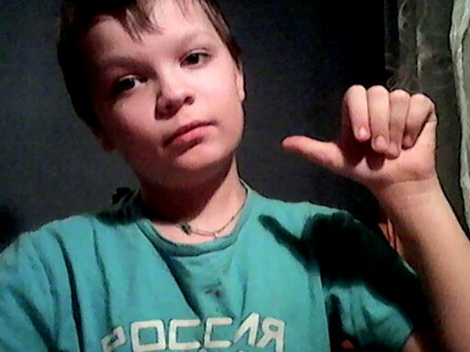
Let me introduce myself
Hi, everybody! I’m Denis from Khanty-Mansiysk Autonomous Area-Ugra, Russia. I’m 13. I am a student of the 6-th form.

Slide 3
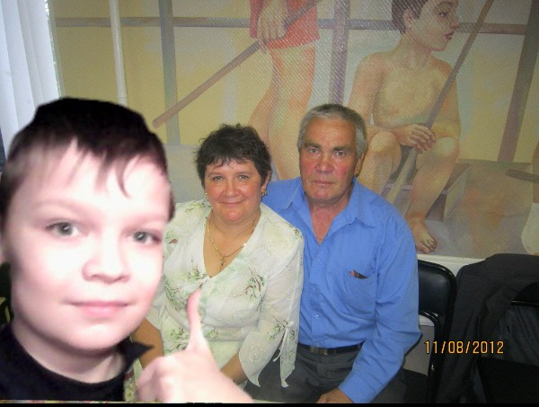
This is my family

Slide 4
My family
There is a grandmother and a grandfather in my family. My grandmother’s name is Alexandra Ilinichna, she is a teacher of Math at our school. She is very kind, but strict.
Mikhail Alexeevich is my grandfather. He is a plumber. He works hard. By nationality he is Khanty, a native person of our region. So, I’m Khanty, too. And I’m very proud of it.
I love and respect my grandparents.
They love me, too.

Slide 5
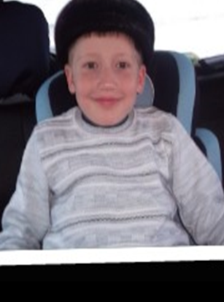
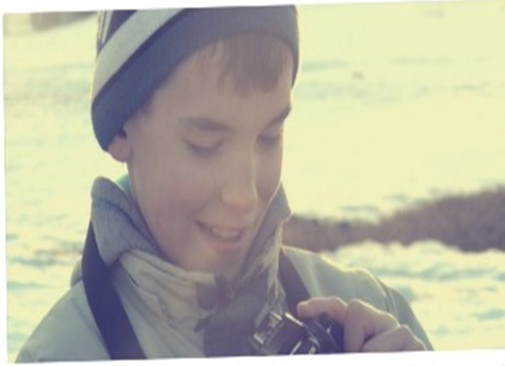
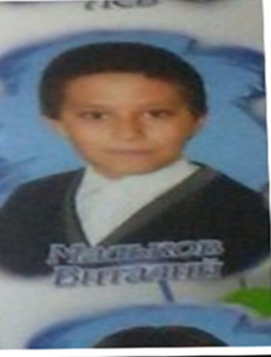
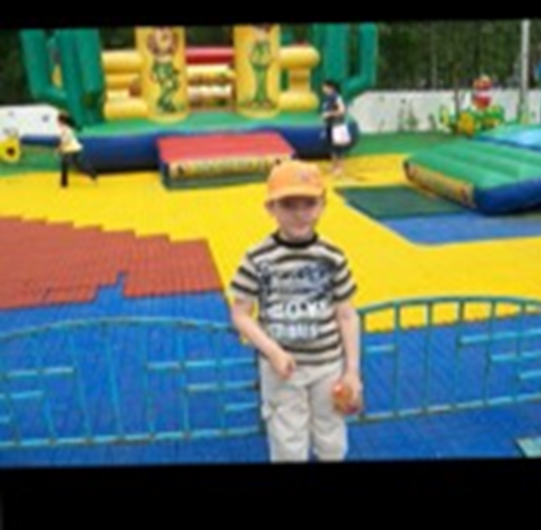
My friends
I have got many friends. They all are my classmates:
Gleb
Ivan
Sergey
Vitaliy
Nikita

Slide 6
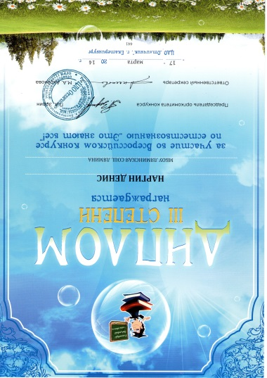
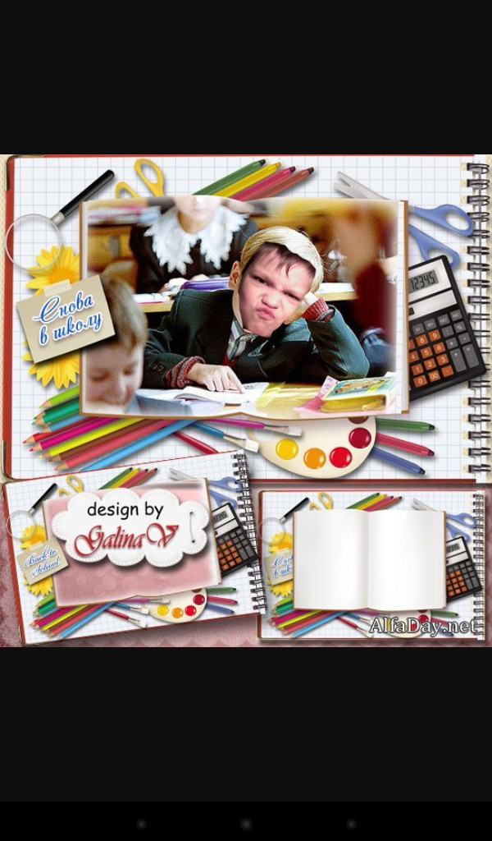
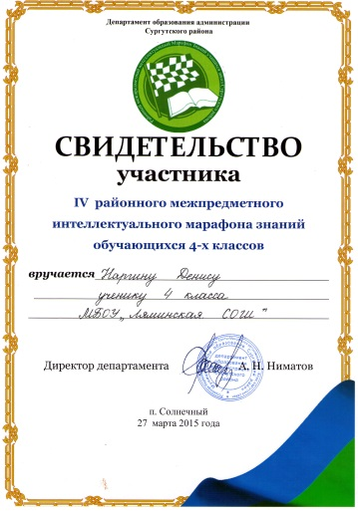
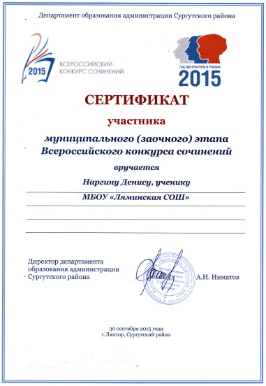
My hobby
Studying is one of my hobbies! May be it is strange, but I enjoy going to school and like all subjects at school!

Slide 7
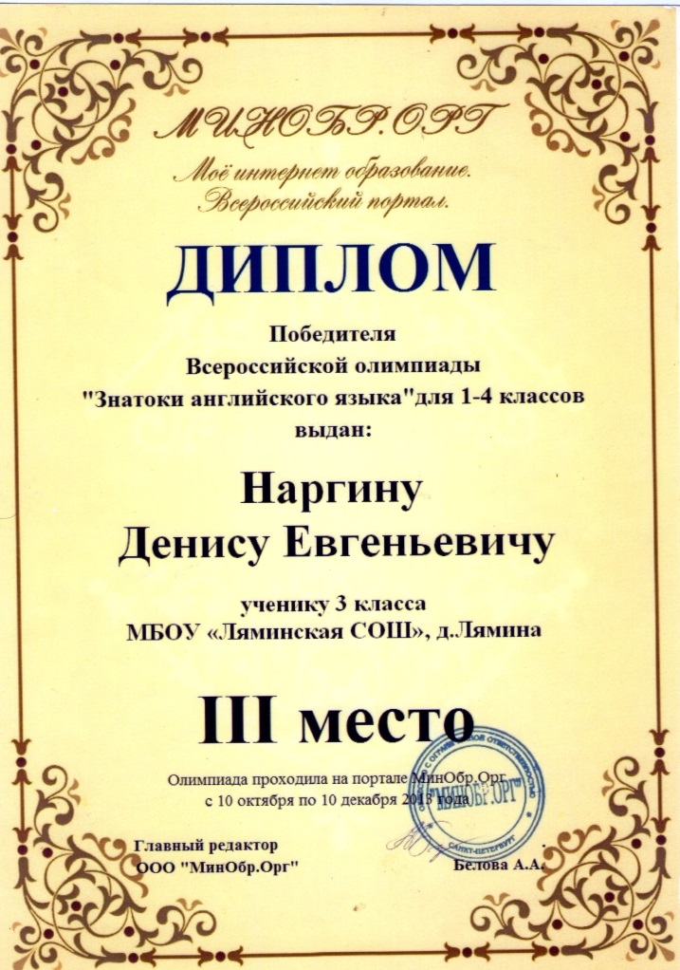
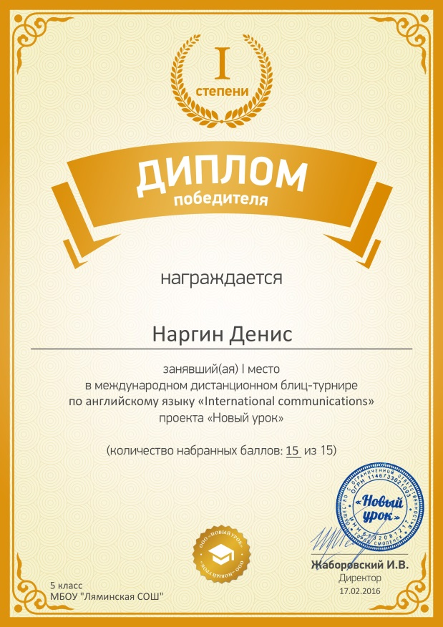
English is one of my favorite subjects

Slide 8
Studying the past of my family
My grand-grandfather took part in the Great Patriotic War and didn’t return home. Last year our country celebrated the 70-th anniversary of the Victory Day. For this holiday I found interesting facts about his life during the war. I made a report a bout him and took the 2 place in the competition of museum guides of Surgut district. The director of the school museum helped me very much.

Slide 9
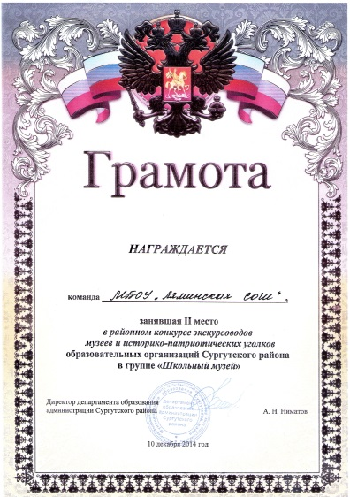
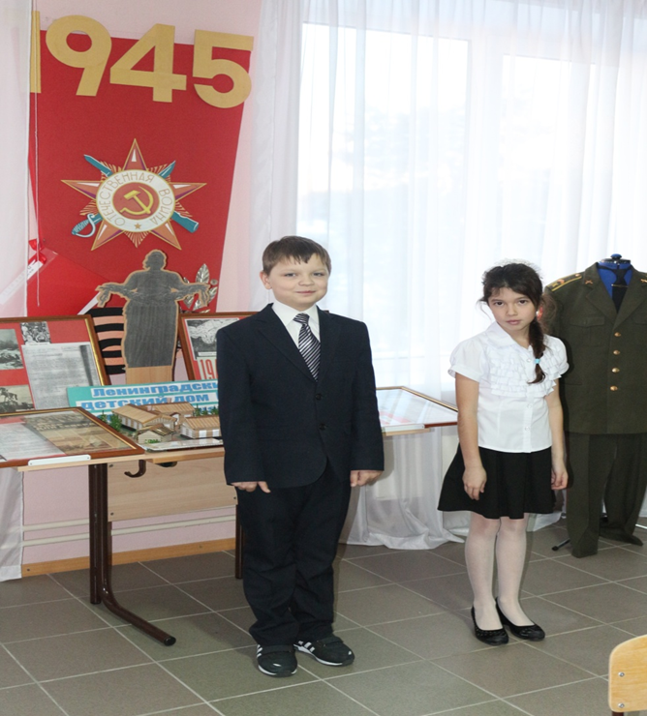
My awards for studying history

Slide 10
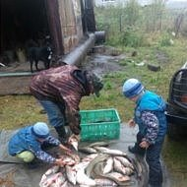
Fishing
Fishing is my another hobby! My Grandfather is a GRATE fisherman! In summer he often takes me with him.

Slide 11
Riding the “BURAN”
Riding the “BURAN” is my
favorite hobby!
Would you to ride it too?
So, I invite you to my place!

Slide 12
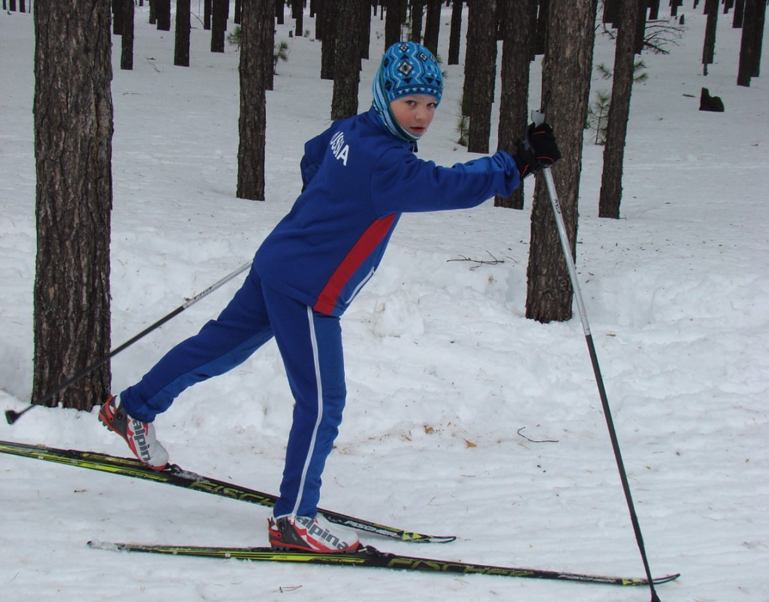
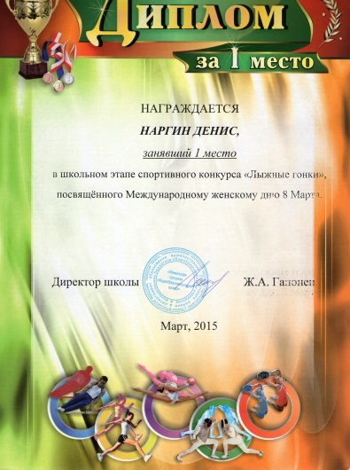
Skiing
One of my uncles is a ski trainer. Of course, I’m a grate lover of skiing, too! Usually I take part in all competitions and take the first, second and third places.

Slide 13
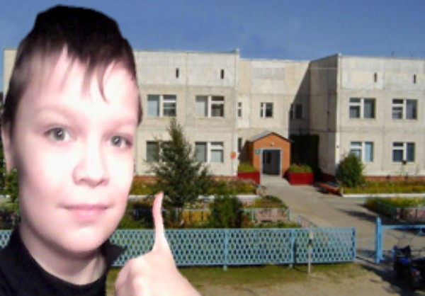
My school
This is my school. It is not very large, but nice.
I love my school and it’s teachers!

Slide 14
Plans for the future
It’s me in the future!
Do you
recognize me?

