Slide 1
Entertain us!
Unit1, Lesson 1
9 grade

Slide 2
Entertain us!
“That's what I like about film-it can be bizarre, classic, normal, romantic. Cinema is to me the most versatile thing.”
Catherine Deneuve
bizarre - причудливый
versatile - разносторонний

Slide 3
Entertain us!
Catherine Deneuve

Slide 4
Entertain us!
A CARTOON A (ROMANTIC) COMEDY A WESTERN A HORROR FILM A CRIME FILM
A THRILLER
A BIOPIC A SCIENCE FICTION FILM

Slide 5
Entertain us!
What type of films do you like?
I prefer____________
What about you? I like_____________________
Mostly I watch______________, but sometimes I feel like watching ________________.

Slide 6
Entertain us!
attractive predictable
imaginative forgettable
interesting awful
amazing dull
fascinating terrible

Slide 7
Reported Speech

Slide 8
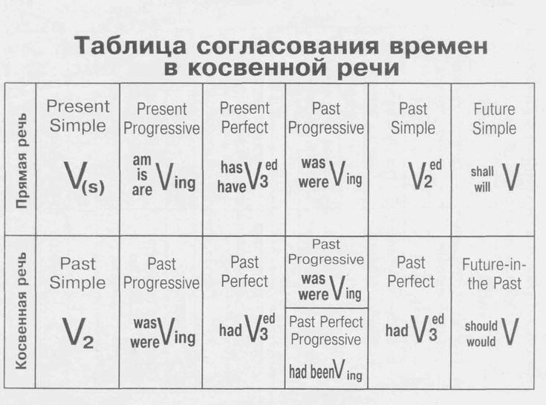
Continuous
Continuous
ed

Slide 9
He said me (that) me He told Jane (that)

Slide 10
Mодальные глаголы изменяются:
shall – should
can – could
may – might
must – had to, НО
mustn’t - mustn’t

Slide 13
+
-
attractive
imaginative
interesting
amazing
fascinating
predictable
forgettable
awful
dull
terrible

Slide 14
+
-
unattractive
unimaginative
uninteresting
amazing
fascinating
unpredictable
unforgettable
awful
dull
terrible

Slide 15
Good luck!))

