Slide 1


Slide 2


Slide 3
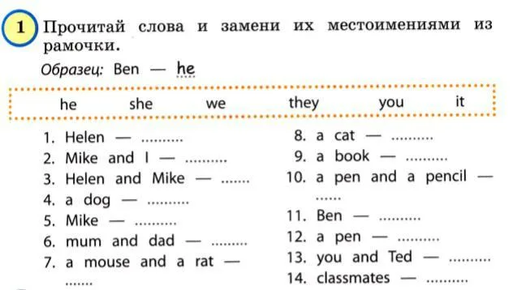

Slide 4
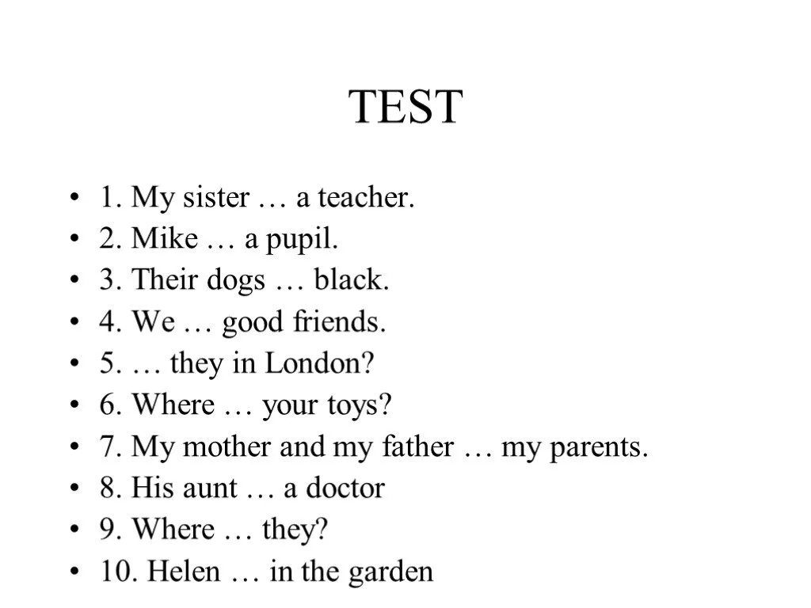
am? is? are?

Slide 5
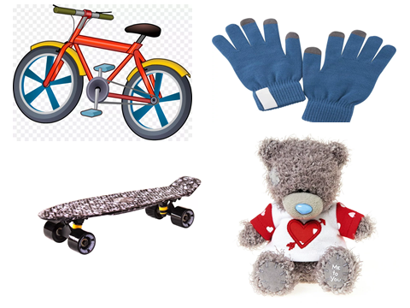

Slide 6
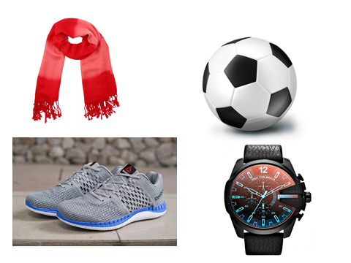

Slide 7
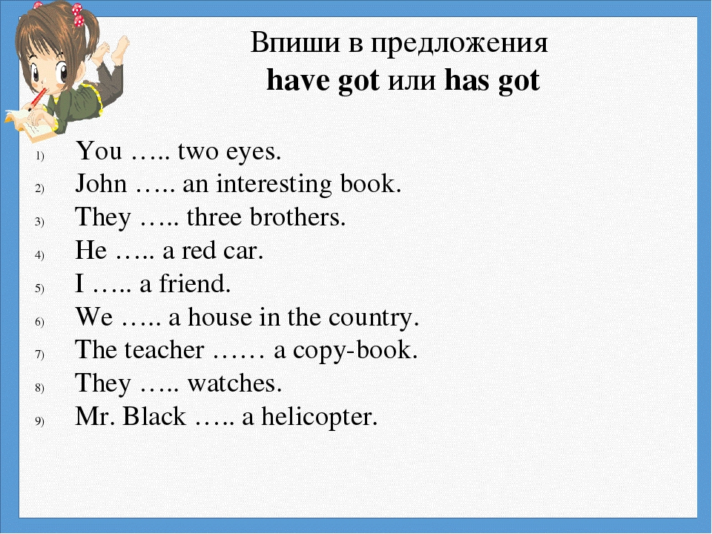

Slide 8
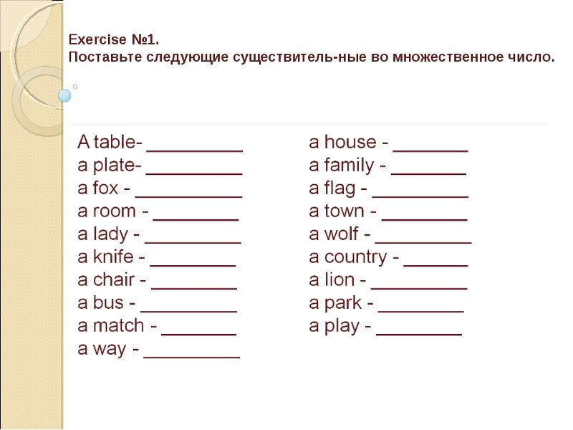

Slide 9
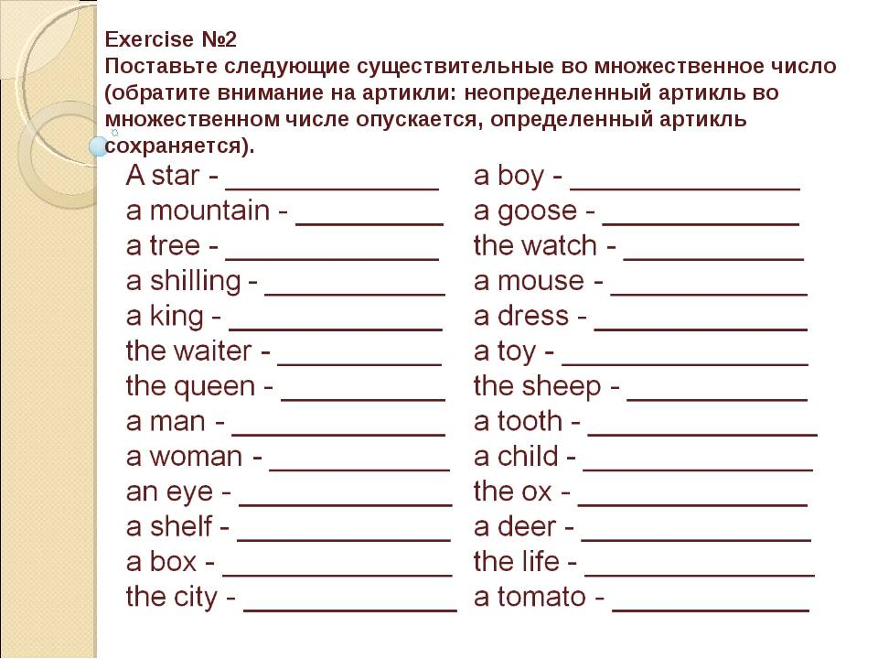

Slide 10
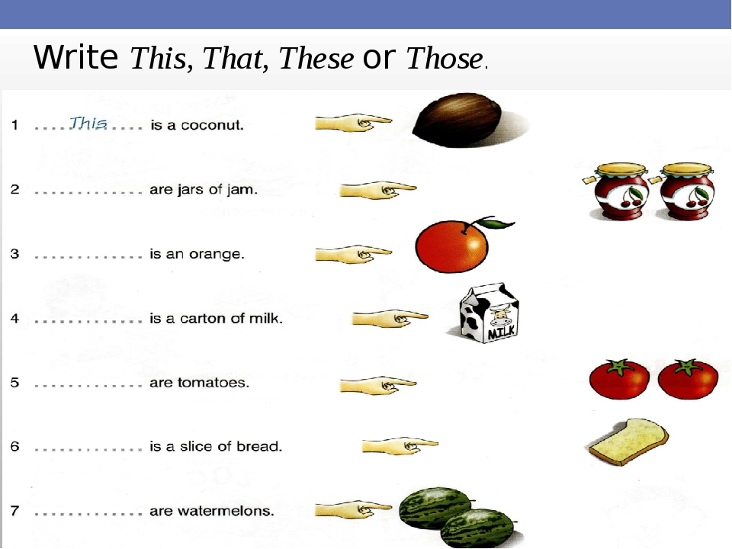

Slide 11
Вставьте is или are и переведите предложения.
1)There … many old trees in the park.
2)There … children under the trees.
3)There … a lake in the park.
4)There … boats on the lake.
5)There … a woman in the boat.
6)There … a glass on the table.
7)There … a cup of coffee on the coffee-table.
8)There … flowers in the vase.
9)There … seven bottles under the table.
10)There … a water-melon in the fridge.

Slide 12
Поставьте притяжательное местоимение:
1)We have a car. ___ car is yellow.
2)He has a bike. ___ bike is new.
3)This is my uncle. ___ name is Jim.
4)This is my cousin ___ name’s James.
5)You have a pet. What is ___ pet’s name?
6)My name’s Lana. ___ mother’s name is Jessica.
7)This is a hamster. ___ color is brown.

Slide 13
Соотнесите предложенные местоимения с пропусками
her your its my his their our
1)I wash ___ hands before a meal.
2)He brushes ___ teeth every morning.
3)They live with ___ parents.
4)We live with ___ friends.
5)This is Melony with ___ dog.
6)Hello, I’m Tom. What’s ___ name?
7)This is a cushion. ___ color is red.
Переведи :
Мяч мальчика, дом мальчиков, машина Бена и Майка, книга девочек, ручка девочки, школа Кати и Маши

Slide 14
Упражнение 1. Поставьте глаголы в следующих предложениях в утвердительную, вопросительную и отрицательную формы Present Simple.
1. I (to do) morning exercises.
2. He (to work) at a factory.
3. She (to sleep) after dinner.
4. We (to work) part-time.
5. They (to drink) tea every day.
6. Mike (to be) a student.
7. Helen (to have) a car.
8. You (to be) a good friend.
9. You (to be) good friends.
10. It (to be) difficult to remember everything.

Slide 15
Упражнение 4. Используйте слова в скобках для образования предложений в Present Simple. Обратите внимание, в какой форме должно стоять предложение (утвердительной, вопросительной или отрицательной).
1) They _____ football at the institute. (to play)
2) She _____ emails. (not / to write)
3) ____ you____ English? (to speak)
4) My mother ____ fish. (not / to like)
5) ____ Ann ____ any friends? (to have)
6) His brother _____ in an office. (to work)
7) She ___ very fast. (cannot / to read)
8) ____ they ____ the flowers every 3 days? (to water)
9) His wife _____ a motorbike. (not / to ride)
10) ____ Elizabeth_____ coffee? (to drink)

Slide 16
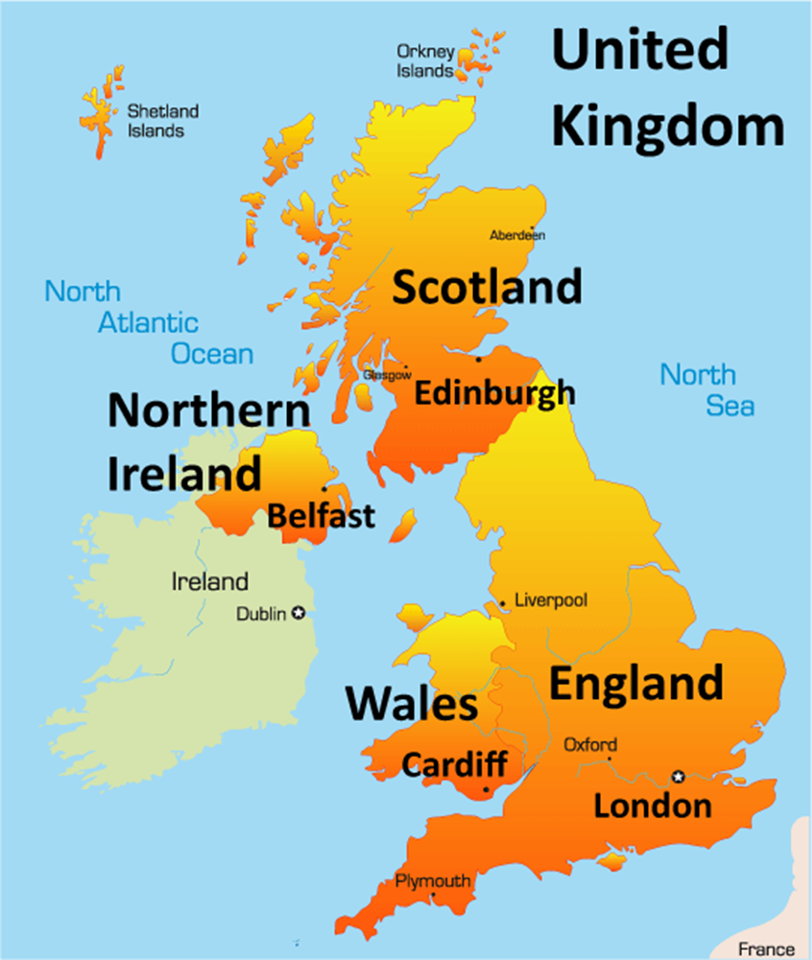

Slide 17


Slide 18
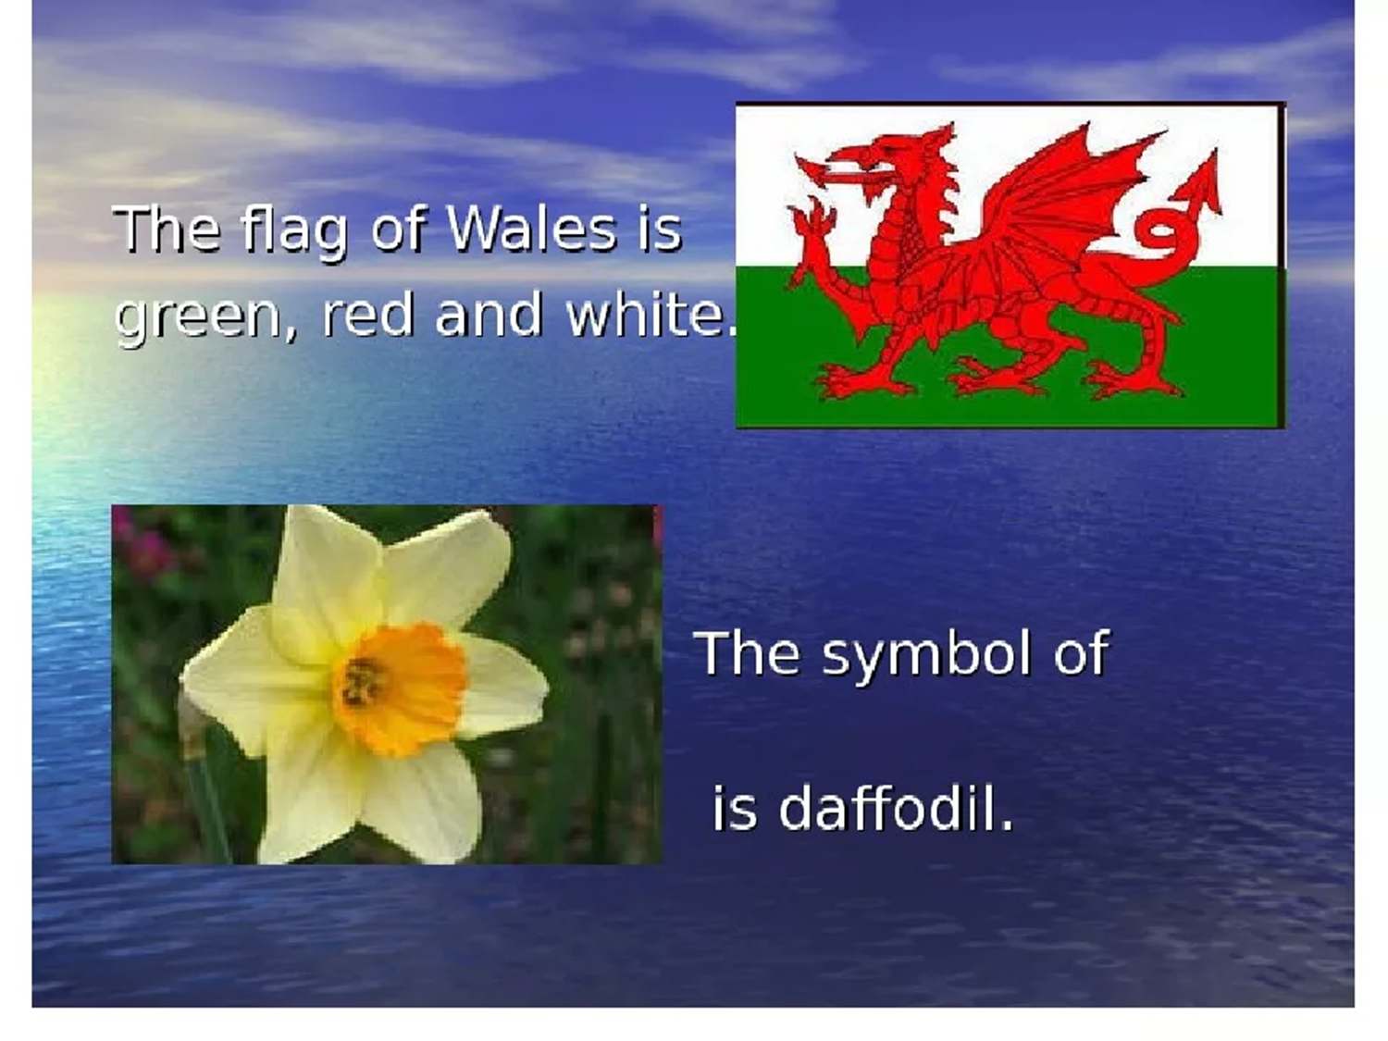

Slide 19
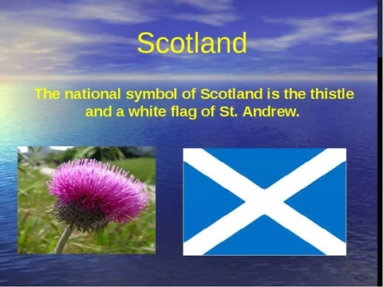

Slide 20
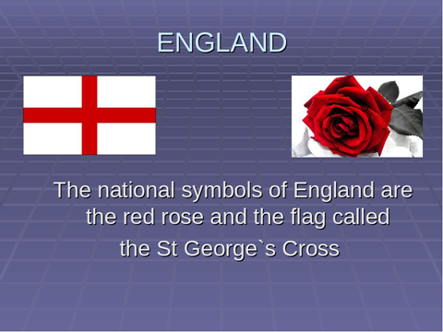

Slide 21
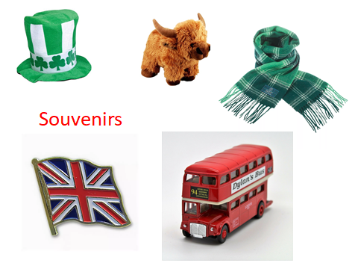

Slide 22
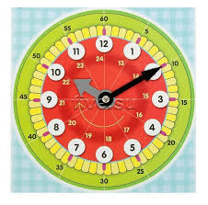
Write the time:
3:00-It is …
5:45-
7:30-
2:15-
2)Fill in: in or at.
…night
…half past eight
…the morning
…noon
…the evening
…midnight
..the afternoon

Slide 23
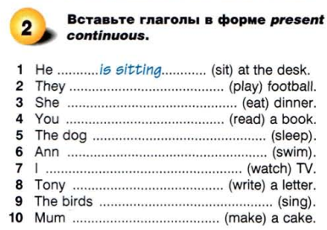

Slide 24
