Slide 1
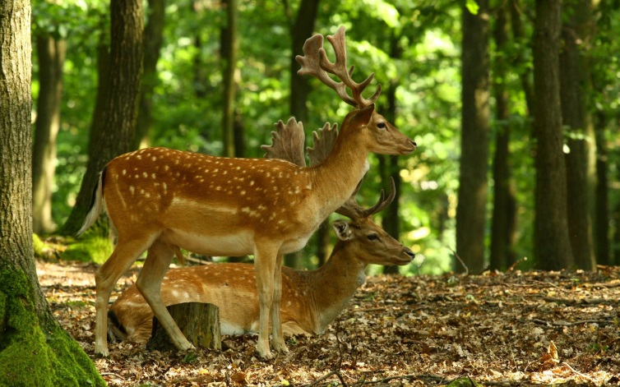
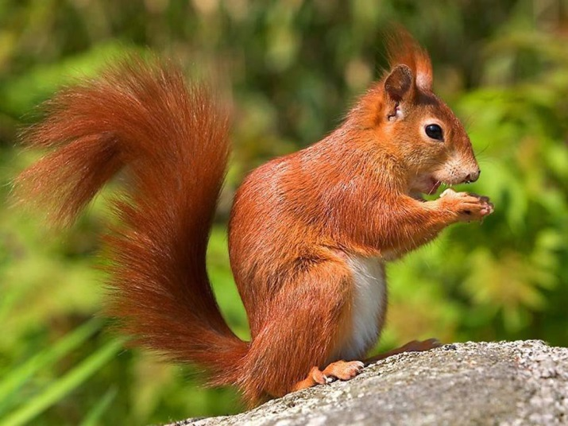
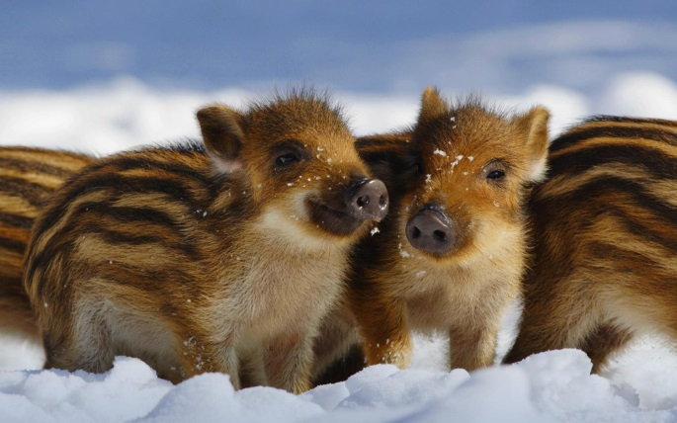
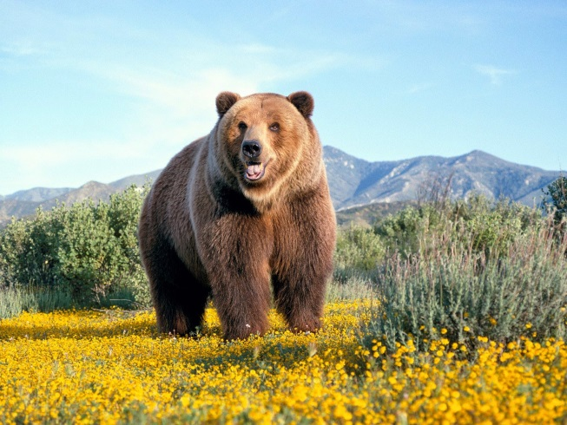
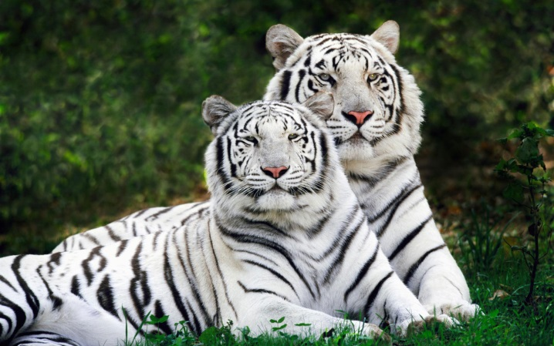
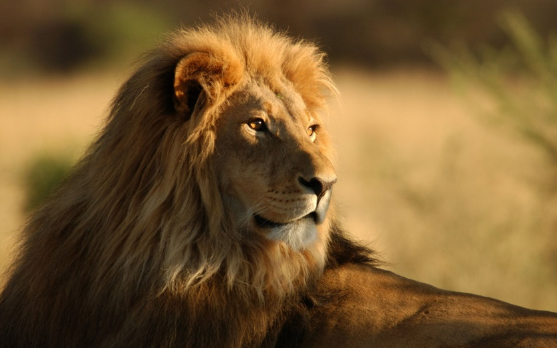
Wild animals

Slide 2
The word puzzle
lion
niol
bocra
cobra
camel
melca
crocodile
eder
dicocoler
deer
hanelept
trunk
elephant
rkunt
leopard
dolepar
horn
nohr
norhi
rhino

Slide 3
The word puzzle
tortoise
dog
ristoeto
gdo
goldfish
sheep
lisdfgoh
sepeh
goat
toga
cow
owc
arbitb
cat
rabbit
act
goose
osgeo
neguia igp
guinea pig
cukd
duck
udigeb
budgie
hne
hen

Slide 4
What can cadets do to save the world of wild animals?
feed birds in winter, don’t destroy the forests, keep water clean, don’t pollute the air…

Slide 5
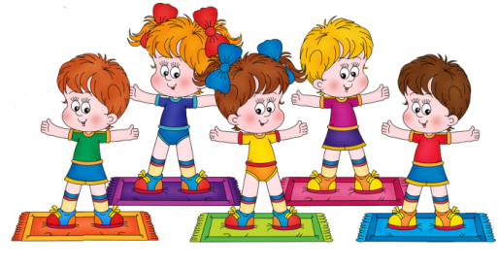
Have a rest !
Morning exercises!

Slide 6
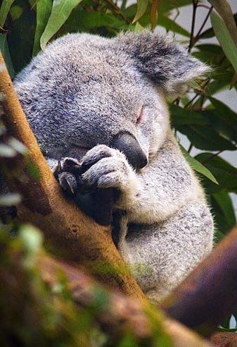
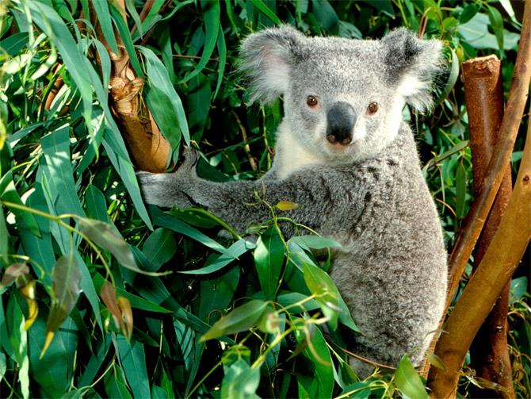
Cute Little Animals-
Koalas

Slide 7

New words: Ex 1 p.71
They don’t make good pets – не поддаются приручению
Marsupial mammals – сумчатые млекопитающие
Liquid – жидкость
Eucalyptus leaves – листья эвкалипта
Claws for climbing – когти для лазания
During the day – в течение дня

Slide 8
Where do koalas live?
What do they look like?
Can they climb?
Do they drink?
What do they eat?
Can they swim?

Slide 9
Fact File | Animal: | 0 | Koala
 | Face: | 1
 | Body: | 2
 | Colour: | 3
 | Home: | 4
 | Food: | 5

Slide 10
Fact File | Animal: | 0 | Koala
 | Face: | 1 | They ‘ve got big round ears and a black nose
 | Body: | 2
 | Colour: | 3
 | Home: | 4
 | Food: | 5

Slide 11
Fact File | Animal: | 0 | Koala
 | Face: | 1 | They ‘ve got big round ears and a black nose
 | Body: | 2 | They’ve got short, strong arms and legs
 | Colour: | 3
 | Home: | 4
 | Food: | 5

Slide 12
Fact File | Animal: | 0 | Koala
 | Face: | 1 | They ‘ve got big round ears and a black nose
 | Body: | 2 | They’ve got short, strong arms and legs
 | Colour: | 3 | They’ve got grey fur
 | Home: | 4
 | Food: | 5

Slide 13
Fact File | Animal: | 0 | Koala
 | Face: | 1 | They ‘ve got big round ears and a black nose
 | Body: | 2 | They’ve got short, strong arms and legs
 | Colour: | 3 | They’ve got grey fur
 | Home: | 4 | They live in trees
 | Food: | 5

Slide 14
Fact File | Animal: | 0 | Koala
 | Face: | 1 | They ‘ve got big round ears and a black nose
 | Body: | 2 | They’ve got short, strong arms and legs
 | Colour: | 3 | They’ve got grey fur
 | Home: | 4 | They live in trees
 | Food: | 5 | They eat eucalyptus leaves

Slide 15
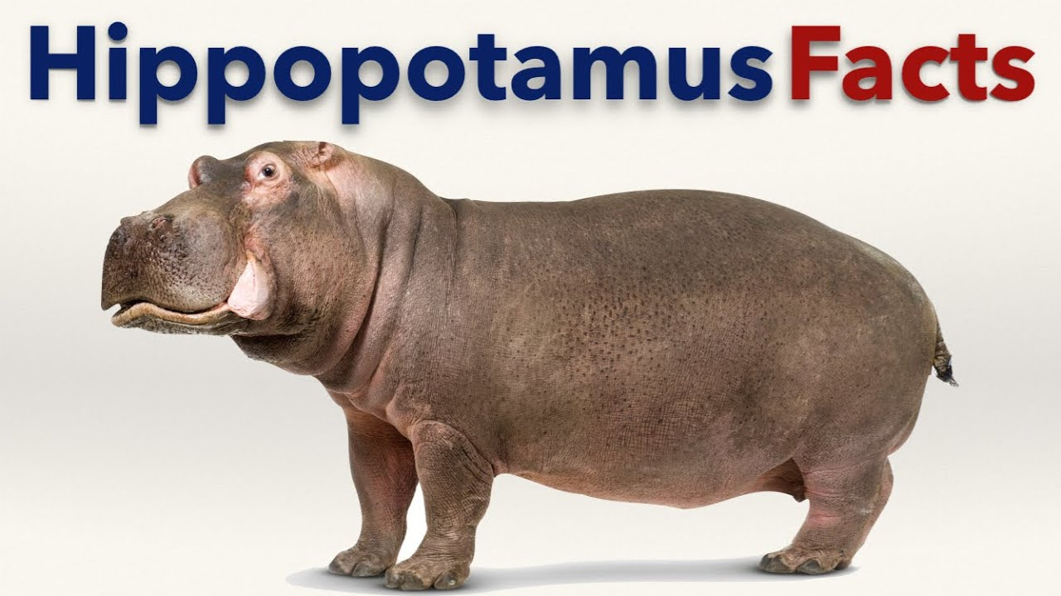
The common hippopotamus or hippo is a large mammal that lives in Africa. Hippos are the third largest living land mammals, after elephants and white rhinos.
Hippos like to stay in water or mud. Hippos can even sleep underwater.
Despite (не смотря на) all these adaptations for life in the water, hippos can’t swim! Hippos eat grass. They are 3.3 to 5 meters long and up to 1.6 meters tall at shoulders. They have big fat bodies, short lags and short tails. They have small eyes and ears but big mouth and big strong teeth. Hippos can be extremely aggressive, they are one of the most dangerous animals in Africa.

Slide 16
The lesson is over, goodbye!
Homework: Be ready for the test module 5!!!!

Slide 17
The Present Simple
CORRECT THE MISTAKES
1 . I works in a school .------------------------------------------------------------
2. She is play rugby .----------------------------------------------------------------
3. My sister make her bed every morning-----------------------------------------
4. Does they speak English ?--------------------------------------------------------
5. She don’t sing at all.--------------------------------------------------------------
6. I doesn’t like doing my homework----------------------------------------------
7. Your brother often ride his bike.-------------------------------------------------
8. My friends works in a shop .----------------------------------------------------
9. John run very fast.-----------------------------------------------------------------
10. Do you always takes the bus to go to school ?-------------------------------

